Slide 1
AOD

Slide 3
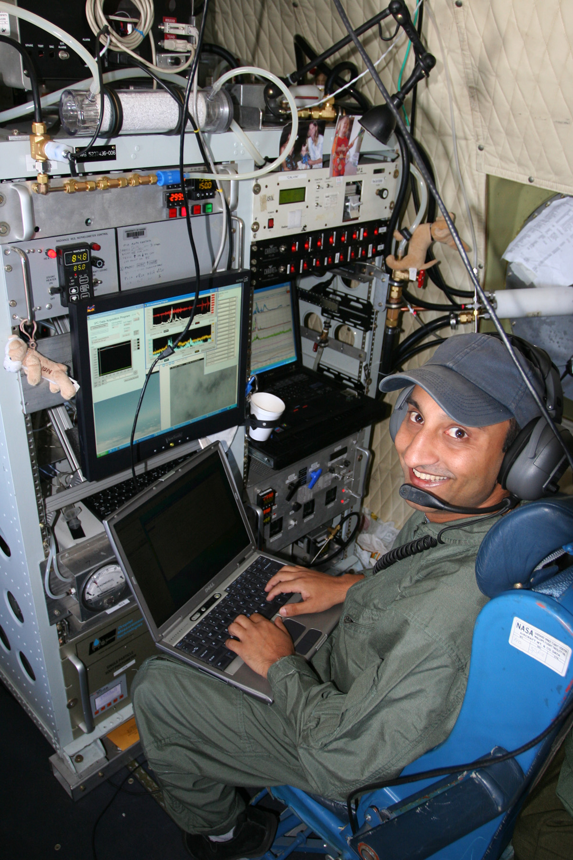
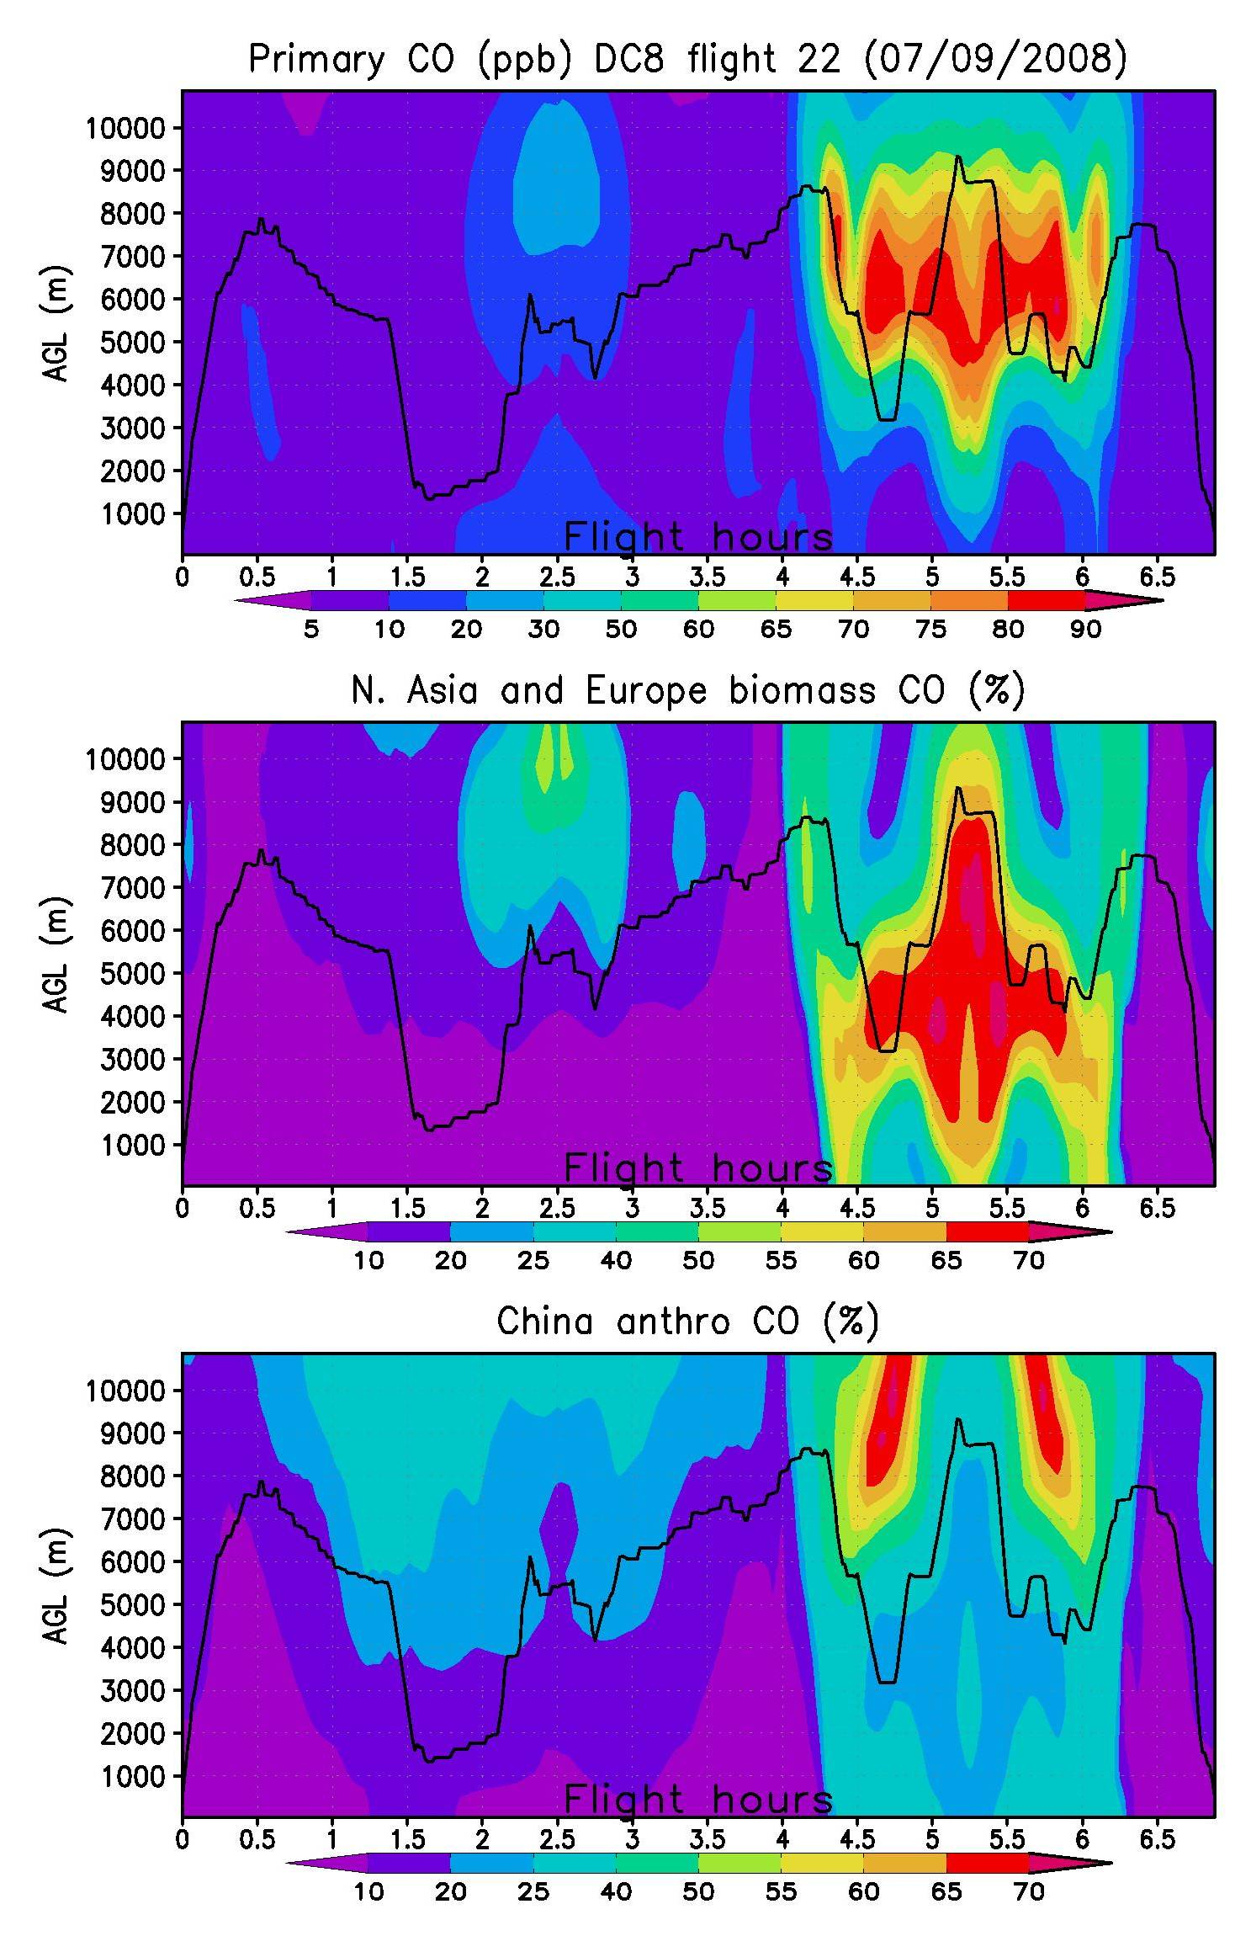

Slide 4
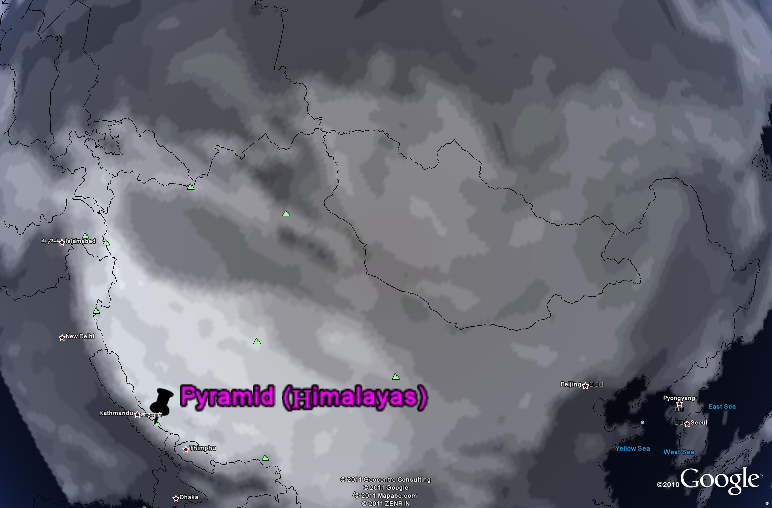
Meters

Slide 5
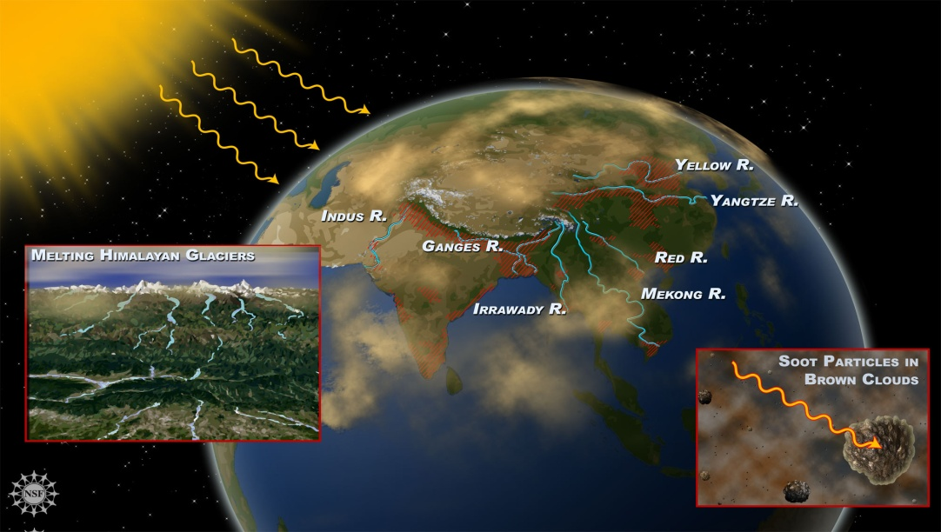
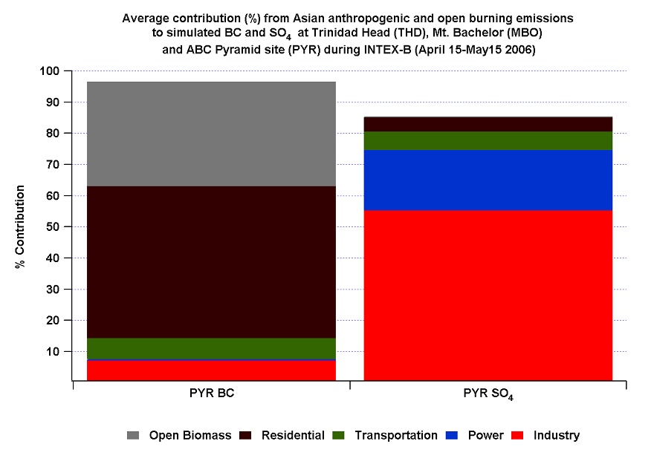
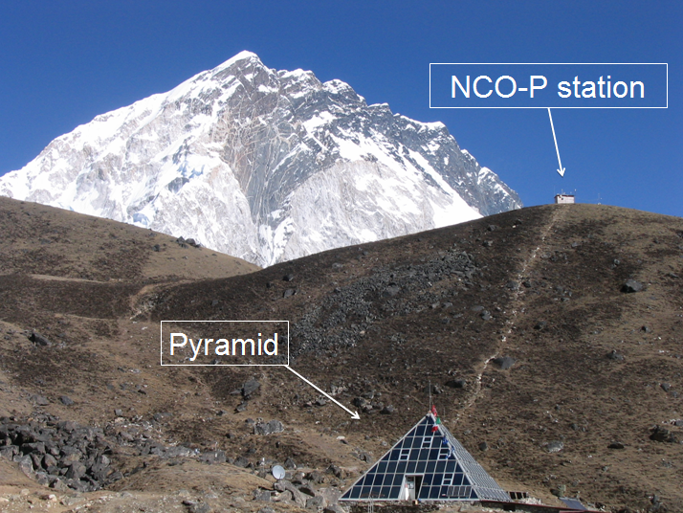
ABC Nepal Climate Observatory (NCO-P)
Remote site in Himalayan region
5079 m asl ,27.9 N, 86.7 E
Complex topography
2006
2006
S. Fuzzi and team
5
Notes:
Accelerate melting.

Slide 6
AOD

