Slide 1
Constraining Aerosol Distributions in Asia by Integrating Models with Observations
Sarika Kulkarni and Greg Carmichael
Center for Global and Regional Environmental Research, University of Iowa,
AGU 2010

Slide 2
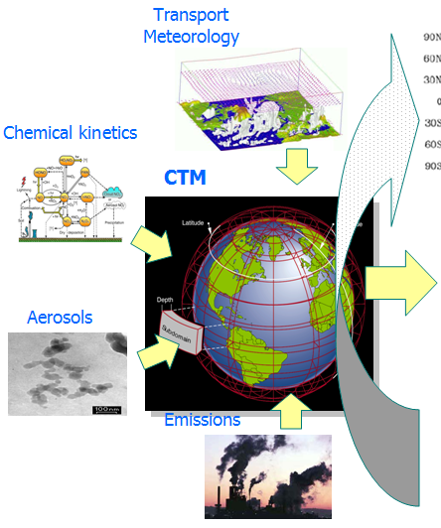
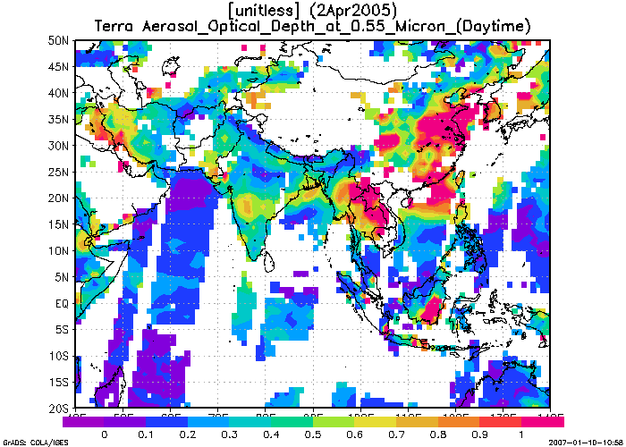
Models Constrained With Observations Play Increasing Important Roles In Research and Application
Assimilation method: optimal interpolation (Adhikary et al., 2008, 2009)
Data used in assimilation: MODIS, Deep Blue (5.1 L3), and MISR (CGAS L3); Total AOD, fine mode, AAOD
Validation against observations: AOD from AERONET using 2 different retrievals (V2 L2); PM₁₀ and SO₄ from EANET
Reduced Uncertainty
Impact Analysis:
+Health (EPA)
+Radiative Forcing (NASA/ABC)
+Food/water
Predicted w/o OI
Constrained
Improved Model
Observations
Notes:
"o (equal to 0.04) is the minimum Root Mean Square (RMS) error of the observation and fo (equal to 0.5)Here "m is the minimum RMS uncertainty in the modeled AOD, which is set to 0.1 and fm, the fractional error inthe model AOD, is set to 0.5. Variables dx and dy are the horizontal distance between two model grid points (equal to 50 km) and lxy is the horizontal correlation length scale for errors in the model fields which is set to 250 km (five grid cells).

Slide 3
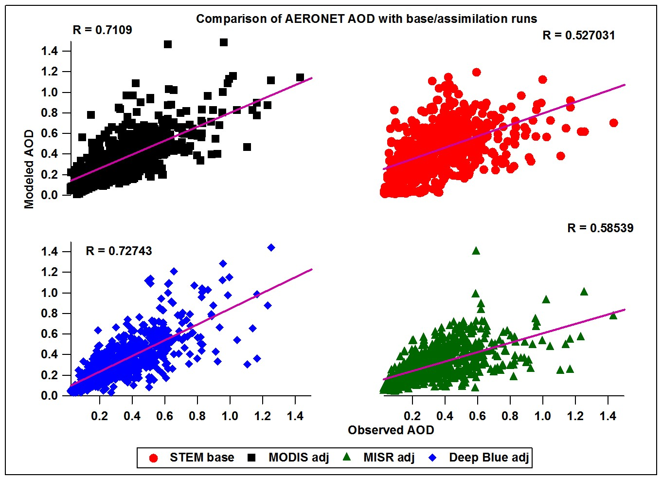
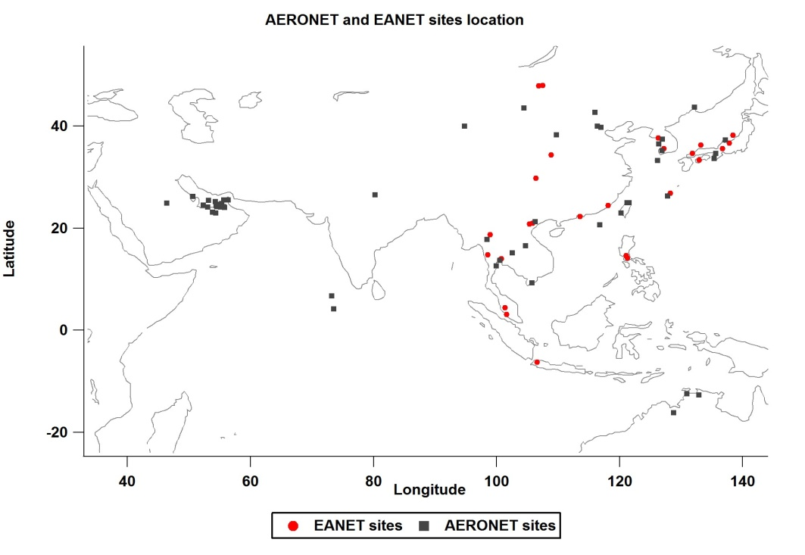
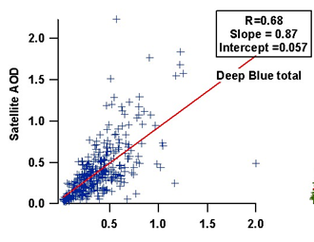
Assimilation of Satellite Data Improves the AOD Fields
AERONET
4-yr STEM simulation 2001-2004; Trace-P emissions; MM5 meteorology

Slide 4
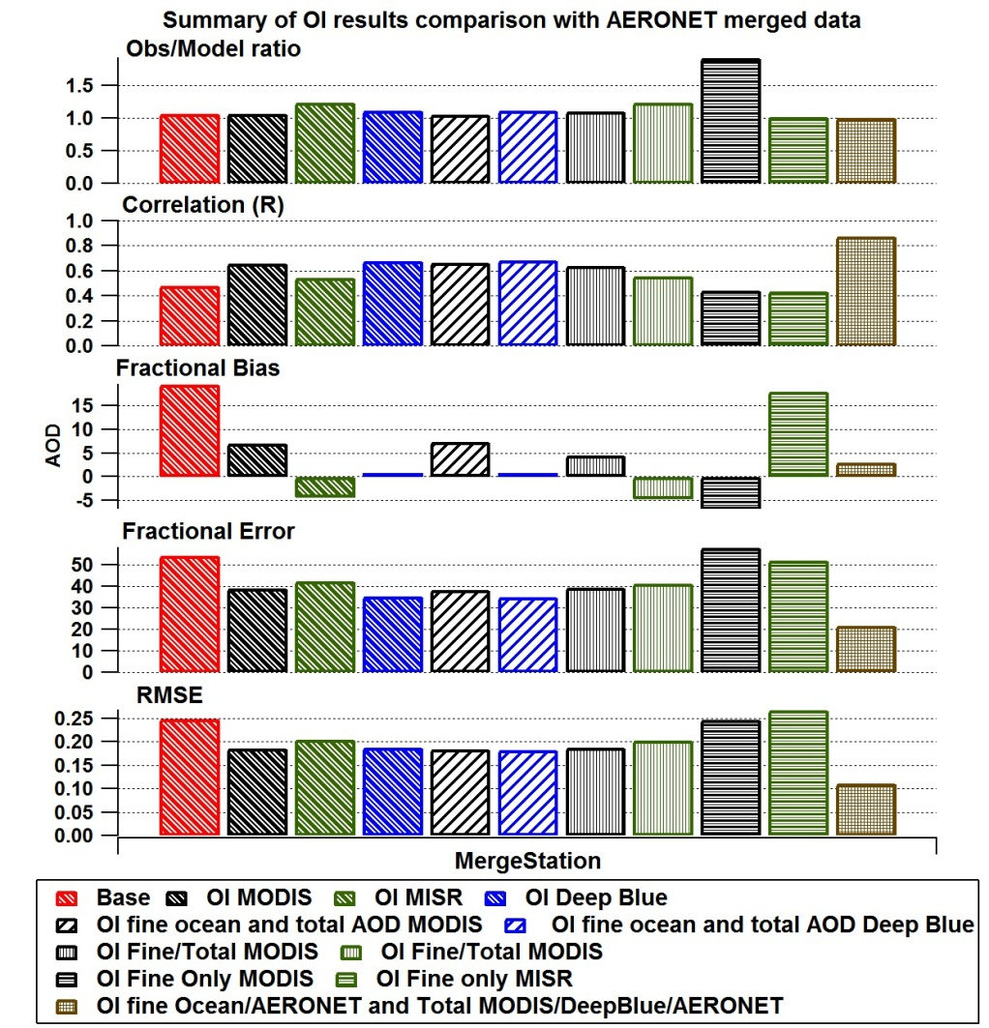
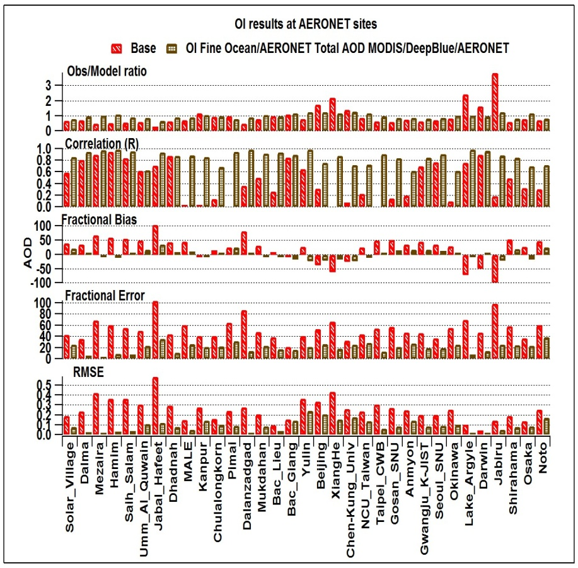
Assimilation Results in AOD Fields with Reduced Bias and Errors
Only total
W fine-mode
Only fine-mode
Best

Slide 5
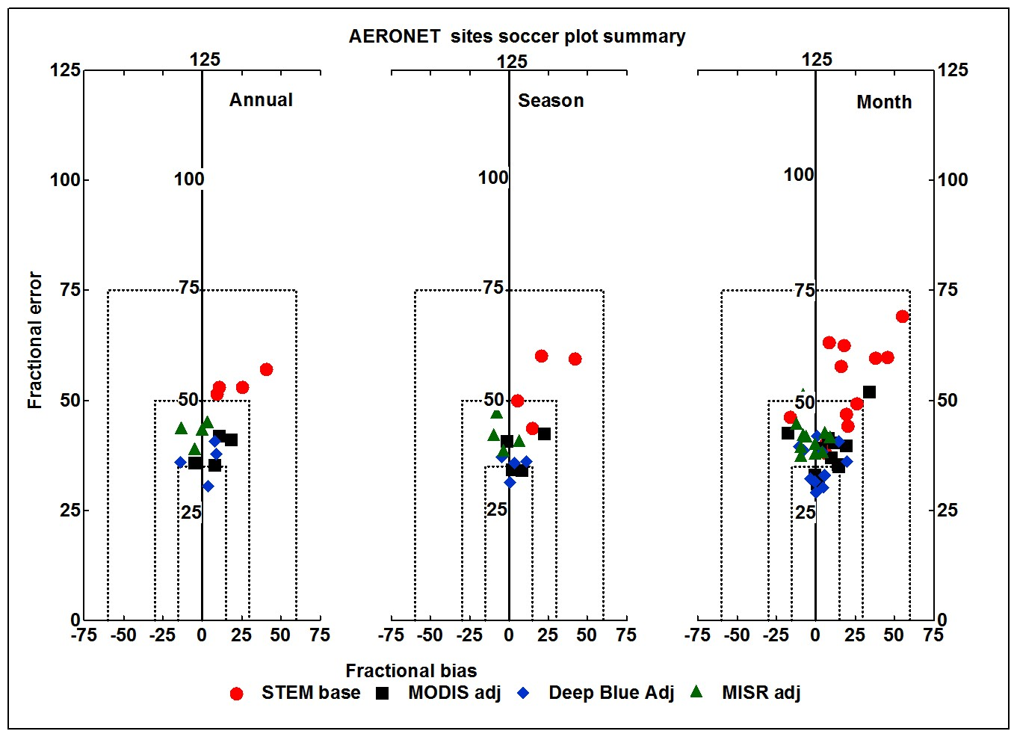
Total AOD - Assimilation Reduces Annual/Seasonal and Monthly Bias and Error
Annual/Seasonal/Monthly Soccer Plots across the domain (Best configuration case)

Slide 6
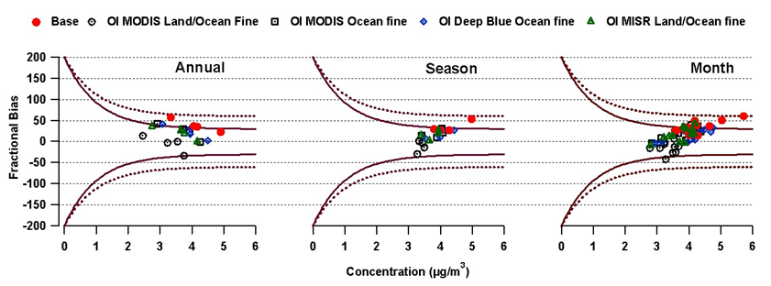
Assimilation Reduces Significantly the Bias in Aerosol Sulfate at EANET Sites – Inclusion of Fine-Mode Helps

Slide 7
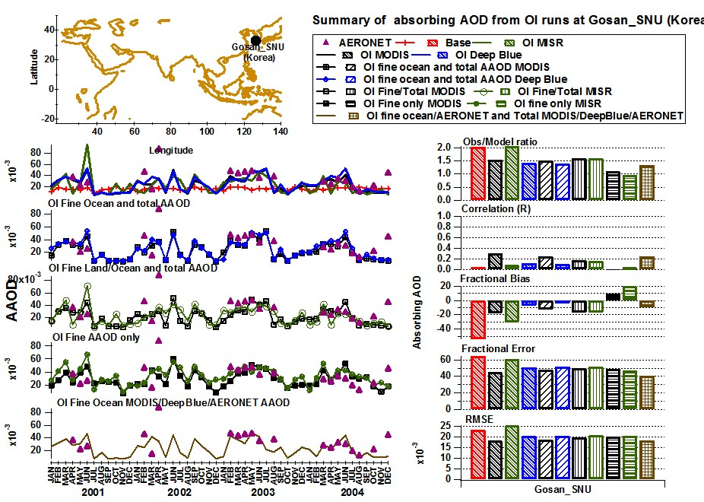
Inclusion of Absorption-AOD Reduces the Systematic Low Bias in the Predictions

Slide 8
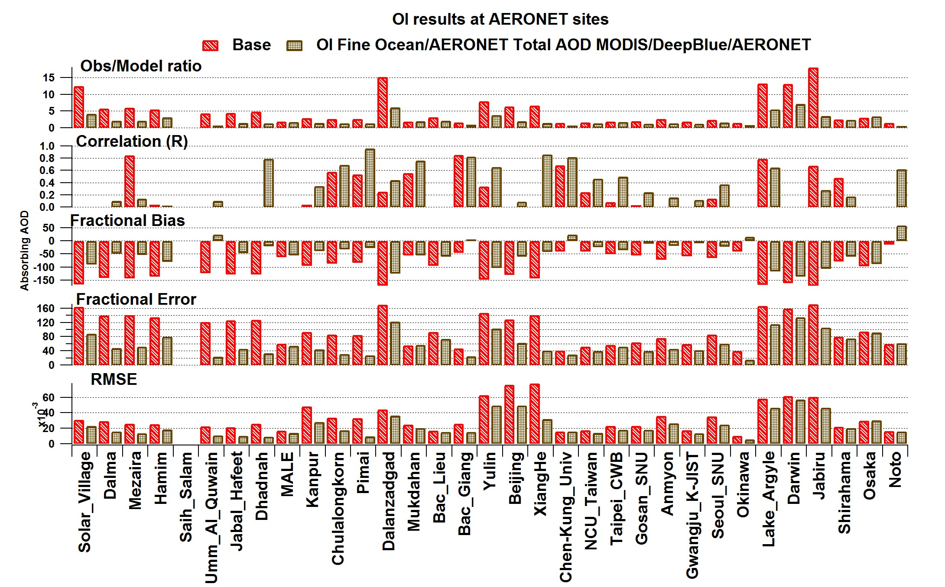
Inclusion of Absorption-AOD Reduces the Systematic Low Bias in the Predictions

Slide 9
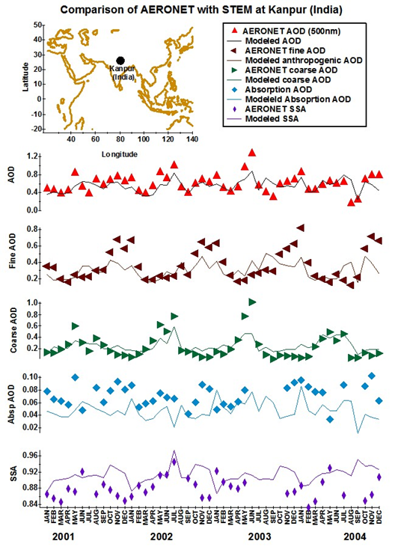
Comparison of Assimilated Results at Kanpur (data not used in assimilation)

Slide 10
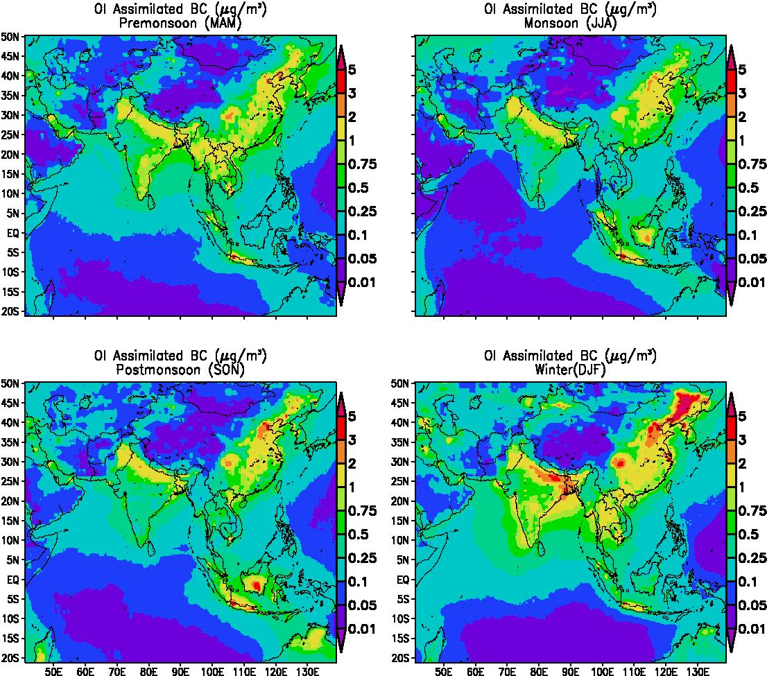
Final 4-Year Mean BC Surface Concentrations By Season

Slide 11
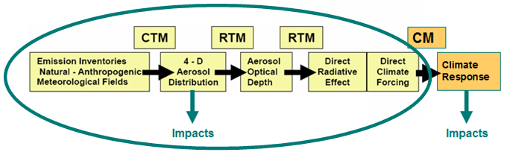
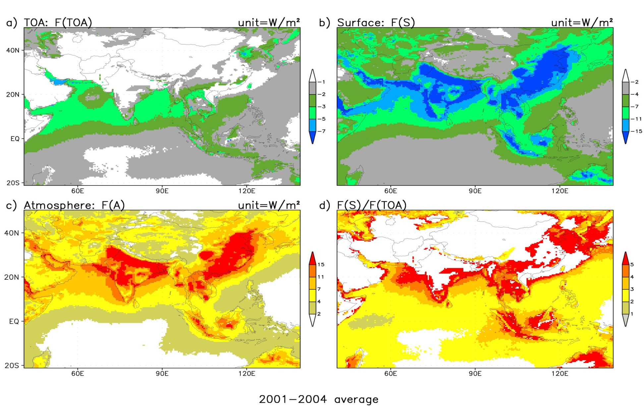
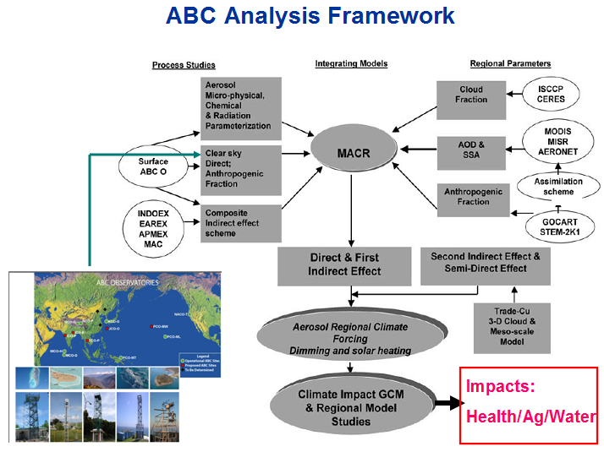
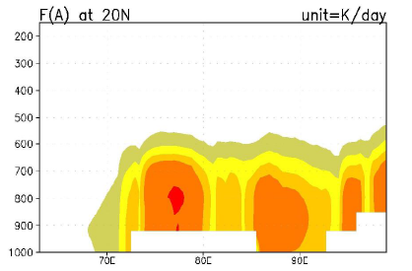
Quantifying Aerosol
Radiative Forcing and the Role of Anthropogenic Components Remains a Challenge
Dimming
Heating
Strong atmospheric heating due to absorbing aerosol has implications for processes impacting weather and climate
  Chung, C. E., et al., ACP, 2010
Notes:
Add radiative forcing

Slide 12
Summary
A 4-year reanalysis of aerosol distributions in Asia have been produced using different satellite products.
Inclusion of fine/coarse/absorbing information adds uniqueness to the assimilation – improves sulfate, BC and dust distributions.
Now analyzing the spatial information in the increment fields to help improve the forward model.
Plan to look at blending of different products AND inclusion of surface observations and extend to 2006-2010 period where we more extensive observations.
Planning model inter-comparison of various approaches under ABC and MICS-Asia activities.

Slide 13

Seasonal Analysis of 4-yr Mean AOD (PMF)

