Slide 1

Trends in Iowa Water Run-off
Rick Cruse, Matt Helmers, Greg Brenneman, and John Laflen
Iowa Water Center, and Iowa State University Extension

Slide 2
Notes:
There are 4 watersheds near Treynor IA that were operated by ARS and ISU for about 30 years. 2 watersheds were in Continuous contour tilled corn, a third in grass for 7 years, and then into till planted corn.The fourth had level terraces for 7 years and then the terrace system was changed. It was always in corn. I’ll illustrate two things using these slides.
The first set of 3 slides are to illustrate the different variabilities in sediment yield, surface runoff and precipitation. This slide is to illustrate the extreme variability from year to year in sediment yield. Having been the professor for a number of graduate students, at what point in time would you want to send out a graduate student to collect data on sediment yield? And, if you were going to make recommendations regarding the efficacy of treatments to control sediment yield, what would be a good time to make the measurements?

Slide 3
Notes:
You can ask the same questions about surface runoff. Note though that runoff is not as variable as sediment yield

Slide 4
Notes:
And, what about this data would lead you to expect that sediment yields in 1965 would be about 130 times greater than the sediment yield of 1973, or more than 1300 times the sediment yield of 1975. Or, 70 times as much surface runoff in 1967 as in 1976.

Slide 5
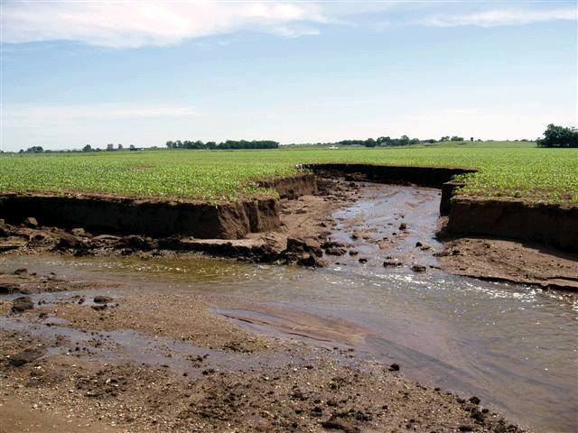
Notes:
The kind of rare storm that we saw in 2008 has the ability to transform landscapes.

Slide 6
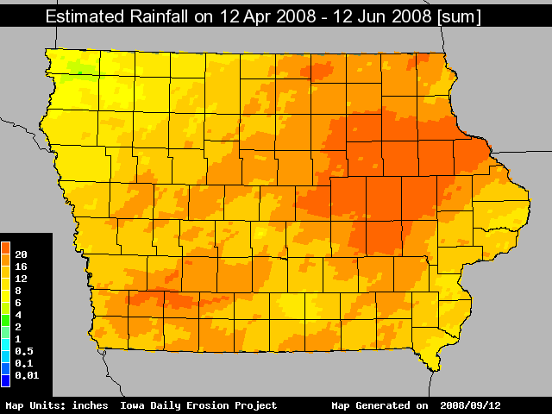
16-20”
>20”
Notes:
This is a map of rainfall amounts measured for the Iowa Daily Erosion Project for the period April 12 to June 12, 2008. Note the area of extreme rainfall, in excess of 20 inches, N & W of Johnson County and surrounding Linn County

Slide 7
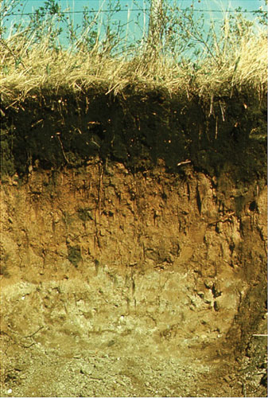
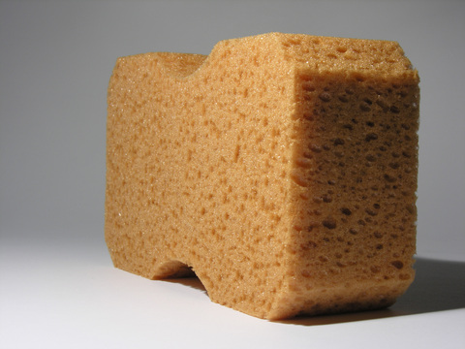
Notes:
To evaluate Trends in Iowa runoff, we need to look at soils, how they affect runoff, and how our manaement impacts runoff. Nearly all of Iowa land surface is used in agriculture. How farmers manage the land has a great impact on hydrology in Iowa.
The soil is kind of like a sponge. When we pour water onto a sponge, it absorbs it, unless it is already full of water, or we pour in on so fast that it can’t be absorbed.

Slide 8
Runoff Occurs When
Rainfall Intensity exceeds rate (infiltration rate) that water can enter the soil (sponge). Infiltration rate affected by
    Physical characteristics of the soil-soil texture and soil structure
    Soil moisture
    Cover on the soil and management of the soil
    Rainfall intensity
Tile Drainage Affects Infiltration
    Tile drainage can reduce soil water, improving infiltration.
    Removes water from saturated ‘sponge’
    Creates storage space for subsequent rainfall
    Reduces runoff for repetitive storms when soil profile is full or nearly full

Slide 9
140 years of Iowa Land Use
Iowa Land Area-35.76 Million Acres
Notes:
Total land area in Iowa is nearly 36 million acres. The acreage amounts for the various land uses are shown here over time. Most of the “all other” is grass land, Corn has been steady since about 1900, small grain was steady from about 1900 to 1960, and has ben declining steadily since 1960. Soybeans have became a dominant land use while the all other and small grain has greatly decreased. What does this mean

Slide 10
Water Yield-Surface Runoff
Watersheds 1 and 3, Treynor IA
Notes:
It means that more of the water yield appears as surface runoff. Increases flooding risks, reduces base flow. Degrades water quality. Would expect as storm size increases and as antecedent moisture equilibrates between the row crop and grass land that surface runoff for the row crop and grasses would become more alike.

Slide 11
Trends in Precipitation
Notes:
Empirical data indicates frequency of heavy rainfall events (those driving soil erosion losses and water degradation) have increased 26% in the Central US from 1970 to 2002.

Slide 12
Cedar River Annual Flow
Cedar Rapids
Notes:
Note the increasing trend in average annual flow in the Cedar River since about 1940. This would appear to have occurred with increasing rainfall along with increasing conversion to row crops.

Slide 13
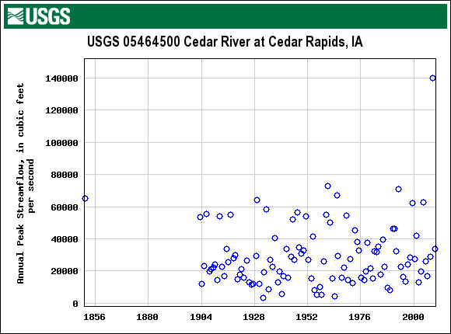
Cedar River Peak Flow Rates
Notes:
It is interesting to note that the Peak flow rates by year have not changed nearly as much (if at all) over the same time period. Also note, the extreme nature of the 2008 event (nearly double) as compared to any event in recorded history.

Slide 14
Concluding Comments
Loss of continuous living cover, increased soil disturbance, and limited use of conservation practices can increase runoff
  Impacts are greater for smaller events and dryer soils
  Much smaller impacts for larger events or wet soils
Removal of water from soil profile (evapotransporation, tile drainage) reduces runoff
Extreme rainfall event frequencies have increased
High production and increased water infiltration (10% perennial cover) may coexist

