Slide 1
Trends in Iowa Water Run-off
Rick Cruse, Greg Brenneman, and Matt Helmers
Iowa Water Center and Iowa State University Extension

Slide 2

Notes:
Sponge is a great teacher. It will absorb water until it is saturated, after which added water runs off (or through). Changing the surface by covering it with a paper towel (for example) reduces the rate at which water applied to the surface can enter (infiltrate). Even a bare sponge has its limits – if water is applied too fast, the sponge cannot absorb (infiltrate) all that is applied.

Slide 3
For a Given Water Application Rate - Runoff Caused By
Surface of sponge restricting water infiltration – paper towel covering sponge
Sponge full of water – nowhere for water to go

Slide 4

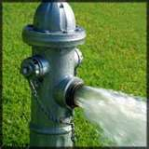
For a Given Sponge Condition – Runoff Caused by
Increased water application rate

Slide 5
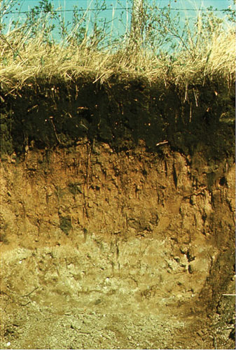
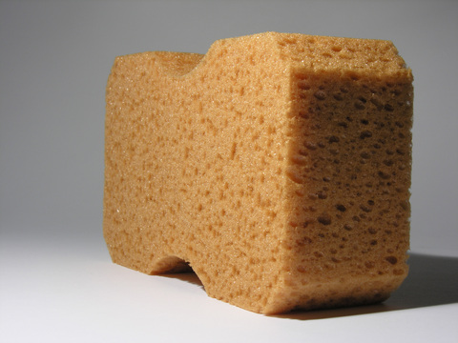

Slide 6
Infiltration
Infiltration – entry of water into the soil.
  Influenced by:
    Physical characteristics of the soil (e.g. soil texture and soil structure)
    Soil moisture
    Cover on the soil and management of the soil
    Rainfall intensity

Slide 7
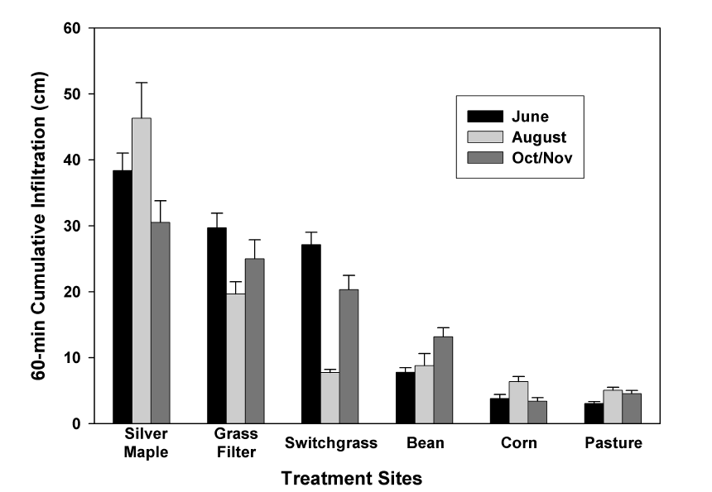
Impacts of Land Use on Infiltration
Source: Bharati et. al., 2002
Source: Bharati et. al., 2002

Slide 8
Landuse Example Pochohantas Co. Watershed

Slide 9
Changes in Iowa Farmland
Notes:
Note the nearly doubling of row crops from the 1930s to present time. Much of this change has come at the expense or loss of small grains that are planted and start growing in very early spring. Note even the change in the past 40 years.

Slide 10
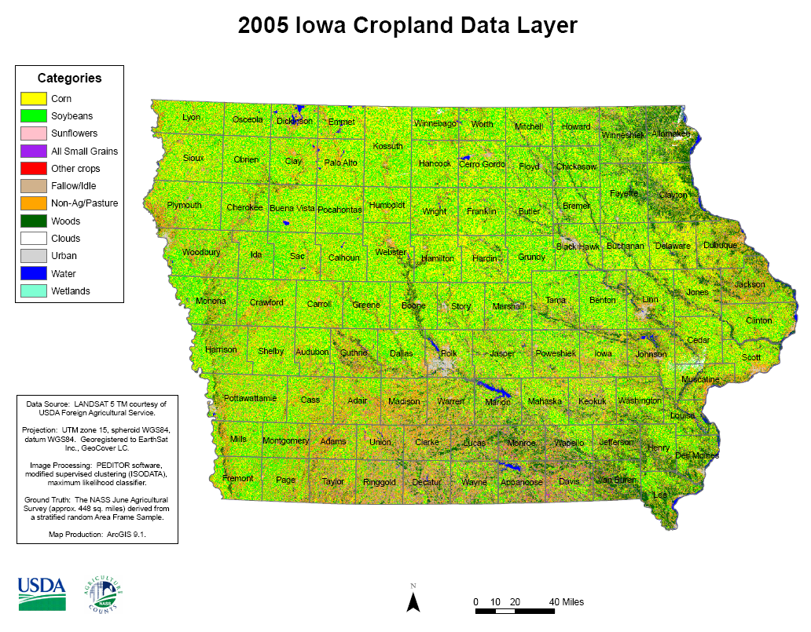
Land Cover Trends
More row crops
Row crops have lower infiltration rates

Slide 11
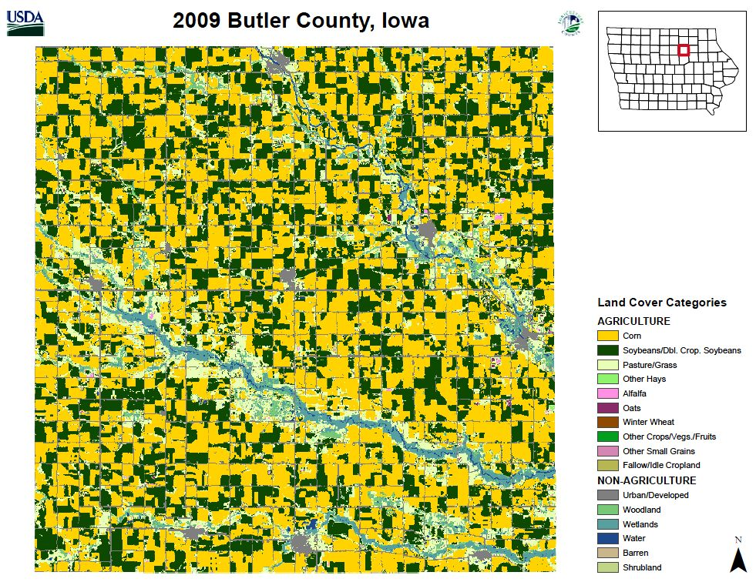
Notes:
Butler county is entirely in the Cedar River watershed. Note the very high predominance of corn and soybeans in the county.

Slide 12
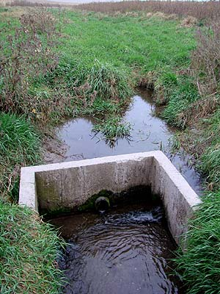
Tile Drainage
Removes water from saturated ‘sponge’
Creates storage space for subsequent rainfall
Reduces runoff for repetitive storms when soil profile is full or nearly full

Slide 14
Trends in Precipitation
Groisman, Pavel Ya., Richard W. Knight, David R. Easterling, Thomas R. Karl,Gabriele C. Hegerl, and Vyacheslav N. Razuvaev. 2005. Trends in intense precipitation in the climate record. J. of Climate. 18:1326-1350.
Notes:
Empirical data indicates frequency of heavy rainfall events (those driving soil erosion losses and water degradation) have increased 26% in the Central US from 1970 to 2002.

Slide 15
Cedar River Annual Flow
Cedar Rapids
Notes:
Note the increasing trend in average annual flow in the Cedar River since about 1940. This would appear to have occurred with increasing rainfall along with increasing conversion to row crops.

Slide 16
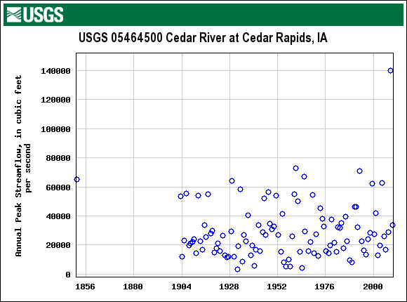
Cedar River Peak Flow Rates
Notes:
It is interesting to note that the Peak flow rates by year have not changed nearly as much (if at all) over the same time period. Also note, the extreme nature of the 2008 event (nearly double) as compared to any event in recorded history.

Slide 17
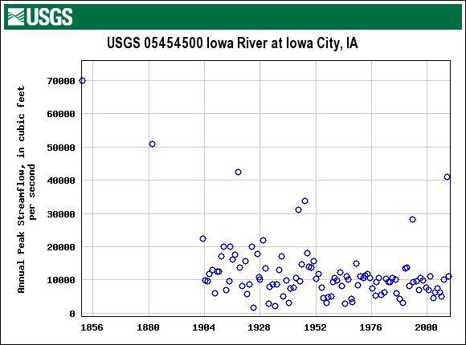
Iowa River Peak Flow Rates
Notes:
In the Iowa River at Iowa City, we have had some very large events in the past - prior to the Coralville Dam being put in place in the 1958. Note all of the peak flows since then (except for 1993 and 2008) have been below about 15000 cfs. Also note the peaks in 93 and 08 are 30K and 40 K respectively.

Slide 18
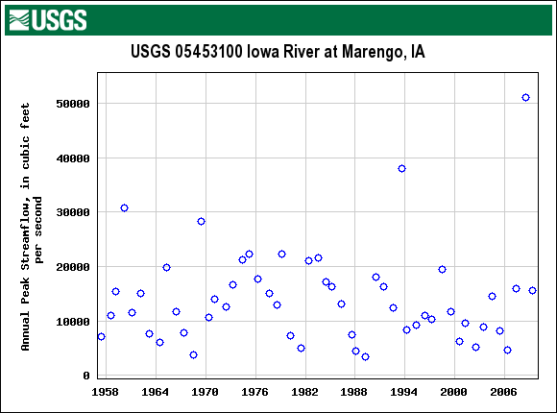
Iowa River Peak Flows - Marengo
Notes:
Now, looking at the Iowa River up stream at Marengo, since 1958 there have been 10 times the flows have exceeded 20K. And in 1993 nearly 40k (less then 30k at IC) and in 2008 over 50 K (about 40K in IC).

Slide 19
Concluding Comments
Loss of continuous living cover, increased soil disturbance, and limited use of conservation practices can increase runoff
  Impacts are greater for smaller events and dryer soils
  Much smaller impacts for larger events or wet soils
Removal of water from soil profile (evapotransporation, tile drainage) reduces runoff
Water runs off concrete, asphalt, and building roofs
Extreme rainfall event frequencies have increased
High production and increased water infiltration (10% perennial cover) may coexist

