Slide 1

A Resource for Critical
Flood Research and Applications

Slide 2
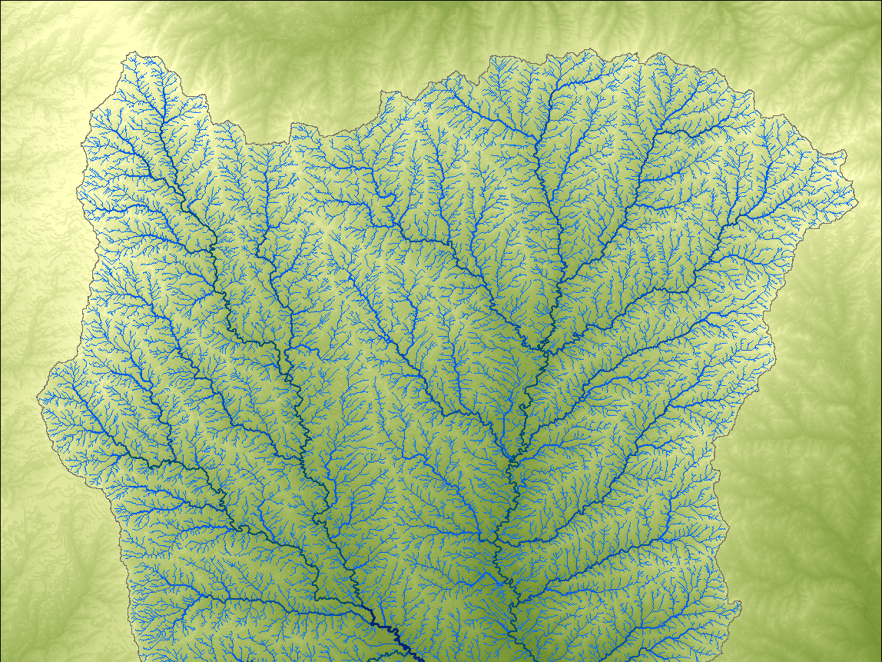

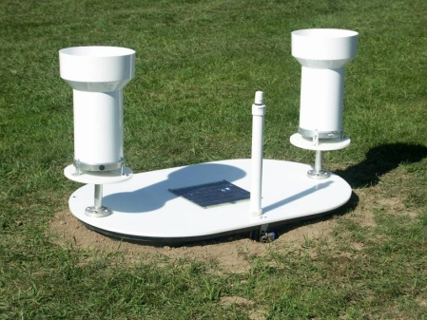
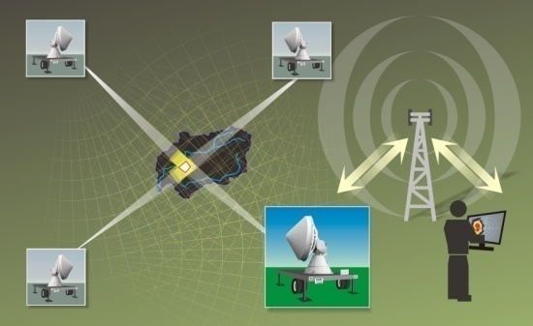
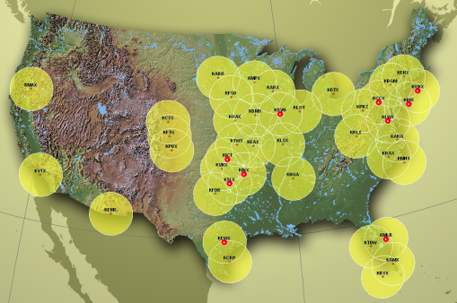
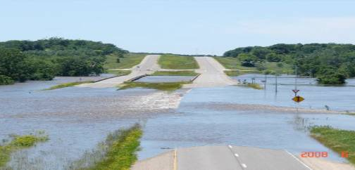
Major Activities
    Creating inundation maps
    Developing flood monitoring instrumentation
    Developing flood forecasting systems
    Updating flood frequency estimates
    Engaging with communities and training new cadres of experts
Notes:
Check to make sure these are tied back to House File 822

Slide 3
http://www.iowafloodcenter.org/
Flood Inundation Mapping
Collaboration with Iowa DNR

Slide 4


Slide 5
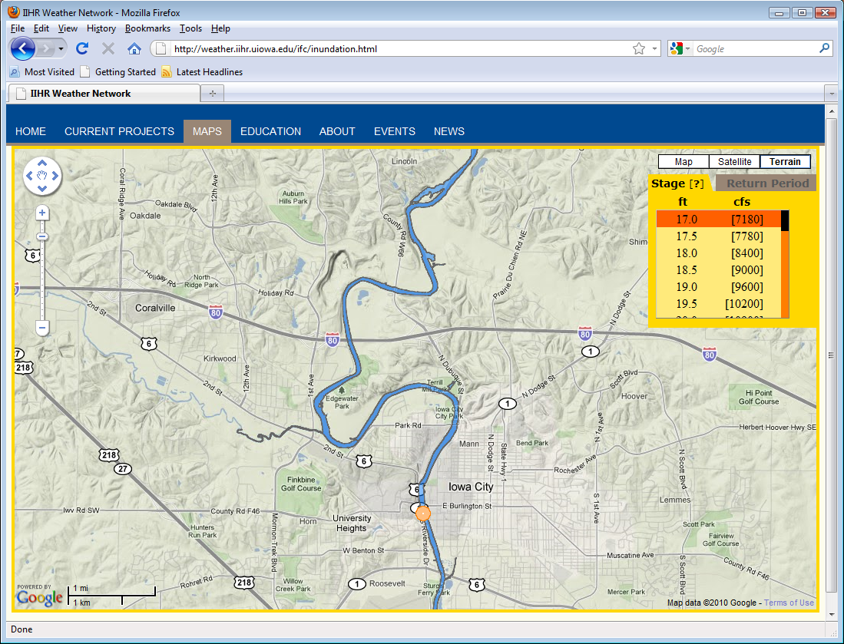

Slide 6
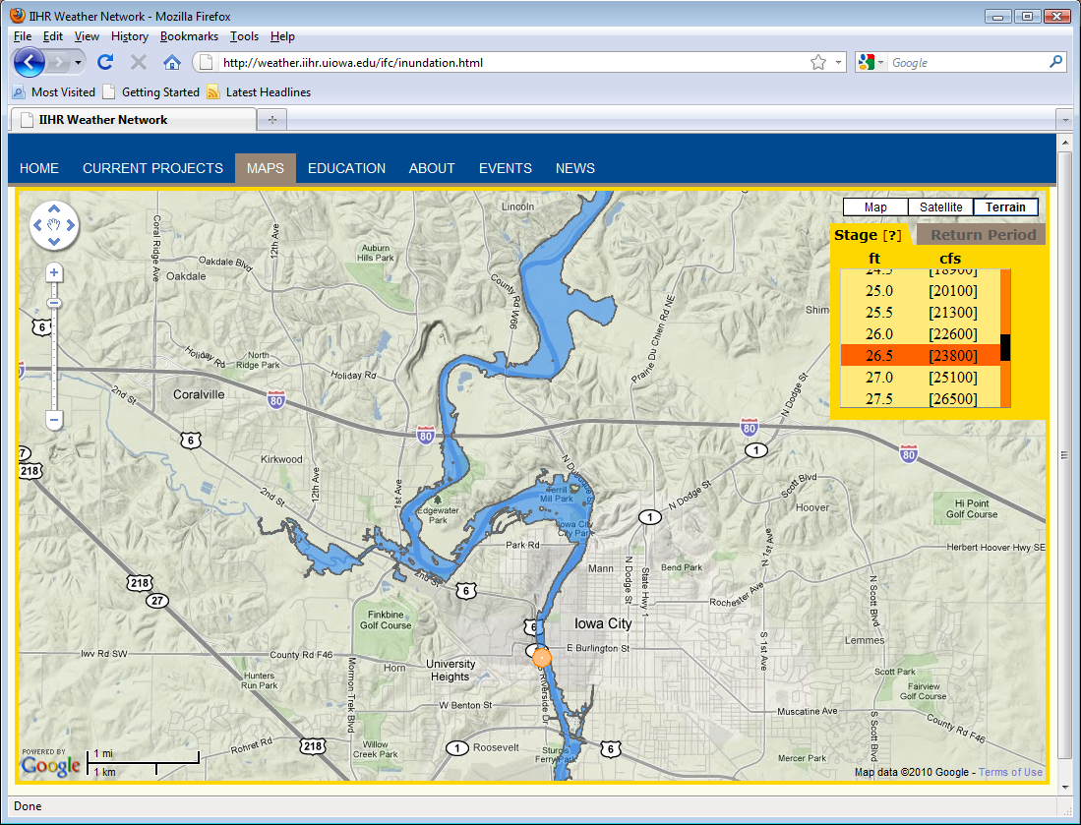

Slide 7
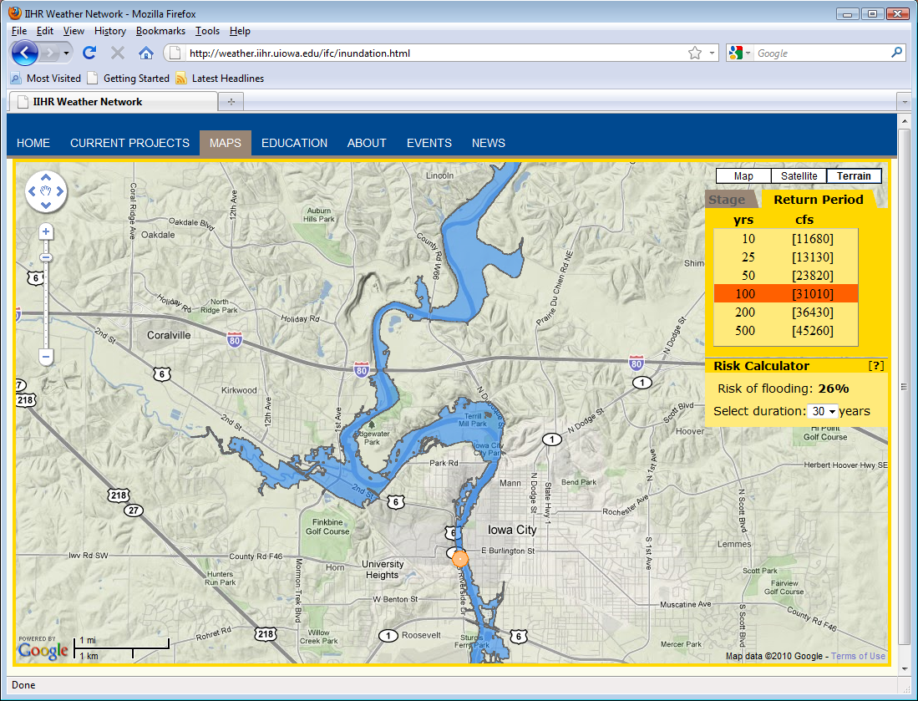

Slide 8
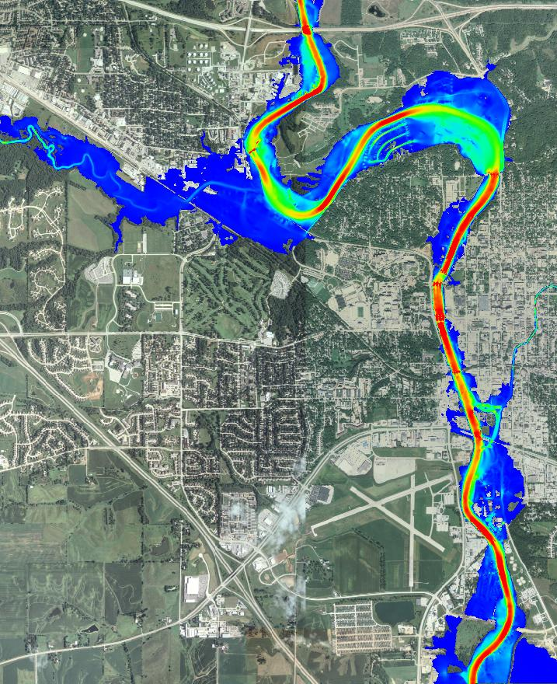
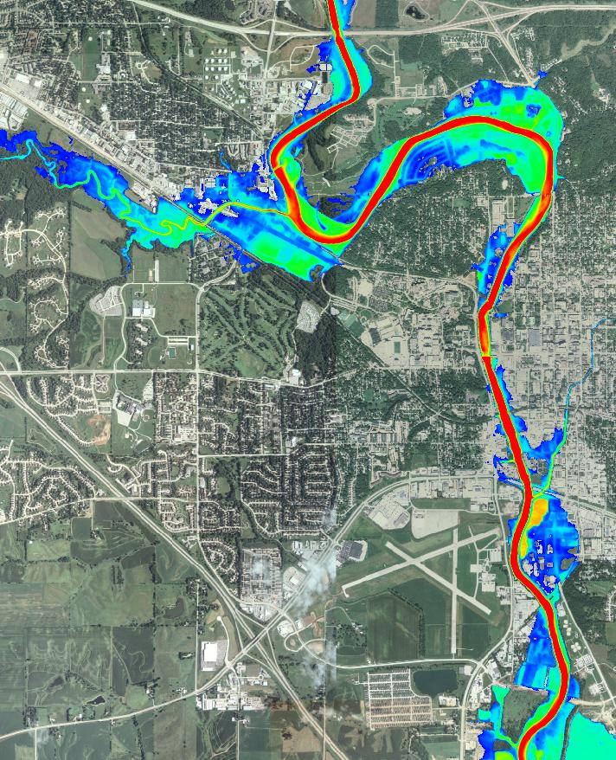
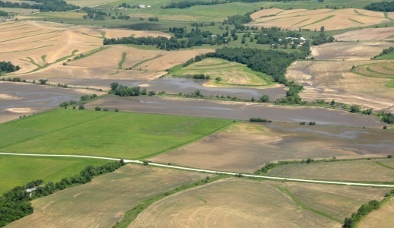
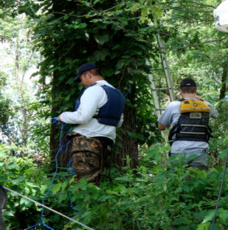
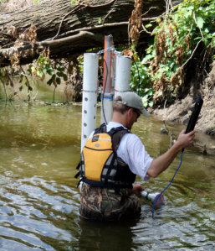
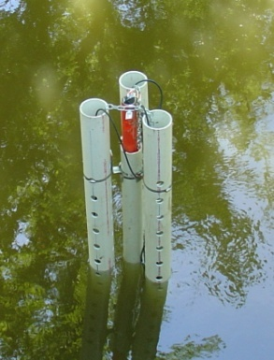
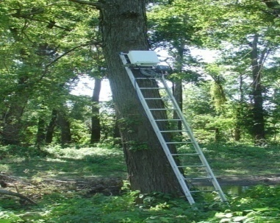
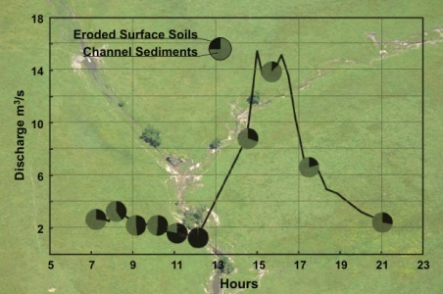
2008 Flood Peak
0
6
0
20
Water velocity (fps)
Water depth (ft)

Slide 9
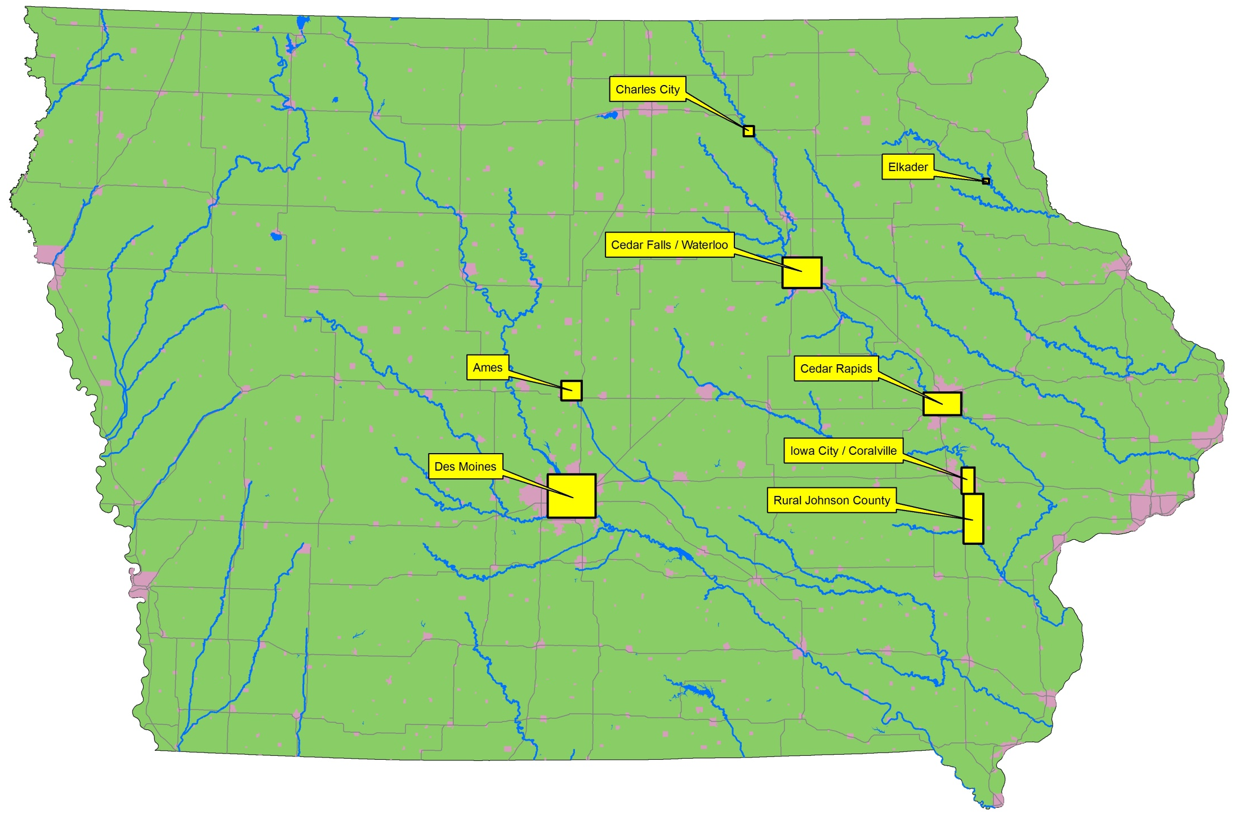

Slide 10
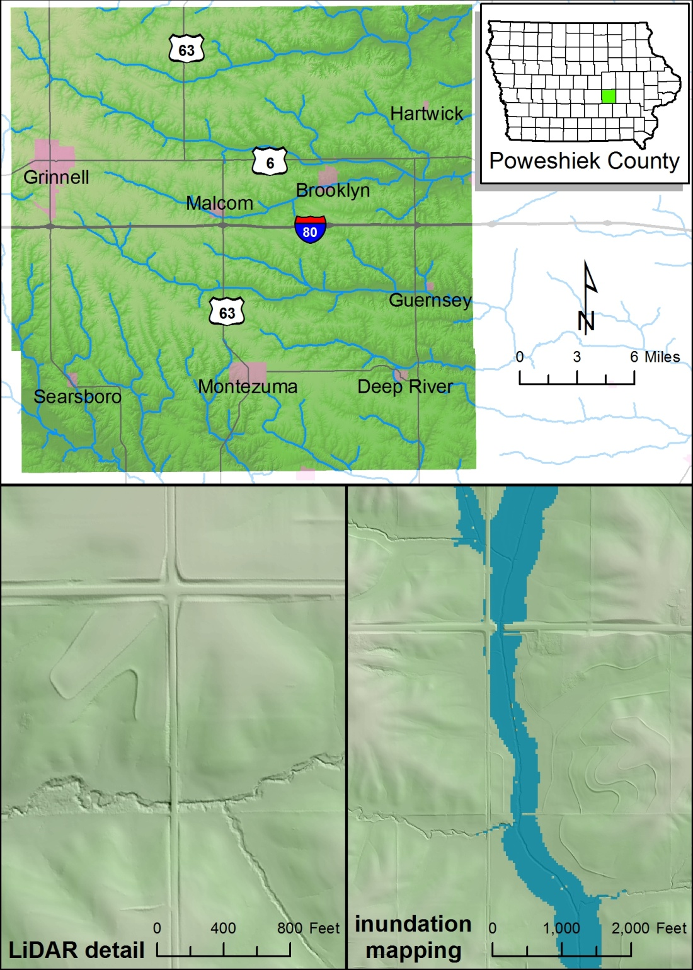

Iowa Department of Natural Resources
Statewide Floodplain Mapping Program
Pilot project goals
  Refine methodologies to take advantage of the LiDAR dataset
  Quantify the time and experience required to perform individual project tasks
  Identify distribution of internal IDNR and external effort to maximize the impact of FEMA funding provided to the State
  Produce Poweshiek County work map products for FEMA review and adoption
Pilot project completion in March 2010

Slide 11
http://www.iowafloodcenter.org/
Flood Monitoring
Creating New Technologies

Slide 12
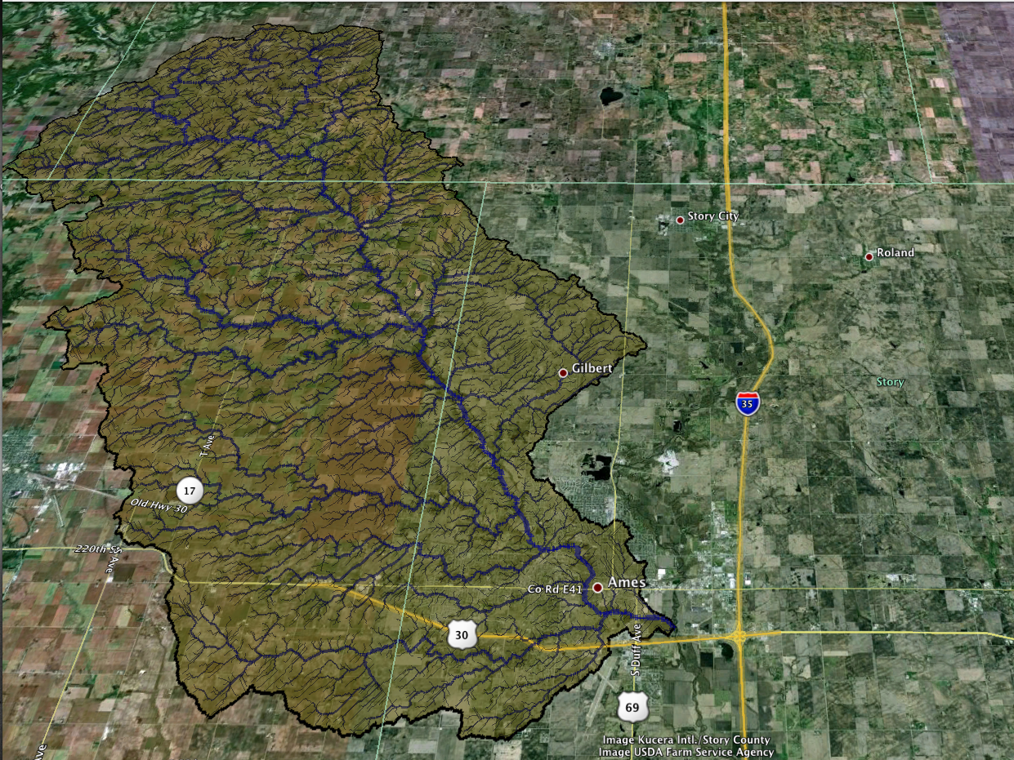
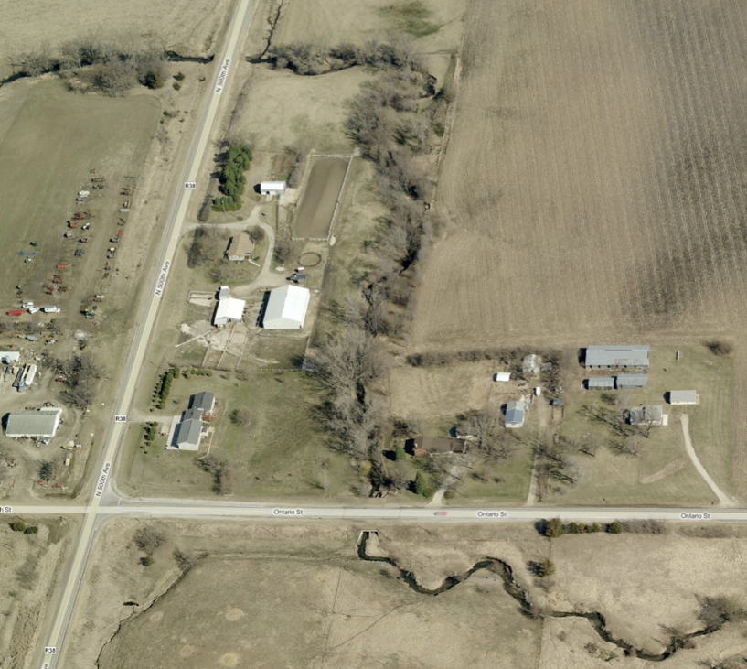

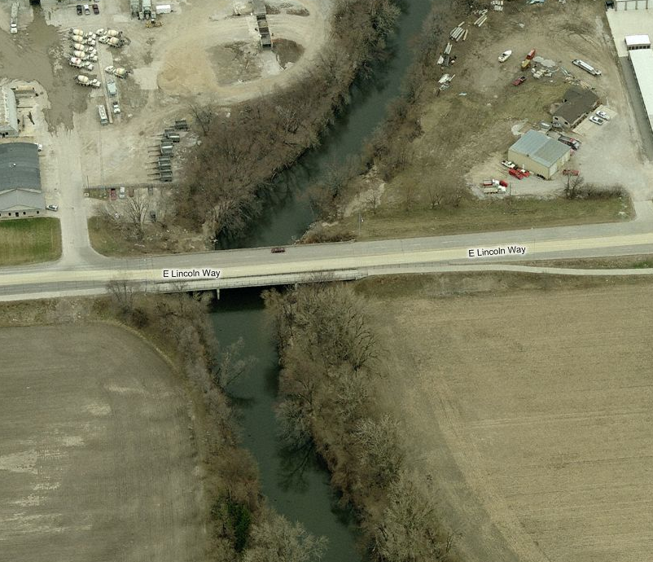

Slide 13
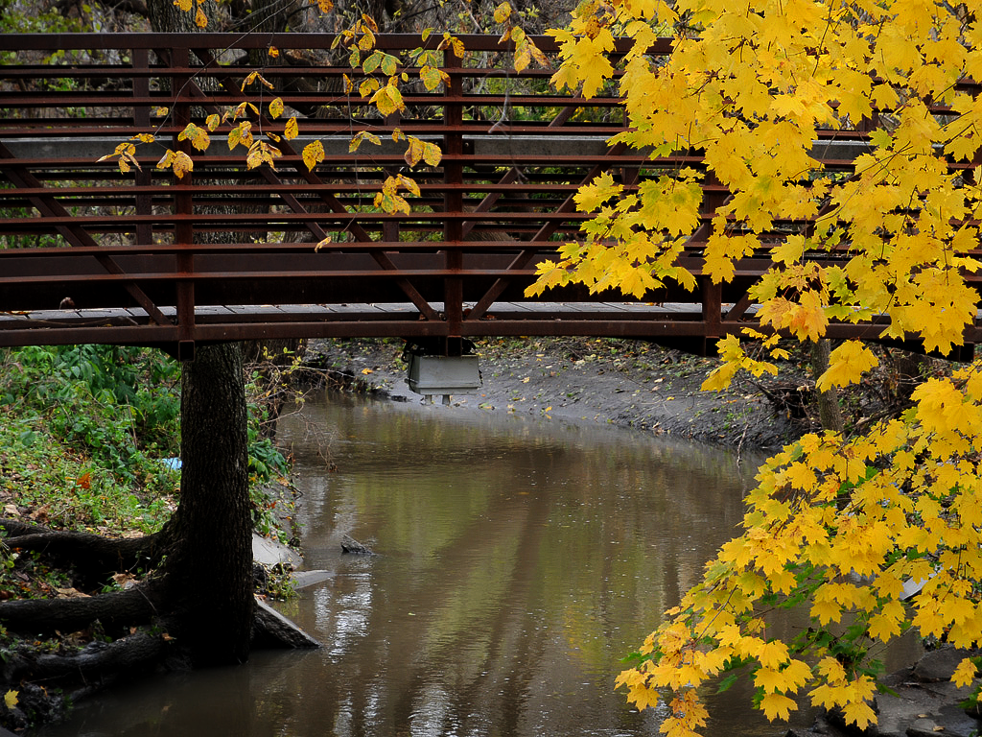
156 USGS stream gauges
25,000 bridges
Every bridge is a potential stream gauge

Slide 14
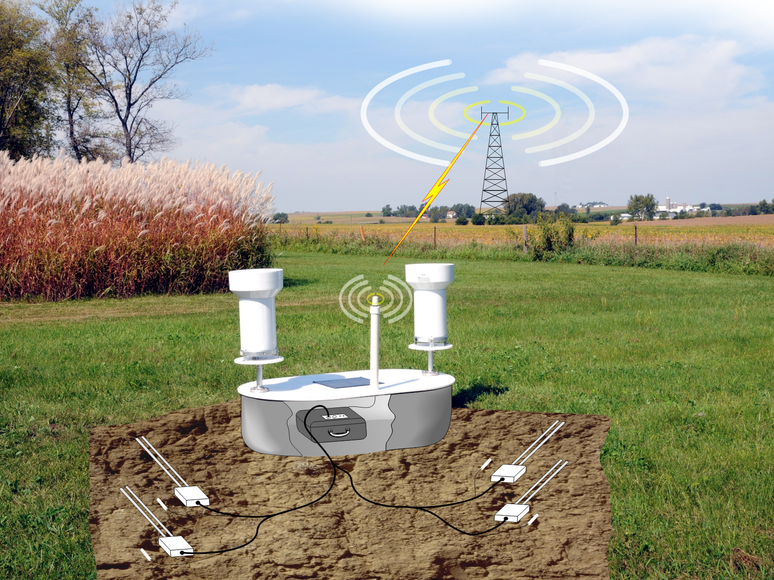

Slide 15
http://www.iowafloodcenter.org/
Real-Time Flood Forecasting
Enhancing Information from USGS and NWS

Slide 16
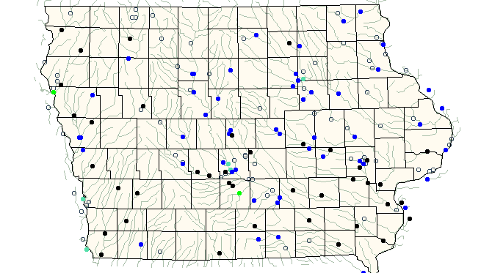
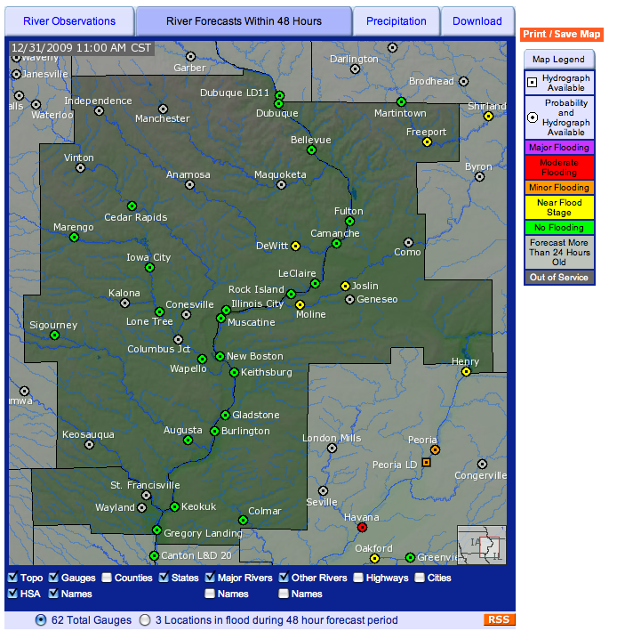
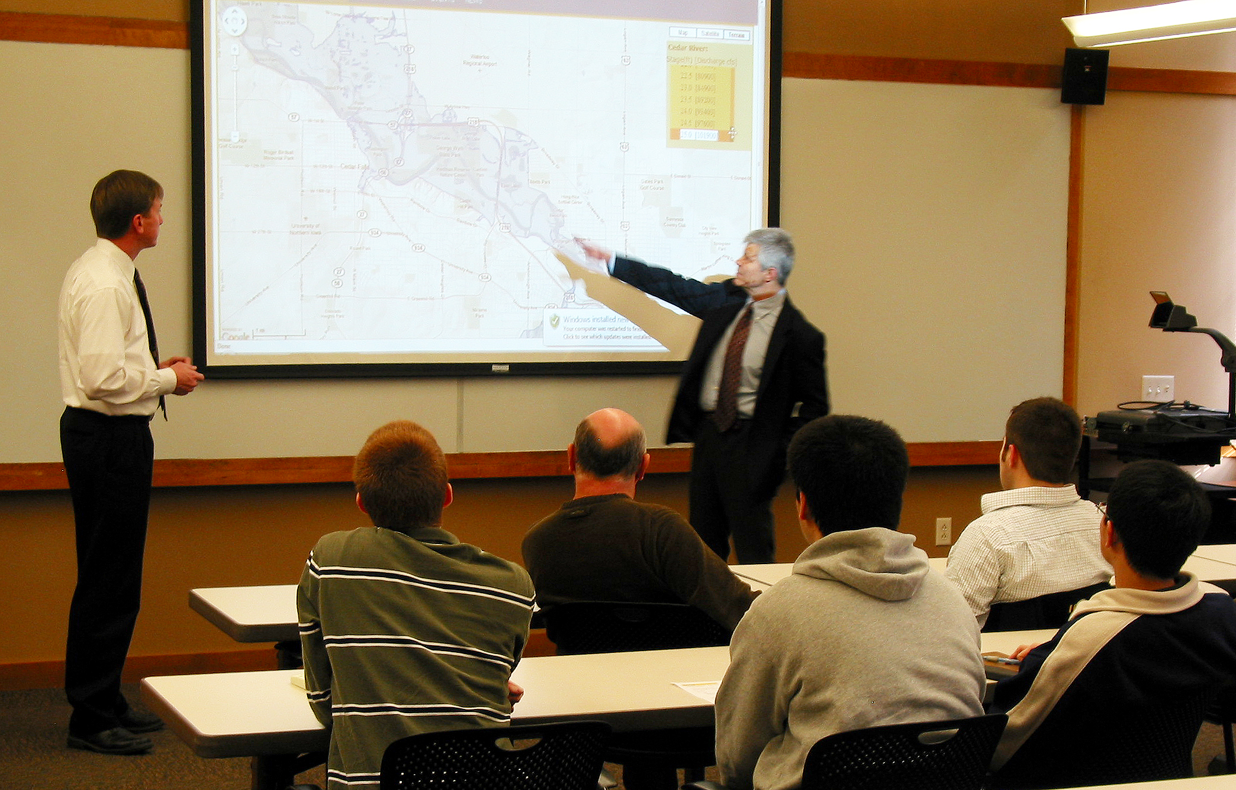

Slide 17
Development of a Real Time Food Forecast System for Iowa

Slide 18
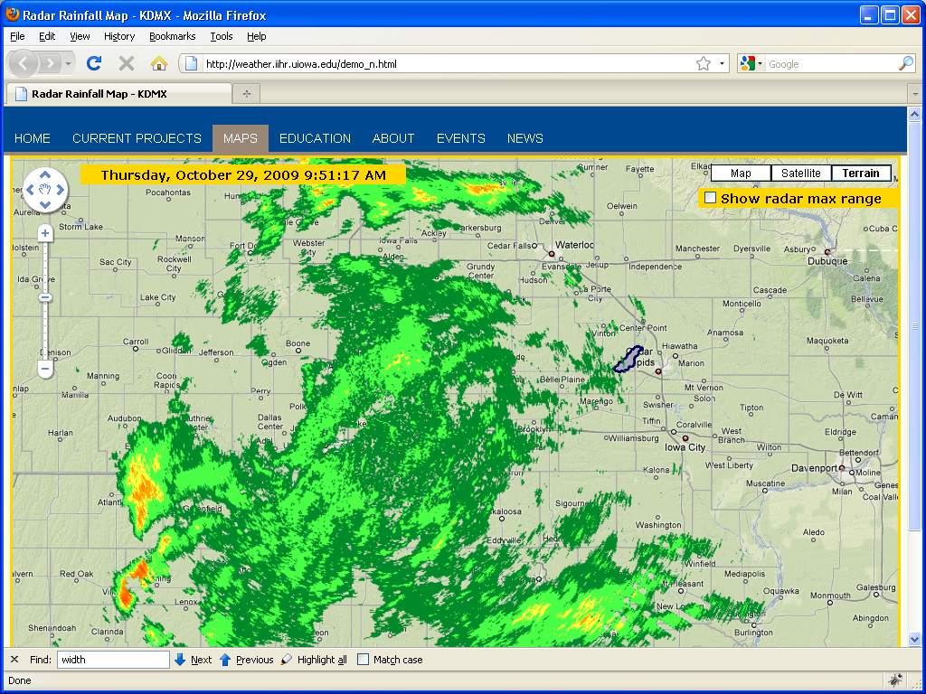

Slide 19
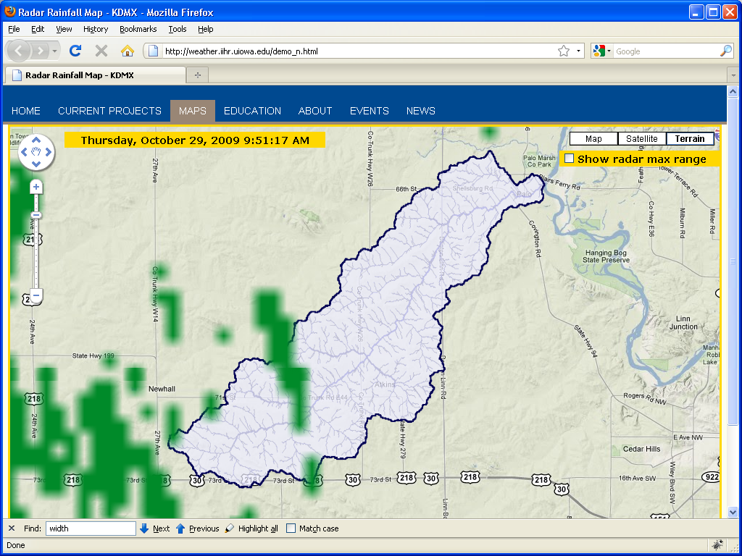

Slide 20
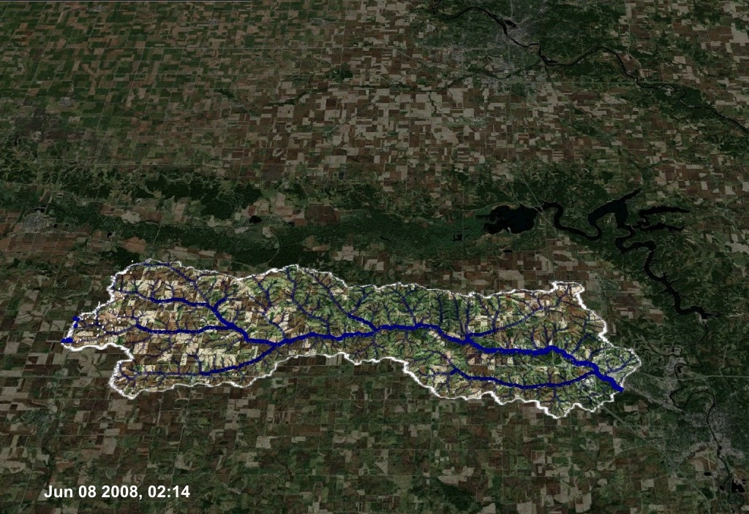

Slide 21
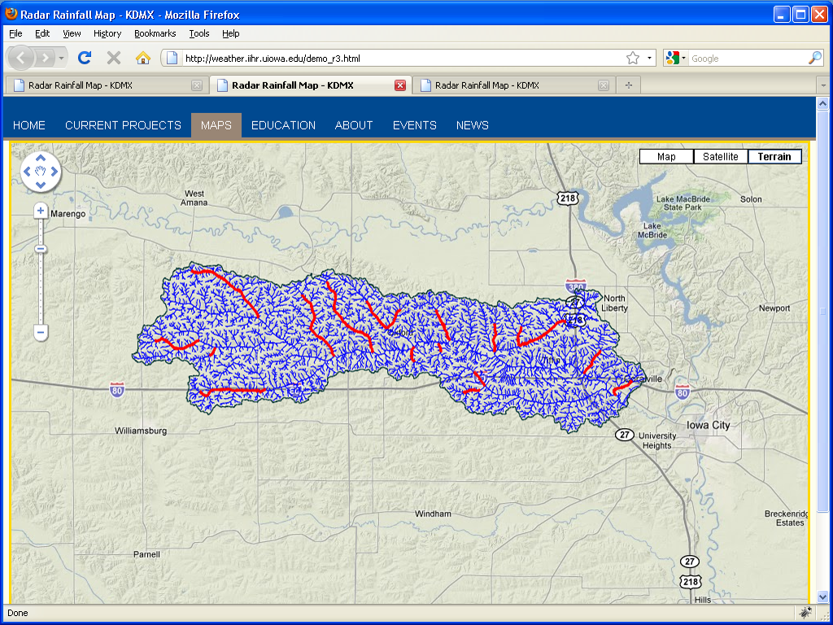
Forecast Lead Time
1h 3h 6h 12h 24h

Slide 22
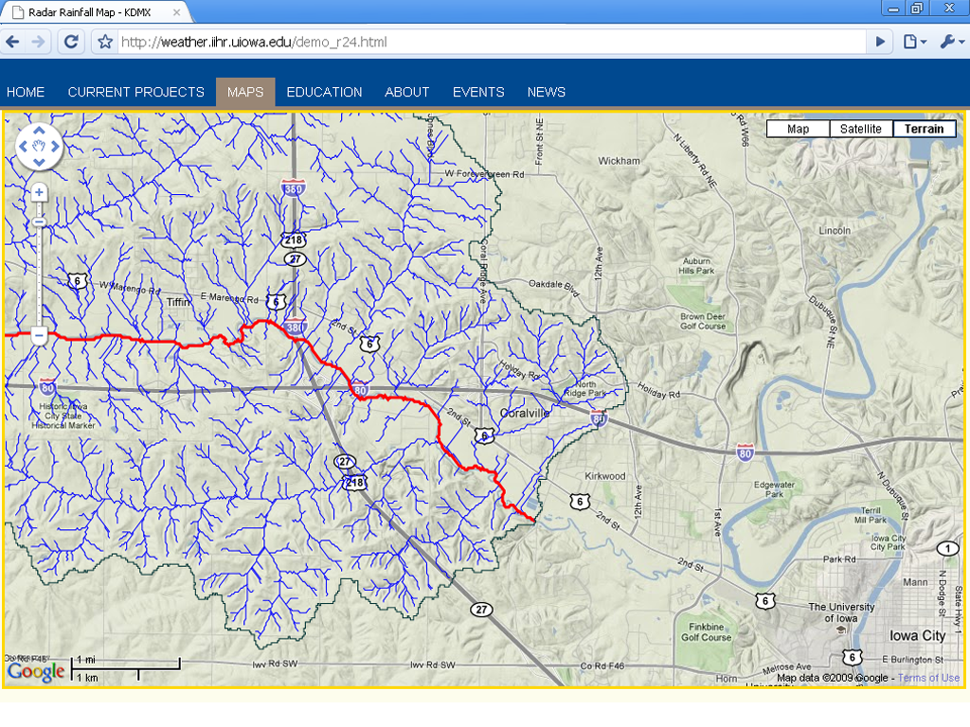
Forecast Lead Time
1h 3h 6h 12h 24h

Slide 23
Outlook
    From preparedness to mitigating risk: distributed storage pilot program (IDALS, DNR)
    Engaging ISU atmospheric science and ag economics: climate issues
    Engaging social and environmental sciences (UI and UNI)
    Seeking and attracting out-of-state funding
    Outreach

Slide 24
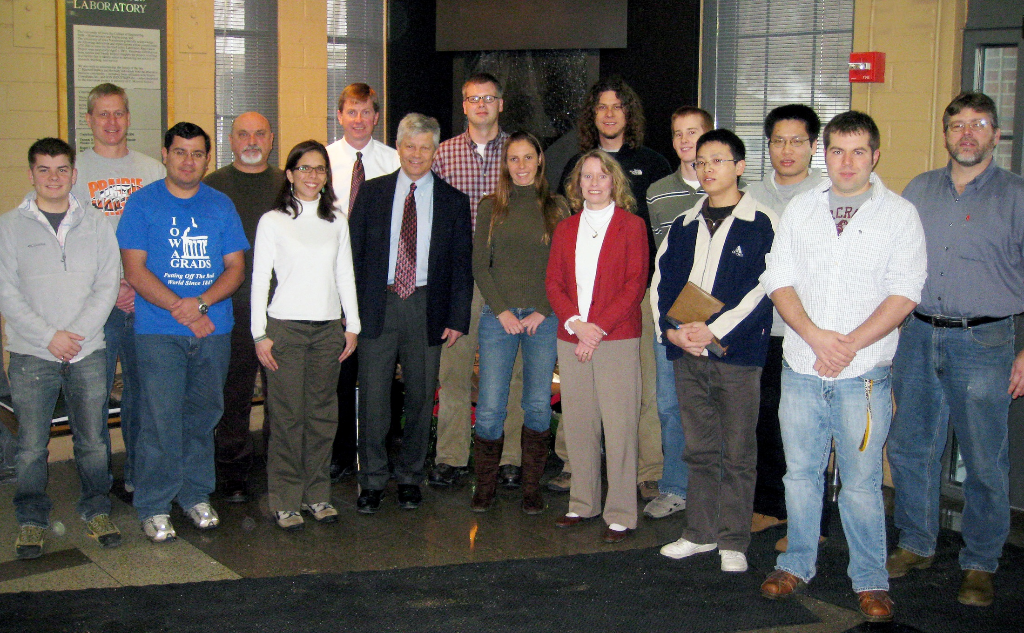
Thank You!

