Slide 1
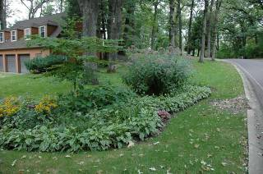
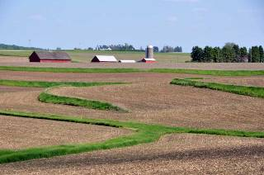
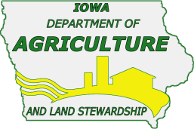
Anatomy of Iowa Floods:
Preparing for the Future
“How urban and rural Iowans work together to reduce flood impacts.”
James Martin, Division of Soil Conservation
Iowa Department of Agriculture & Land Stewardship

Slide 2
How Do Urban and Rural Iowans Work Together?
The 1st step in the process is
You!
Contact your local Soil and Water Conservation District (SWCD).
  www.IowaAgriculture.gov/SoilConservation.asp
    Discuss your resource concerns.
    Ask what activities are underway to address your concerns.
Request financial or technical assistance.

Slide 3
Iowa’s First
Soil and Water Conservation Law
Enacted in 1939
Created State Soil Conservation Agency
integrate soil and water conservation into agricultural production to insure long-term resource protection
Protecting soil productivity was the initial priority

Slide 4
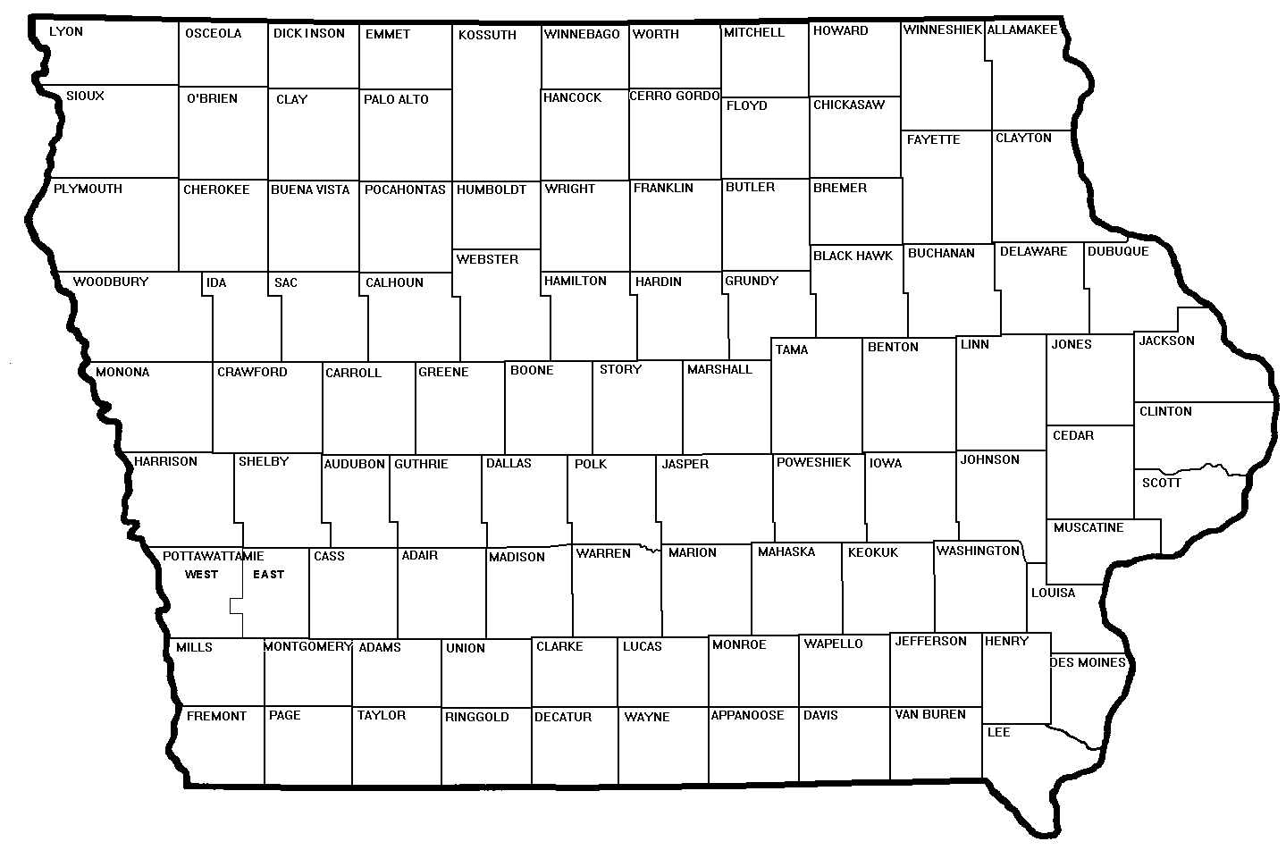
State law also provided for establishment of Iowa’s 100 Soil and Water Conservation Districts (SWCDs)
assess soil erosion, floodwater and sediment damages
develop comprehensive resource management plans to address these issues
carry out preventive and control measures as needed
local entity to deliver state assistance

Slide 5
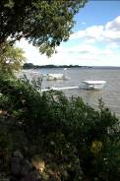
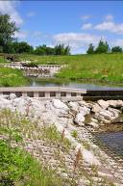
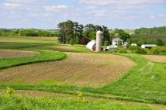
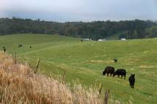
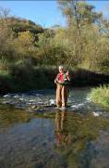
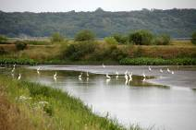
Unique SWCDs Framework
Each SWCD is unique
  resource conservation problems it addresses
  way it chooses to package and deliver programs to urban and rural landowners, farm operator and local communities.
Elected SWCD commissioners represent
  rural and urban constituents
  soil and water resource needs

Slide 6
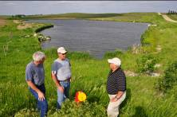
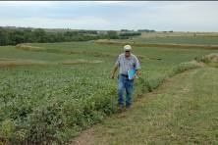
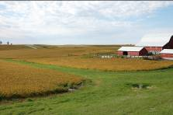
Standing Up to the 2008 Floods
Ag conservation practices operated properly in reducing flood impacts
90% grade stabilization structures and water/sediment control basins
83% terraces
55% grassed waterways
no-till and reduced tillage

Slide 7
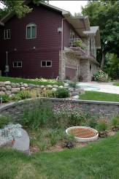
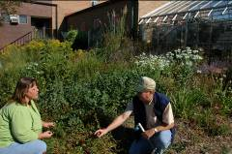
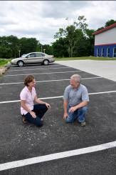
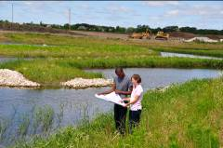
Standing Up to the 2008 Floods
Urban conservation practices operate in a similar way to reduce flood impacts.
Capture
Hold
Infiltrate
Reduce runoff
Protect WQ

Slide 8
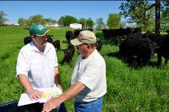
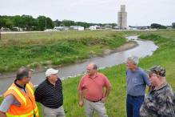
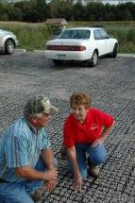
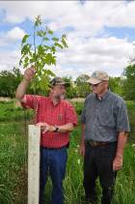
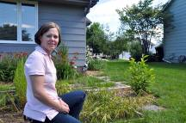
Don’t think you have a problem or resource concern?
Urban or rural Iowans, rain and snow fall on your property.
You are a watershed stakeholder.
Manage the water that falls on your land.
Your action or inaction impacts others.
Work cooperatively with others in the watershed.

Slide 9
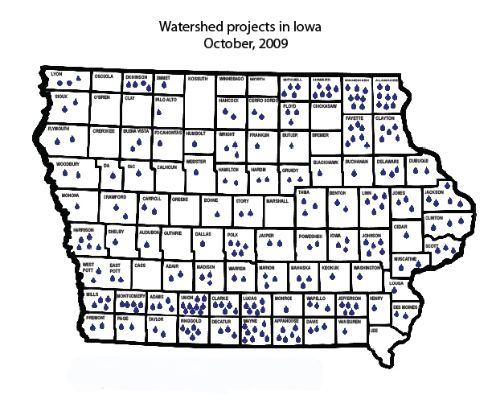
204 projects in Iowa
(completed or underway)
The Division of Soil Conservation works cooperatively with SWCDs, NRCS, DNR and other partners.
Notes:
Many of these projects include rural and urban partners that have worked together on a watershed basis to target limited resources to get the best return on investment.

Slide 10

“Iowa Watershed Projects” Publication
feature stories highlight effectiveness of the Division/District grassroots framework
individual project summaries focus on the scope and variety of projects
Iowa Department of Agriculture & Land Stewardship
Division of Soil Conservation
www.iowaagriculture.gov/soilConservation.asp

Slide 11
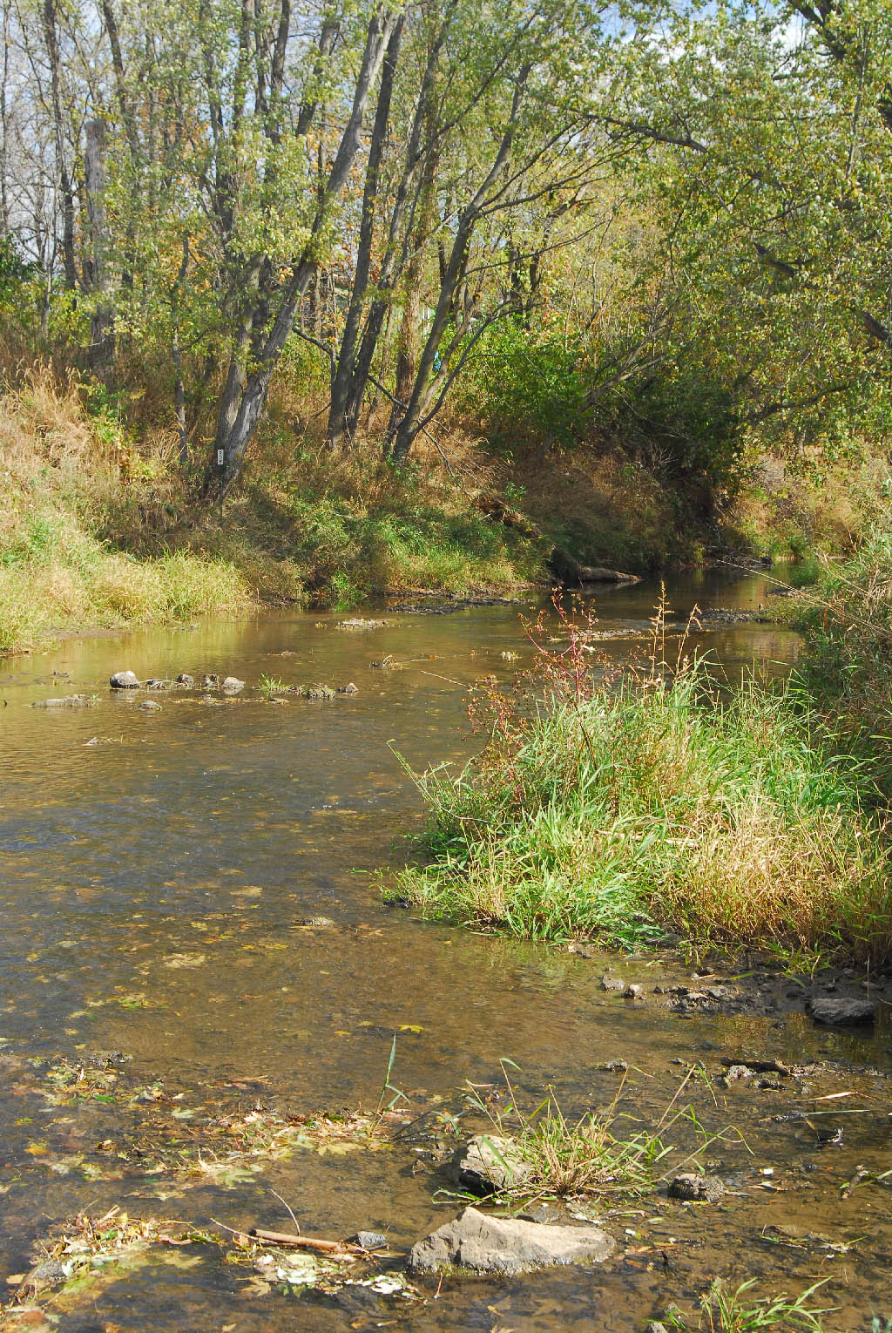
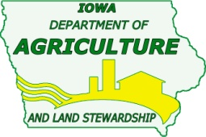
A Project of the Iowa & Johnson SWCDs
Coordinator: James Martin
Environmental Specialist
Iowa Dept. of Ag. And Land Stewardship – Division of Soil Conservation
Ph. 319-668-2359
Email: james.martin@ia.nacdnet.net

Slide 12
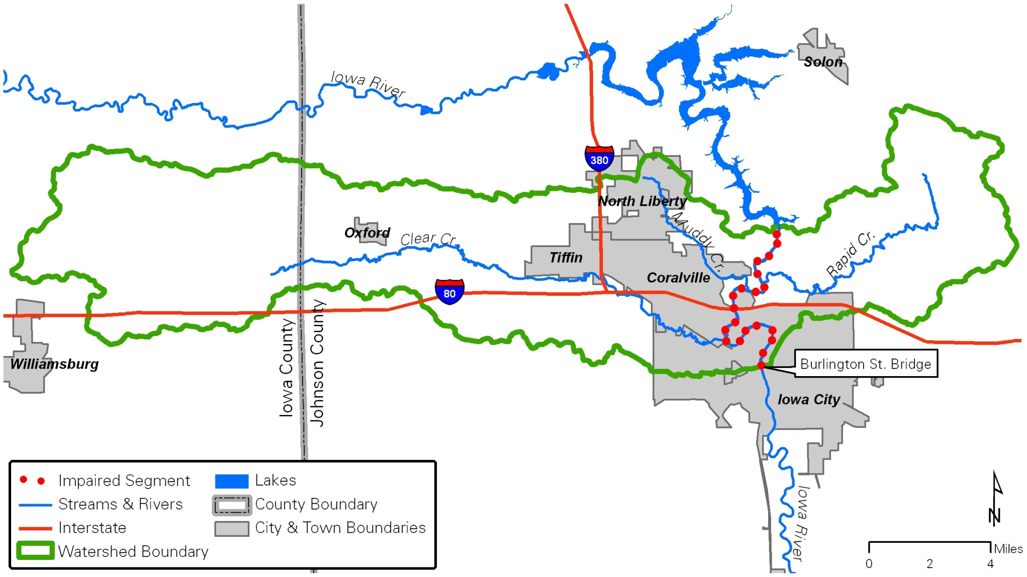
Clear Creek Watershed
Conroy to Coralville
Conroy
Notes:
66,142 Acres with three headwater streams converging in Iowa Co., extending 25 miles into the Iowa River in Coralville, Johnson County
Clear Creek is relevant because it’s the largest of three watersheds that are contributing to the impairment of the Iowa River between the Coralville Reservoir and the Burlington St Bridge in Downtown Iowa City.
Clear Creek contributed to Flooding in urban Coralville in several events including 1990 and 1993. The 93 event contributed to the closing of Int. 80 near Tiffin.

Slide 13

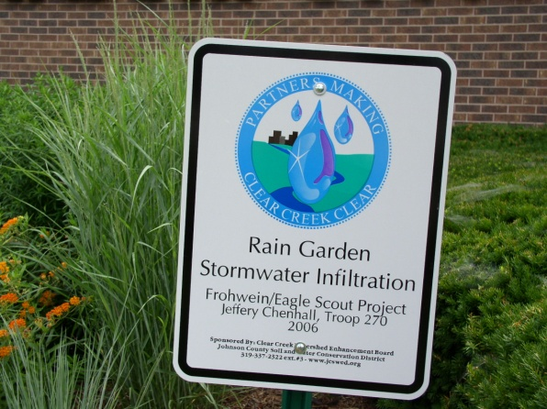
The Clear Creek Watershed Enhancement Project Board
  Members includes stakeholders representing a variety of partners
    Farmers and residents from the watershed
    City of Coralville
    The University of Iowa
    Clear Creek Amana Community Schools
    Johnson County Conservation Board
    Business leaders
    District Commissioners
Notes:
The CCWEP is an extension of the JCSWCD.
The board felt they could better focus their time on a smaller watershed rather than focus on the entire Iowa Basin. Local Example: In Indian Creek, where impervious services are a bigger contributor we can do a much better job of reducing frequent, flash flooding with urban practices. Whereas on the whole, urban is a small percentage of the watershed.
CCWEP recent Outcomes:
Conroy’s sewage is now treated in a lagoon made possible by a WIRB grant.
7,779 tons of soil/yr saved = 500 dump trucks/yr
6,000 ft of fence
16,000 ft of filter strips
95 ac. of grassed waterways
120 Water & Sediment Basins / Terraces
City of Coralville provides some cost-share for raingardens
IDALS-DSC/SWCD provides an urban specialist as needed and REAP cost-share and low interest loans are available for urban BMPS

Slide 14
Urban and rural collaboration for watershed protection
Notes:
The Clear Creek Project has received grant awards from the IDALS/DSC, DNR, and WIRB for BMPs and a watershed coordinator.
Currently working with the Iowa Flood Center to access flooding.

