Slide 1
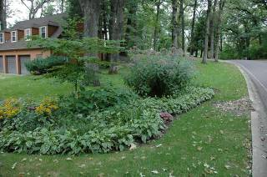
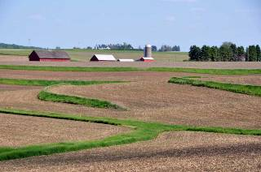
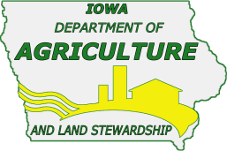
Anatomy of Iowa Floods:
Preparing for the Future
“How urban and rural Iowans can work together to reduce flood impacts.”
James Martin, Division of Soil Conservation
Iowa Department of Agriculture & Land Stewardship

Slide 2
Become familiar / Get involved with your local SWCD
Contact your local Soil and Water Conservation District (SWCD).
  www.IowaAgriculture.gov/SoilConservation.asp
Request financial or technical assistance.
Volunteer

Slide 3
Iowa’s First Soil and Water Conservation Law
Enacted in 1939 Created State Soil Conservation Agency
Goal was to integrate soil and water conservation into agricultural production to insure long-term resource protection
Protecting soil productivity was the initial priority
Water quality protection and reducing flood potential are additional priorities

Slide 4
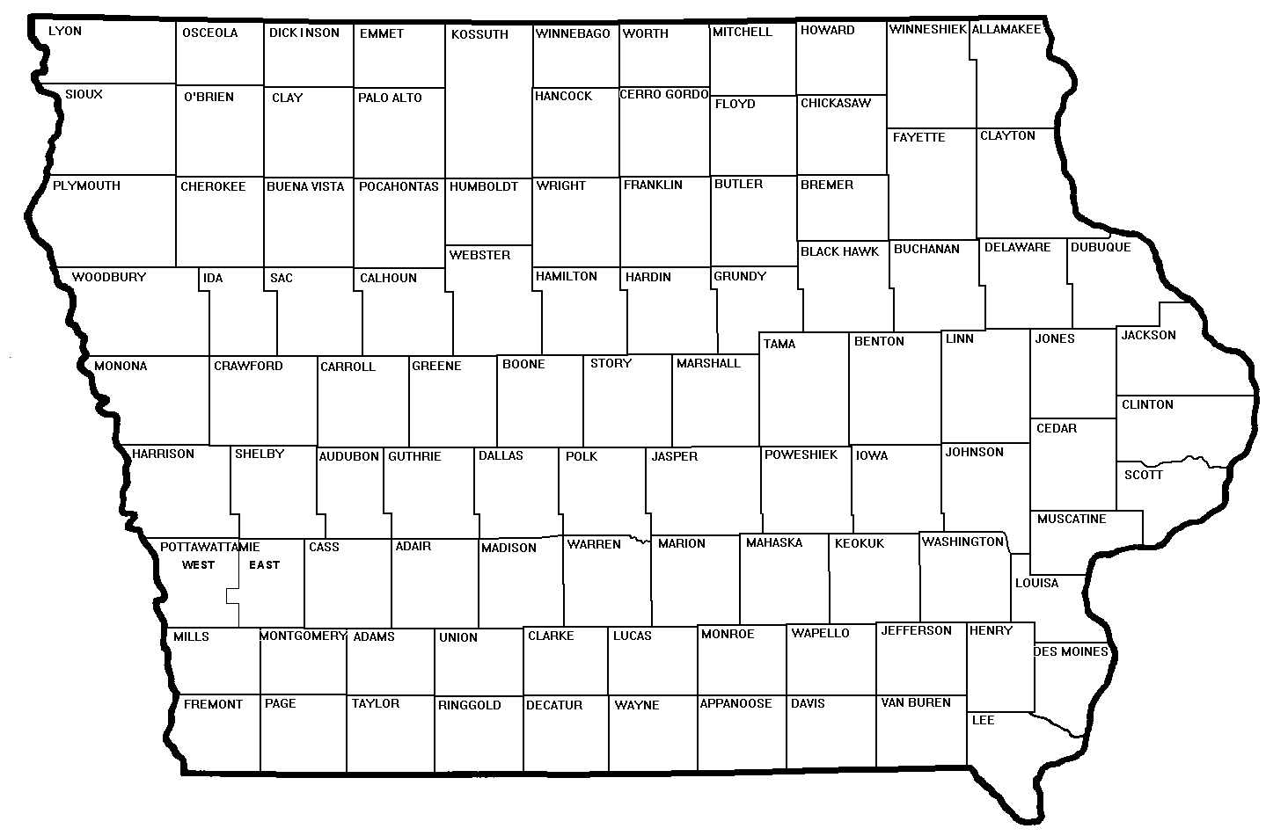
State law provided for establishment of Iowa’s 100 Soil and Water Conservation Districts (SWCDs)
SWCD’s: a local entity to deliver technical and financial assistance
assess natural resource needs and develop resource management plans
carry out needed conservation measures

Slide 5
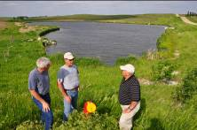
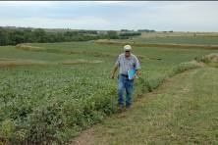
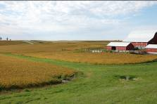
Standing Up to the 2008 Floods
Ag conservation practices operated properly in reducing flood impacts
90% grade stabilization structures and water control basins functioned properly
83% terraces and 55% grassed waterways functioned properly
no-till helped reduce runoff.

Slide 6
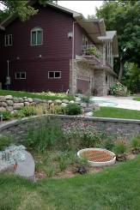
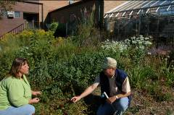
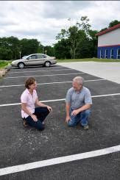
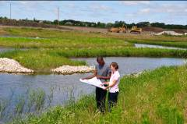
Standing Up to the 2008 Floods
Urban conservation practices operate in a similar way to reduce flood impacts.
Capture
Hold
Infiltrate
Reduce runoff
Protect WQ

Slide 7
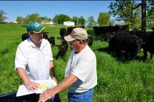
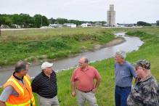
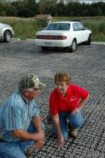
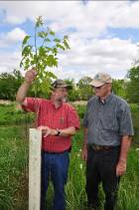
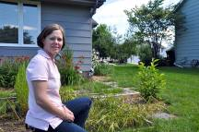
What is your hydrologic footprint?
If rain and snow fall on your property your property probably generates runoff.
Your action or inaction impacts others.
Manage the water that falls on your land sustainably.
You are a watershed stakeholder - work cooperatively with others in your watershed.

Slide 8
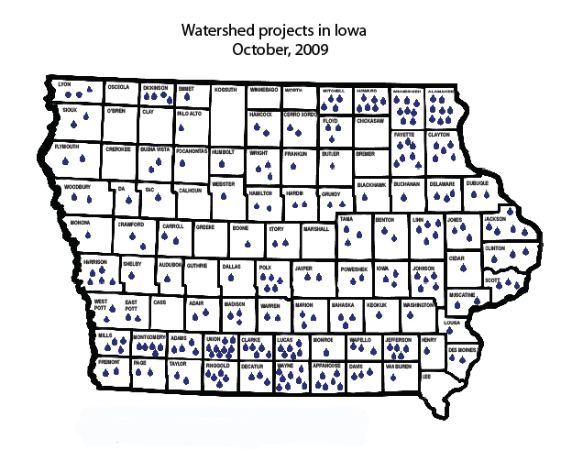
204 projects in Iowa
(completed or underway)
The Division of Soil Conservation works cooperatively with SWCDs, NRCS, DNR and other partners.
Notes:
Many of these projects include rural and urban partners that have worked together on a watershed basis to target limited resources to get the best return on investment.

Slide 9
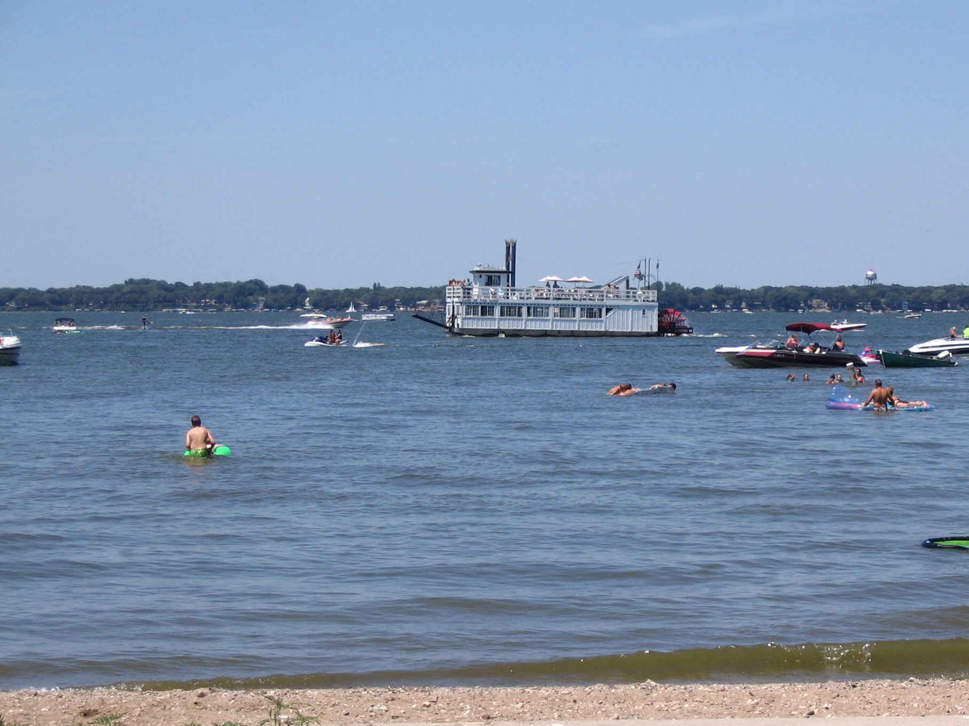
Clear Lake Enhancement and Restoration Project
Hancock & Cerro Gordo SWCDs
Project Coordinator: David Knoll – Environmental Specialist
Iowa Department of Agriculture and Land Stewardship - Division of Soil Conservation
Phone: 641-923-2837 Ext. 3 Email: david.knoll@ia.nacdnet.net

Slide 10
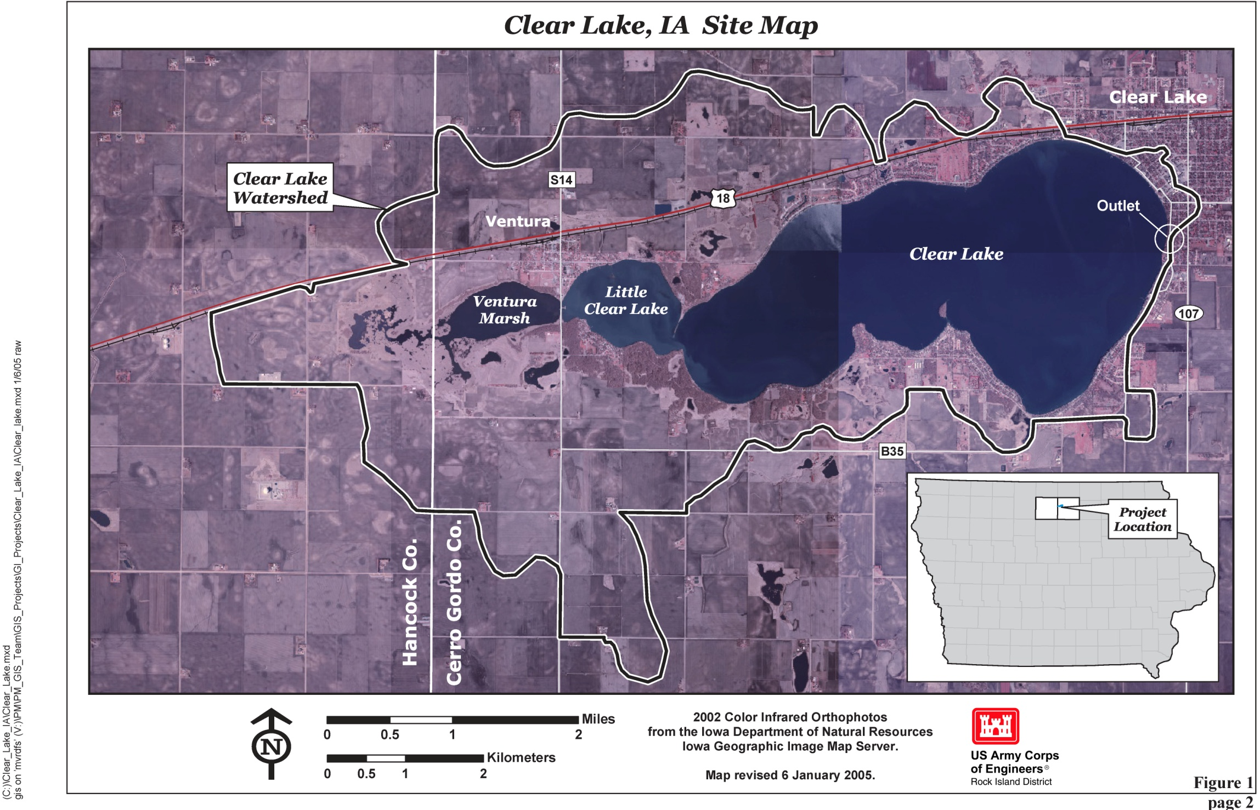

Slide 11
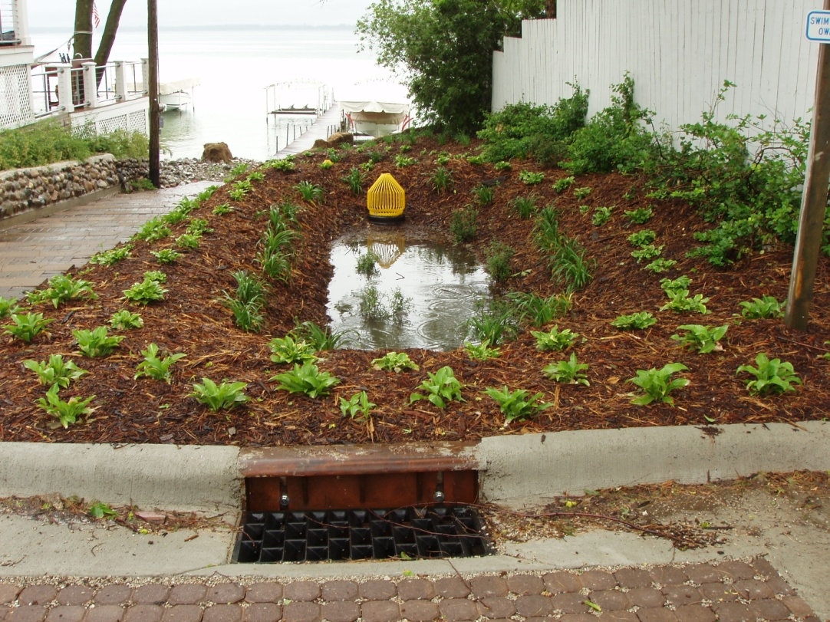
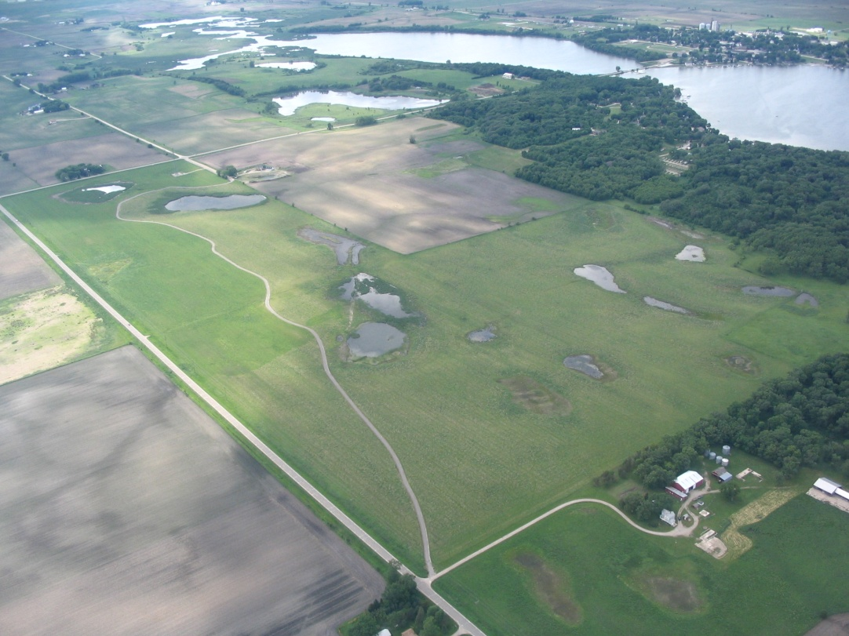
Developed Areas:
Agricultural Areas:
More than 40 storm water BMPs installed (Over $1 mil investment)
Ordinances passed for proper yard waste disposal and pet waste pick up
Infiltrating storm water runoff improves WQ and reduces flooding
Over 700 cropland acres converted to prairie/wetland areas
193 tons of sediment kept out of Clear Lake annually by ag conservation practices
Native grasses and wetlands improve WQ and reduce flooding

Slide 12
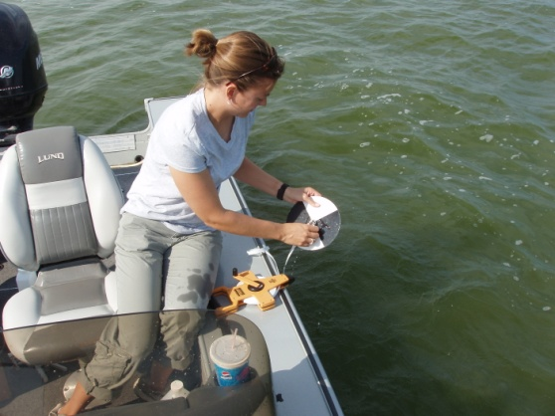
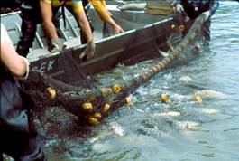
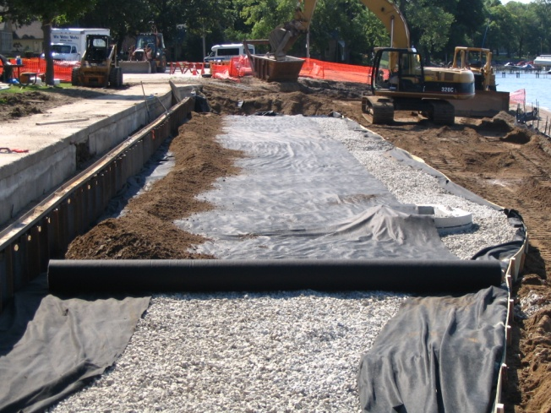
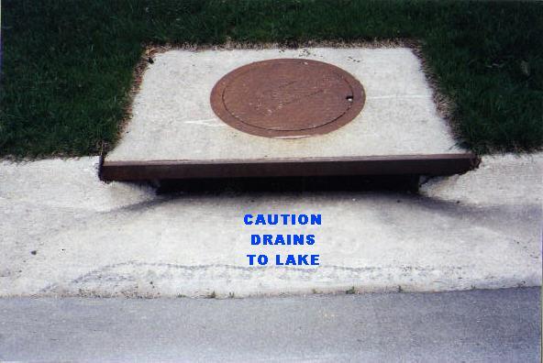
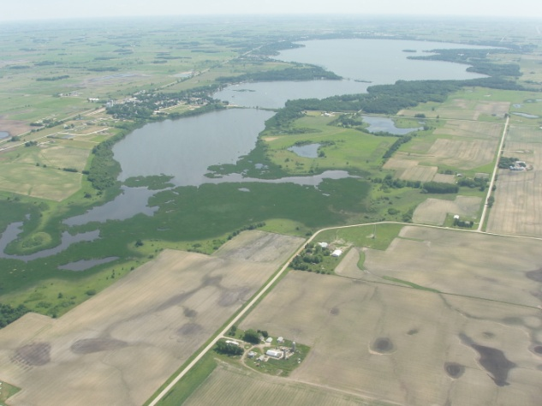

Lake/River Restoration
Steps

Slide 13

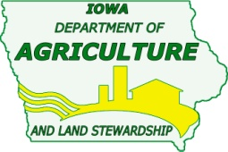
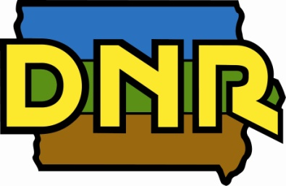

CLEAR Project Sponsors/Partners
Hancock and Cerro Gordo SWCD
IDALS/DSC
Iowa DNR
Association for the Preservation of Clear Lake
City of Clear Lake, Ventura
Cerro Gordo County
Natural Resources Conservation Service
US EPA
US Army Corps of Engineers

Slide 14
Urban and rural collaboration for watershed protection
Notes:
The Clear Creek Project has received grant awards from the IDALS/DSC, DNR, and WIRB for BMPs and a watershed coordinator.
Currently working with the Iowa Flood Center to access flooding.

