Slide 1
Trends in Iowa Precipitation: Observed and Projected Future Trend
Christopher J. Anderson, PhD
Scientist, Assistant Director Climate Science Program
Iowa State University
cjames@iastate.edu
A Watershed Year: Anatomy of the Iowa Floods of 2008
Lessons Learned – Preparing for the Future
Mason City, Iowa
14 July 2010

Slide 2
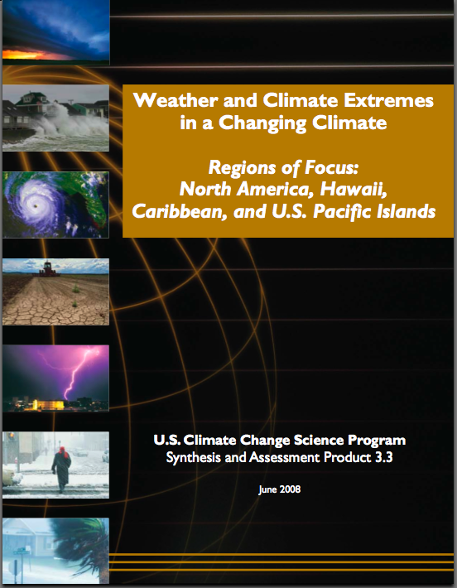
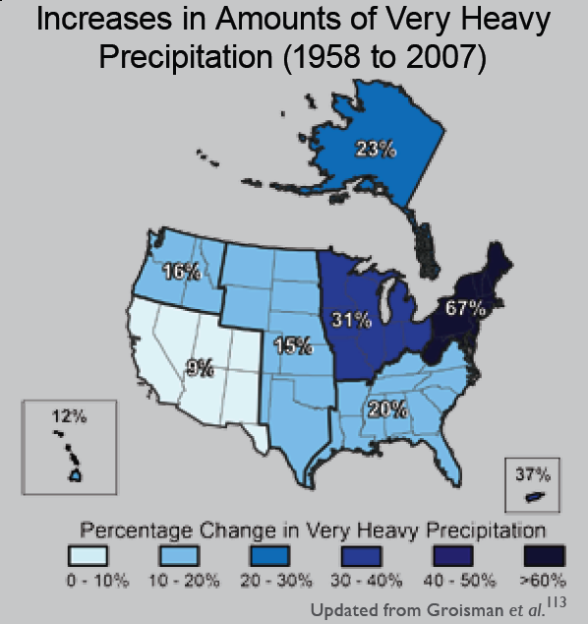
Title Here
Column 1 info here
Column 2 info here
“One of the clearest trends in the United States observational record is an increasing frequency and intensity of heavy precipitation events… Over the last century there was a 50% increase in the frequency of days with precipitation over 101.6 mm (four inches) in the upper midwestern U.S.; this trend is statistically significant.“

Slide 3
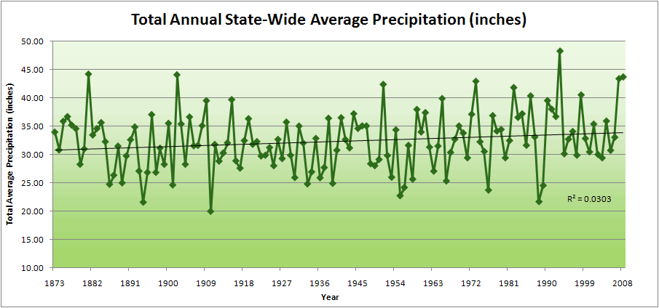
Title Here
Column 1 info here
Column 2 info here

Slide 4
Title Here
Column 1 info here
Column 2 info here
37.5”
31.5”
19% increase

Slide 5
Title Here
Totals above 40”
8 years
2 years
Column 1 info here
Column 2 info here
37.5”
31.5”
19% increase

Slide 6
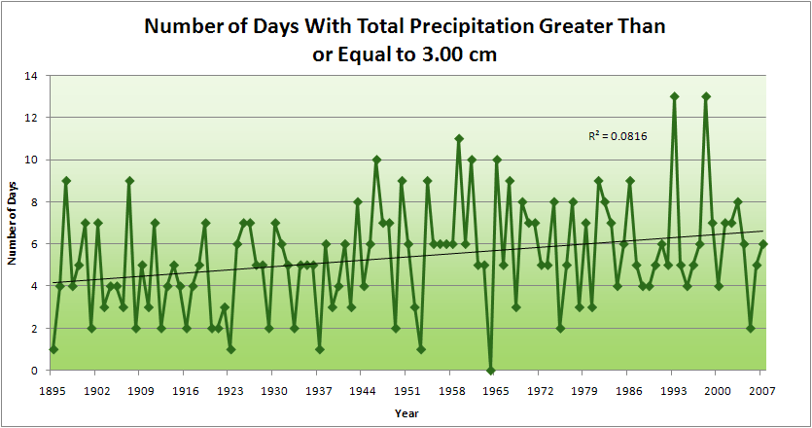
Title Here
1.25”
Column 1 info here
Column 2 info here
4.2 days
57% increase
6.6 days

Slide 7
Title Here
1.25”
Column 1 info here
Column 2 info here
11
2
4.2 days
57% increase
6.6 days

Slide 8
What is causing heavy rainfall events?
More water vapor is in the air over the Midwest.
Warmer Gulf of Mexico and Caribbean Sea
Increase in agricultural production and irrigation
Current Pacific temperature pattern diminishes drought.
Guides storm systems over rather than north of Midwest
Likely to continue for ~10 years
Wet soils more rainfall wet soils

Slide 9
What about greenhouse gases?
Greenhouse gas increases have warmed the oceans, adding water vapor to the air over the Gulf of Mexico and Caribbean Sea.
The relative importance of ocean warming, Pacific temperature patterns, and soil moisture is an ongoing discussion among scientists.

Slide 10
What does the future hold?
2010-2020
Rainfall is likely to be similar to the last decade.
2020-2040
Days with heavy rainfall will be mixed with dry periods.
Beyond 2040
Days with heavier rainfall than present will result in increase of streamflow of 20% or more.

Slide 11
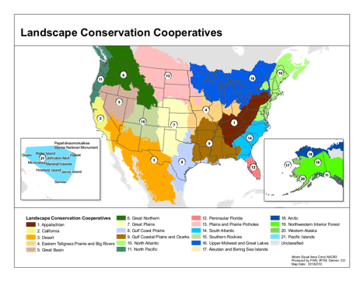
How can we build capital to adapt?
Multi-priority adaptation plans
US Fish and Wildlife Service Landscape Conservation Cooperatives have been developed within the last year to coordinate land, wildlife, and fisheries management. Wildlife conservation and flood mitigation priorities might support similar adaptations (e.g. watershed restoration).

Slide 12
Climate Science Program Contacts:
gstakle@iastate.edu
cjames@iastate.edu
Climate Science Program Information:
http://climate.engineering.iastate.edu

