Slide 1
Trends in Iowa Runoff
Kristie J. Franz
Department of Geological & Atmospheric Sciences
Iowa State University
kfranz@iastate.edu

Slide 2
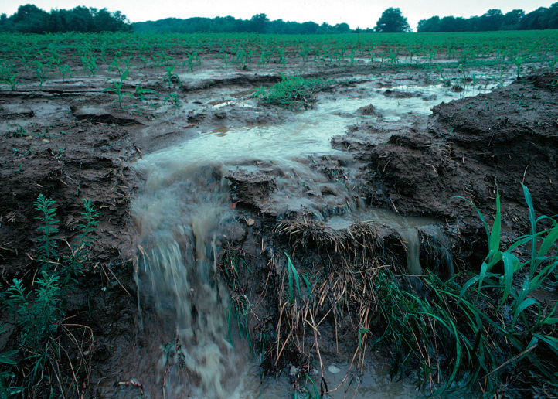
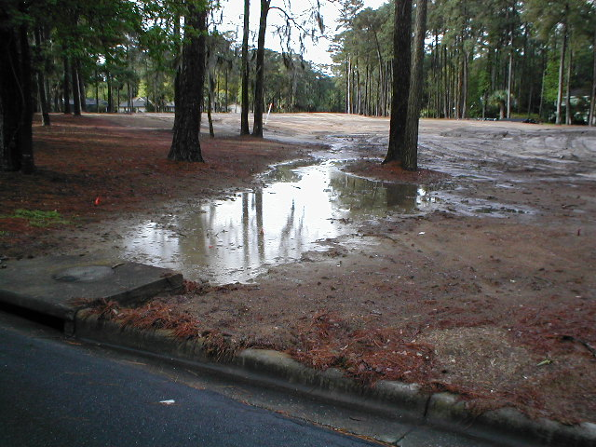
Runoff – water that runs over land
Influenced by:
Soil texture and structure
Land surface characteristics (slope, vegetation, bare soil, land use)
Water input rate
http://www.savannahenvironmental.com/stormwater.htm

Slide 3
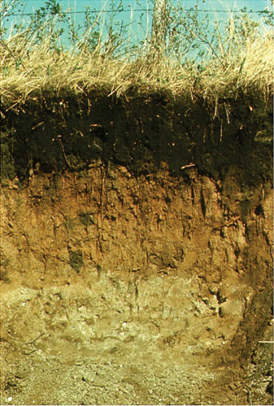
Runoff = Water input - Infiltration
Infiltration – entry of water into soil
Influenced by:
Physical characteristics of the surface and soil (e.g. soil texture and structure, land cover, land use)
Soil moisture

Slide 4
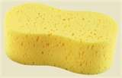
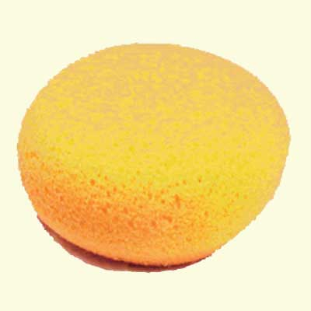
Number and size of holes tell us how much water soil can hold
Notes:
Sponge is a great teacher. It will absorb water until it is saturated, after which added water runs off (or through). Changing the surface by covering it with a paper towel (for example) reduces the rate at which water applied to the surface can enter (infiltrate). Even a bare sponge has its limits – if water is applied too fast, the sponge cannot absorb (infiltrate) all that is applied.

Slide 5
Connections, size and content of open spaces tell us how fast water can move into and through soil.

Slide 6
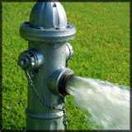
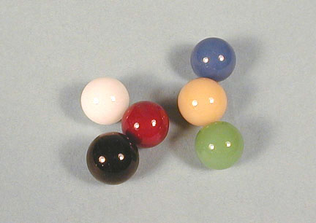
Amount of runoff also depends on water application rate
Runoff = Water input - Infiltration

Slide 7
Trends in Iowa Runoff (Streamflow)
Number of high flow days per year
Of 10 watersheds studied:
8 had increasing average daily streamflow (50% increase)
9 had increasing number of high flow days
3 had increasing number of extreme flow days
1950 2000
1950 2000
(10-year running averages)
Conrad, 2010

Slide 8
Modeling Watersheds
10 year running average mean daily discharge
“tune” the model to different time periods
Model results from the 3 calibrations were plotted with the observed
We would expect each simulation to match best with the period it was calibrated to
Increasing streamflow in response to climate for all scenarios
But none follow observed perfectly
We are not considering land use change over time
1950 2000
Conrad, 2010

Slide 9
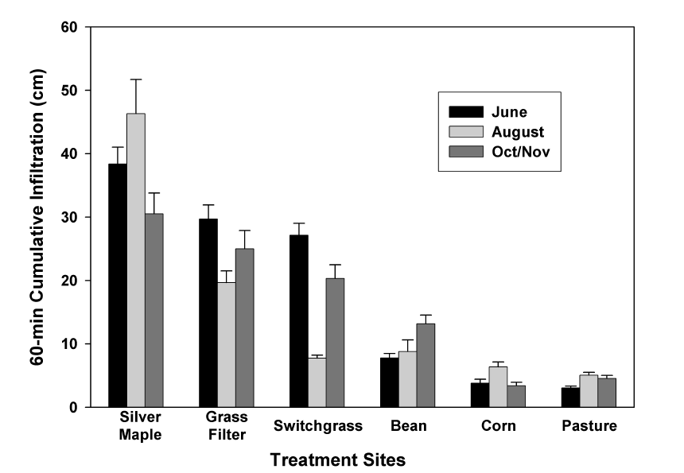
Impacts of Land Use on Infiltration
Source: Bharati et. al., 2002
Source: Bharati et. al., 2002

Slide 10
Changes in Iowa Farmland
More row crops
Row crops have higher runoff rates
Notes:
Note the nearly doubling of row crops from the 1930s to present time. Much of this change has come at the expense or loss of small grains that are planted and start growing in very early spring. Note even the change in the past 40 years.

Slide 11
Summary
We get more runoff when:
soils are wetter
we get more intense precipitation
We have wetter soils when:
we get more precipitation on average (snow or rain)
we get more frequent precipitation (no time to dry or drain)
Climate does explain increasing runoff trends in Iowa
...but need to also consider land use change

