Slide 1
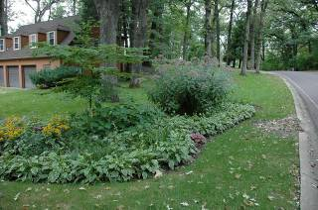
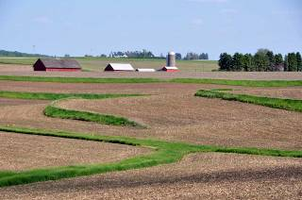
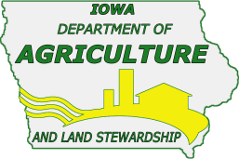
Anatomy of Iowa Floods:
Preparing for the Future
“How urban and rural Iowans can work together to reduce flood impacts.”
James Martin, Division of Soil Conservation
Iowa Department of Agriculture & Land Stewardship

Slide 2
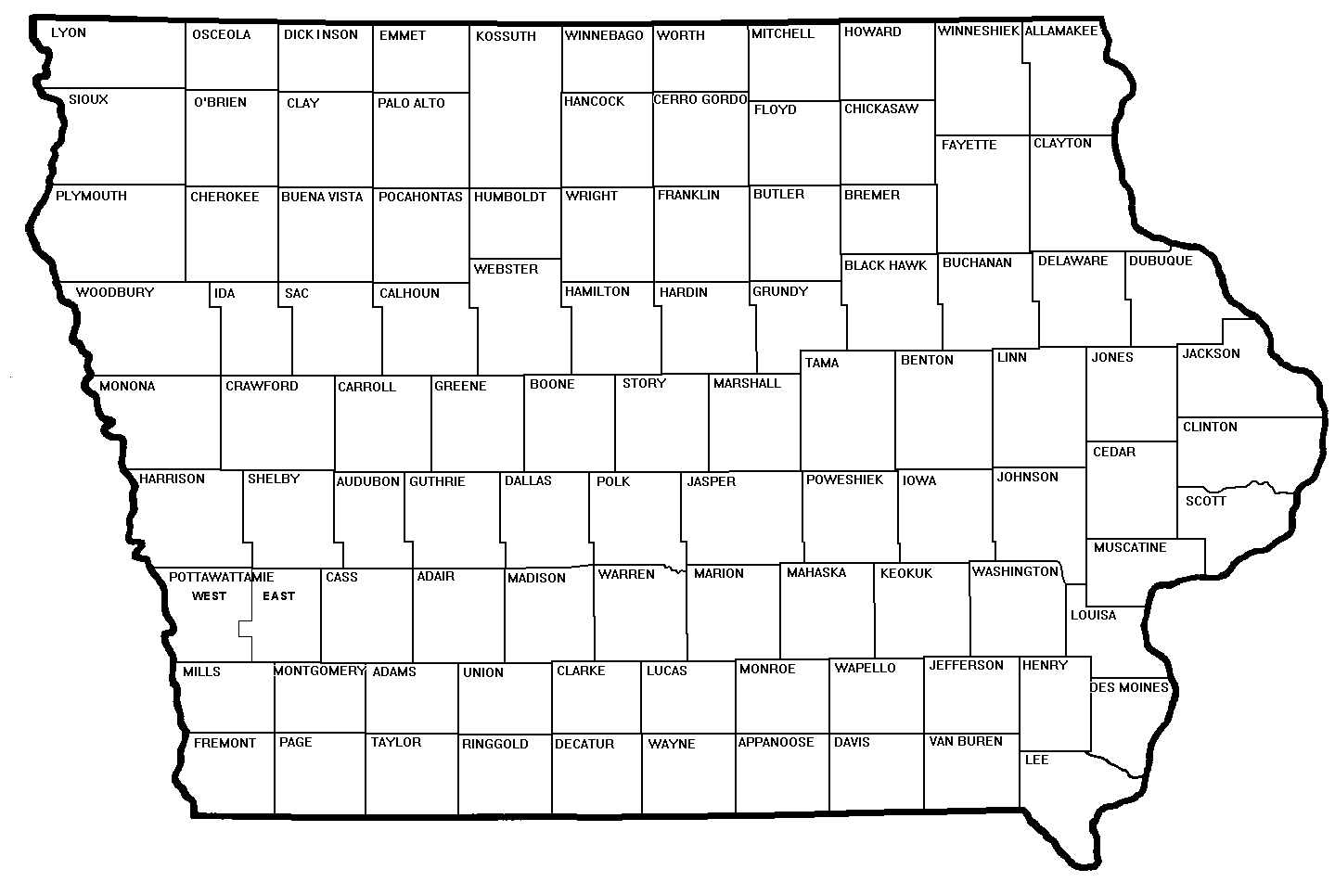
State law provided for establishment of Iowa’s 100 Soil and Water Conservation Districts (SWCDs)
SWCD’s: a local entity to deliver technical and financial assistance
assess natural resource needs and develop resource management plans
carry out needed conservation measures

Slide 3
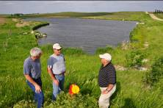
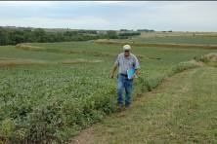
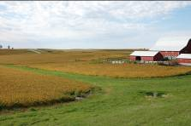
Standing Up to the 2008 Floods
Ag conservation practices operated properly in reducing flood impacts
90% grade stabilization structures and water control basins functioned properly
83% terraces and 55% grassed waterways functioned properly
no-till helped reduce runoff.

Slide 4
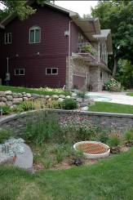
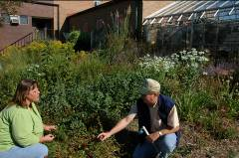
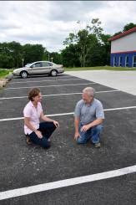
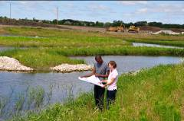
Standing Up to the 2008 Floods
Urban conservation practices operate in a similar way to reduce flood impacts.
Capture
Hold
Infiltrate
Reduce runoff
Protect WQ

Slide 5
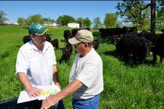
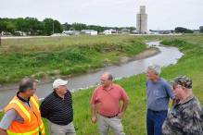
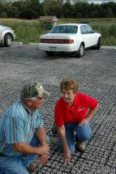
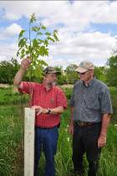
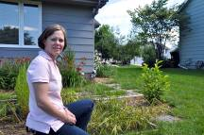
What is your hydrologic footprint?
If rain and snow fall on your property your property probably generates runoff.
Your action or inaction impacts others.
Manage the water that falls on your land sustainably.
You are a watershed stakeholder - work cooperatively with others in your watershed.

Slide 6
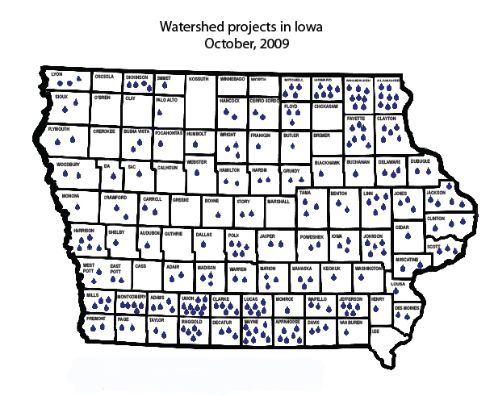
204 projects in Iowa
(completed or underway)
The Division of Soil Conservation works cooperatively with SWCDs, NRCS, DNR and other partners.
Notes:
Many of these projects include rural and urban partners that have worked together on a watershed basis to target limited resources to get the best return on investment.

Slide 7

76,642 acres
120 sq miles
36% urban
64% ag land

Slide 8
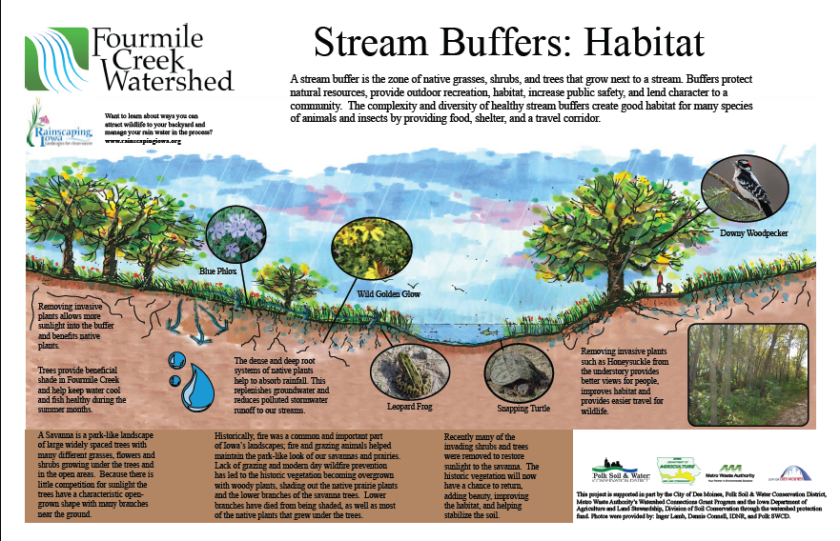
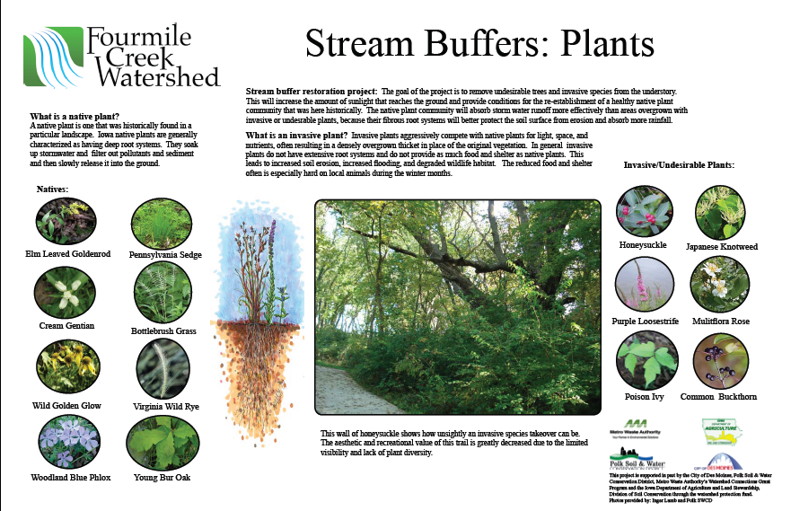
Stream Buffers
Ordinances & Restoration

Slide 9
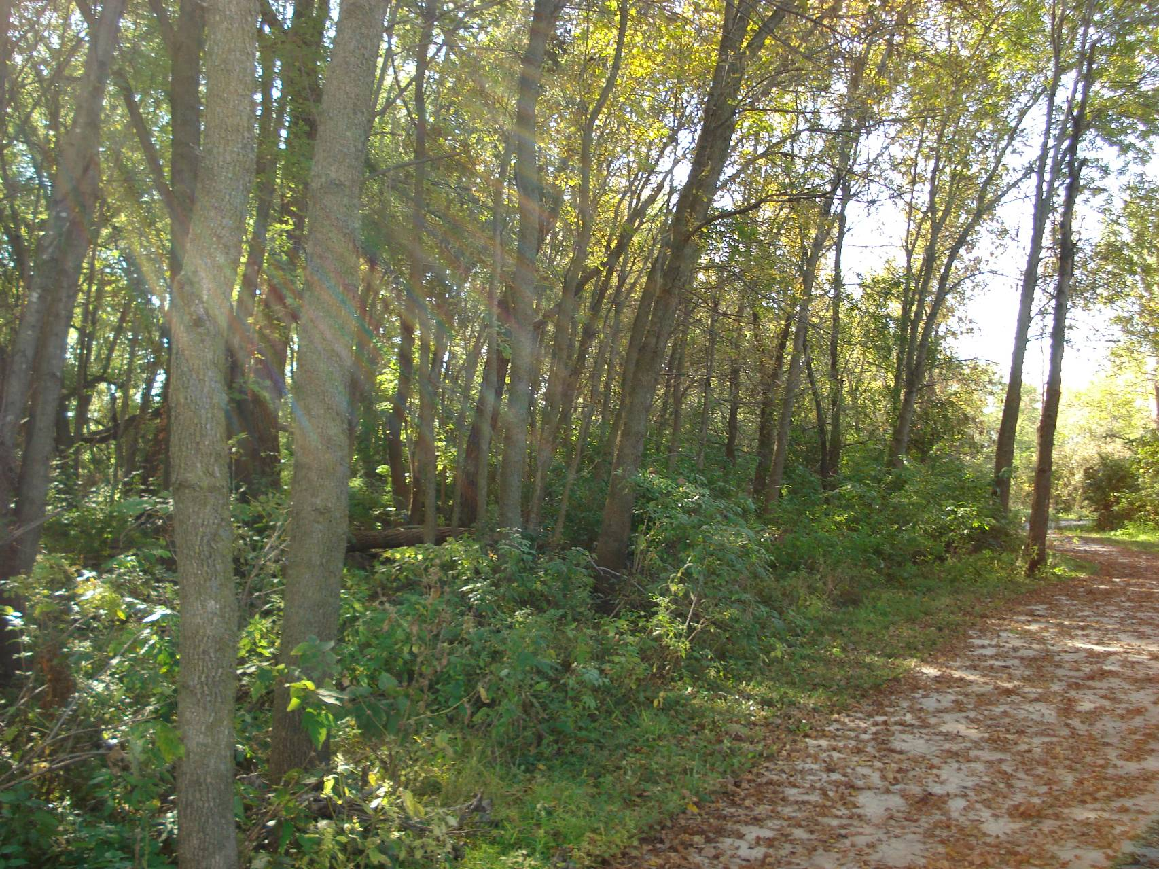

Slide 10
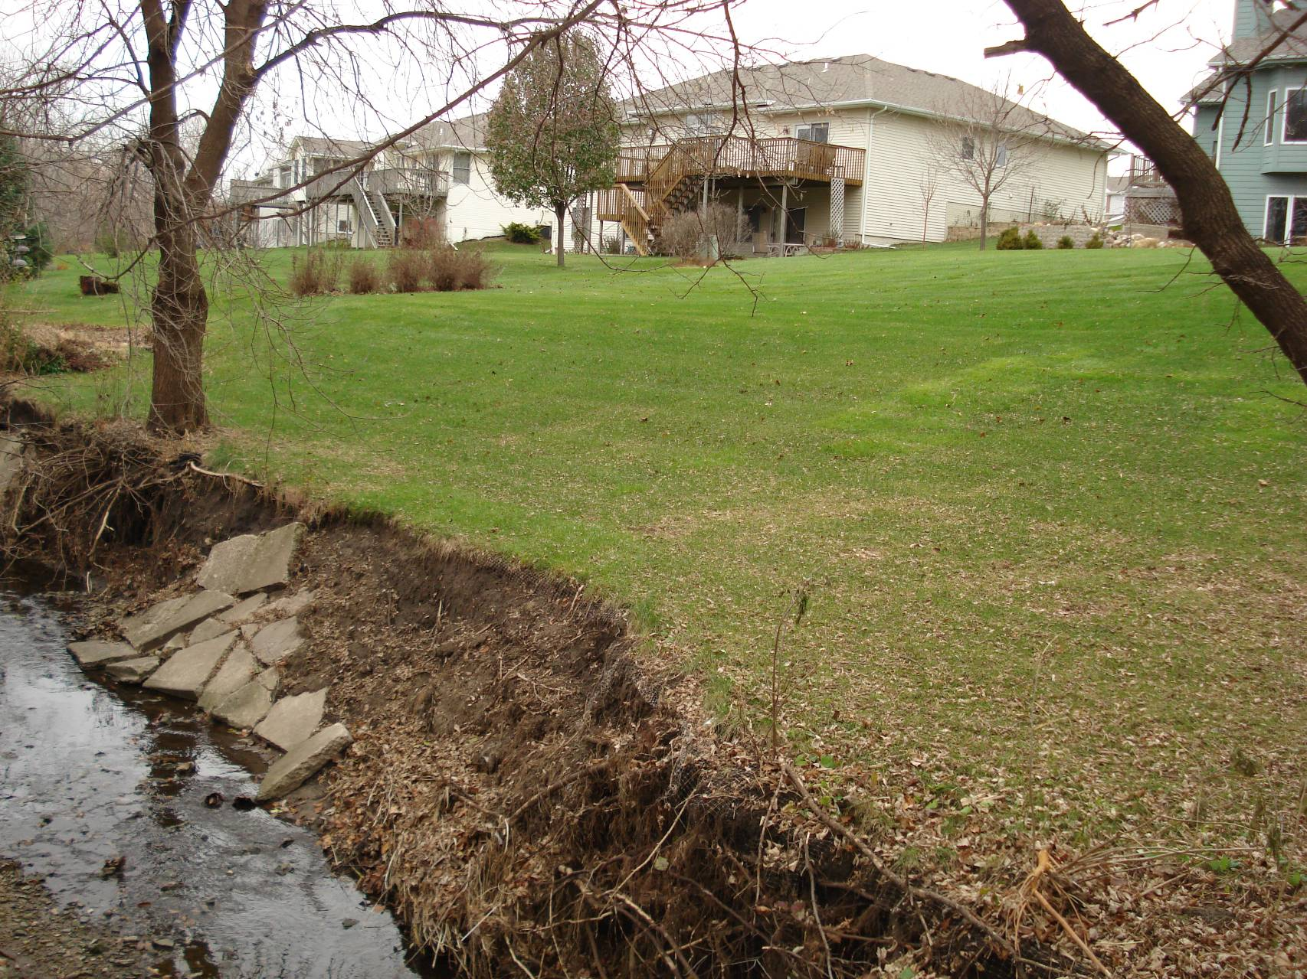

Slide 11
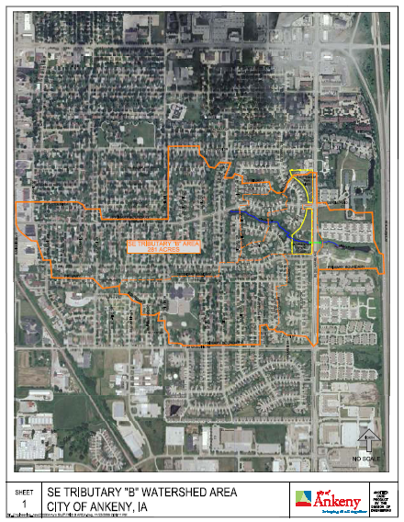
Summerbrook Park--Ankeny
  Stormwater Retrofit
  281 acre drainage area
  “Tributary B”
  Funding:
  I-Jobs= $100,000
  WIRB= $169,800
  SWCD= $17,000 +
  MWA= $10,000
  Approx Cost $500,000

Slide 12
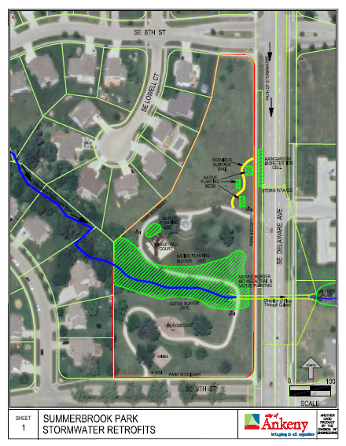
Practices
  Streambank stabilization
  Native plantings
  Extending the buffer
  Bioretention cells
  Rain gardens
  Soil quality restoration
  Pervious surfaced trails
Results
  Biocells= 160,000+ gallons/year
  Bank stabilization= 23 tons/year

Slide 13


Slide 14
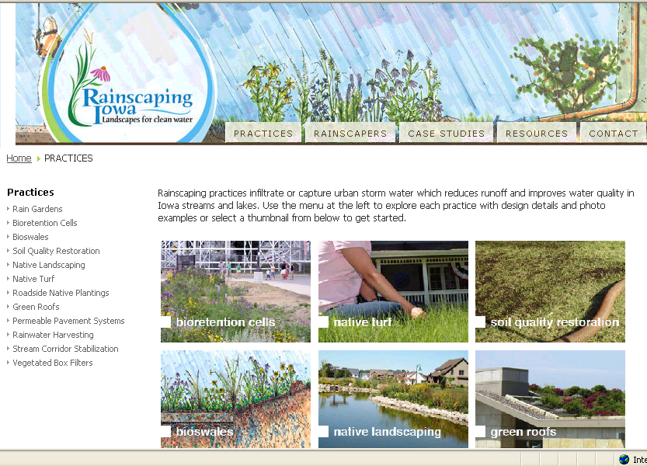

Slide 15
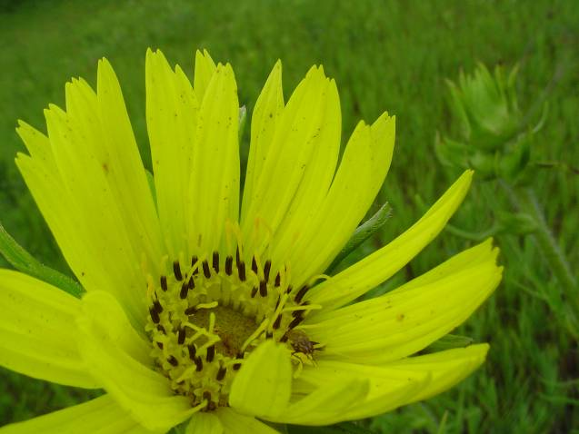
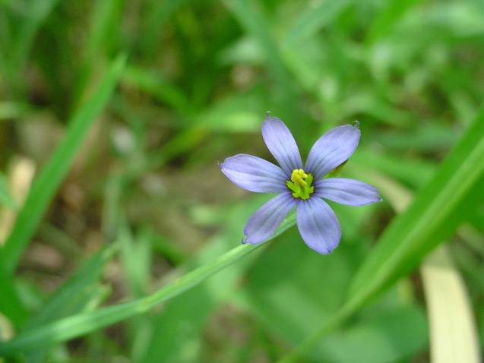


  Jennifer Welch, CPESC
  Urban Conservationist
  1513 North Ankeny Blvd.
  Ankeny Iowa 50023
  515-964-1883 ext 3
  www.polk-swcd.org
  jennifer.welch@ia.nacdnet.net
  www.rainscapingiowa.org

