Slide 1

A Resource for Critical
Flood Research and Applications

Slide 2
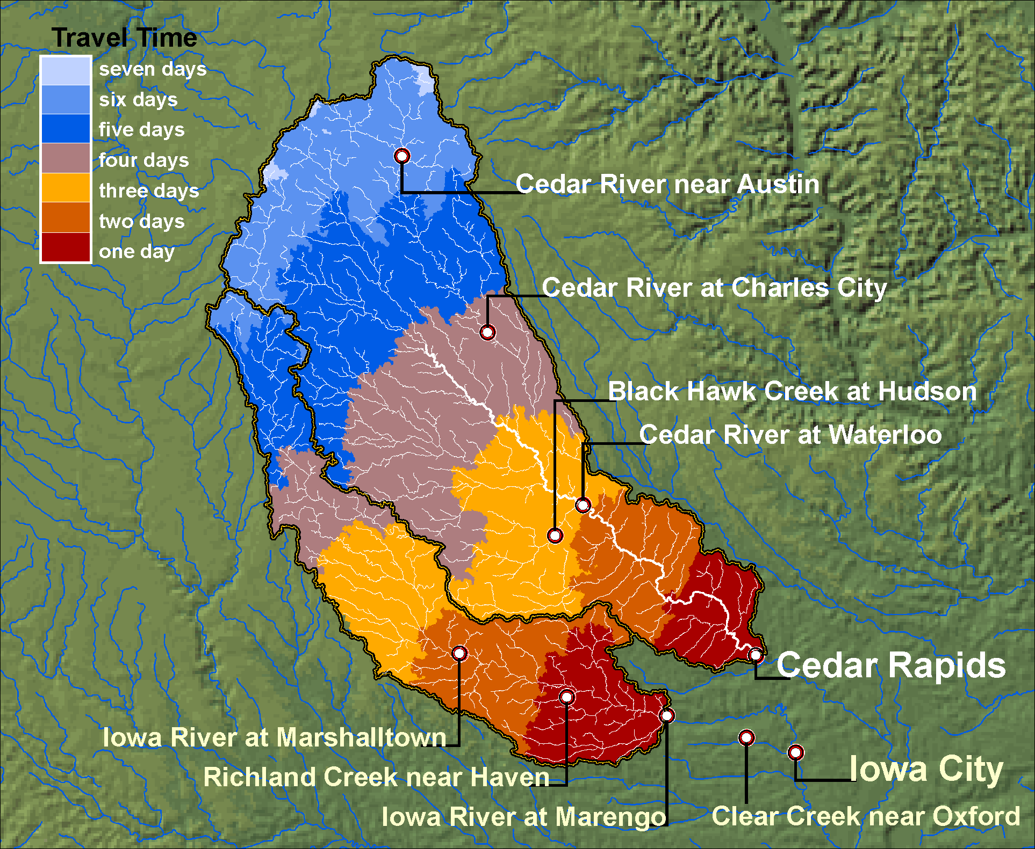
Average Travel Times in River Network

Slide 3
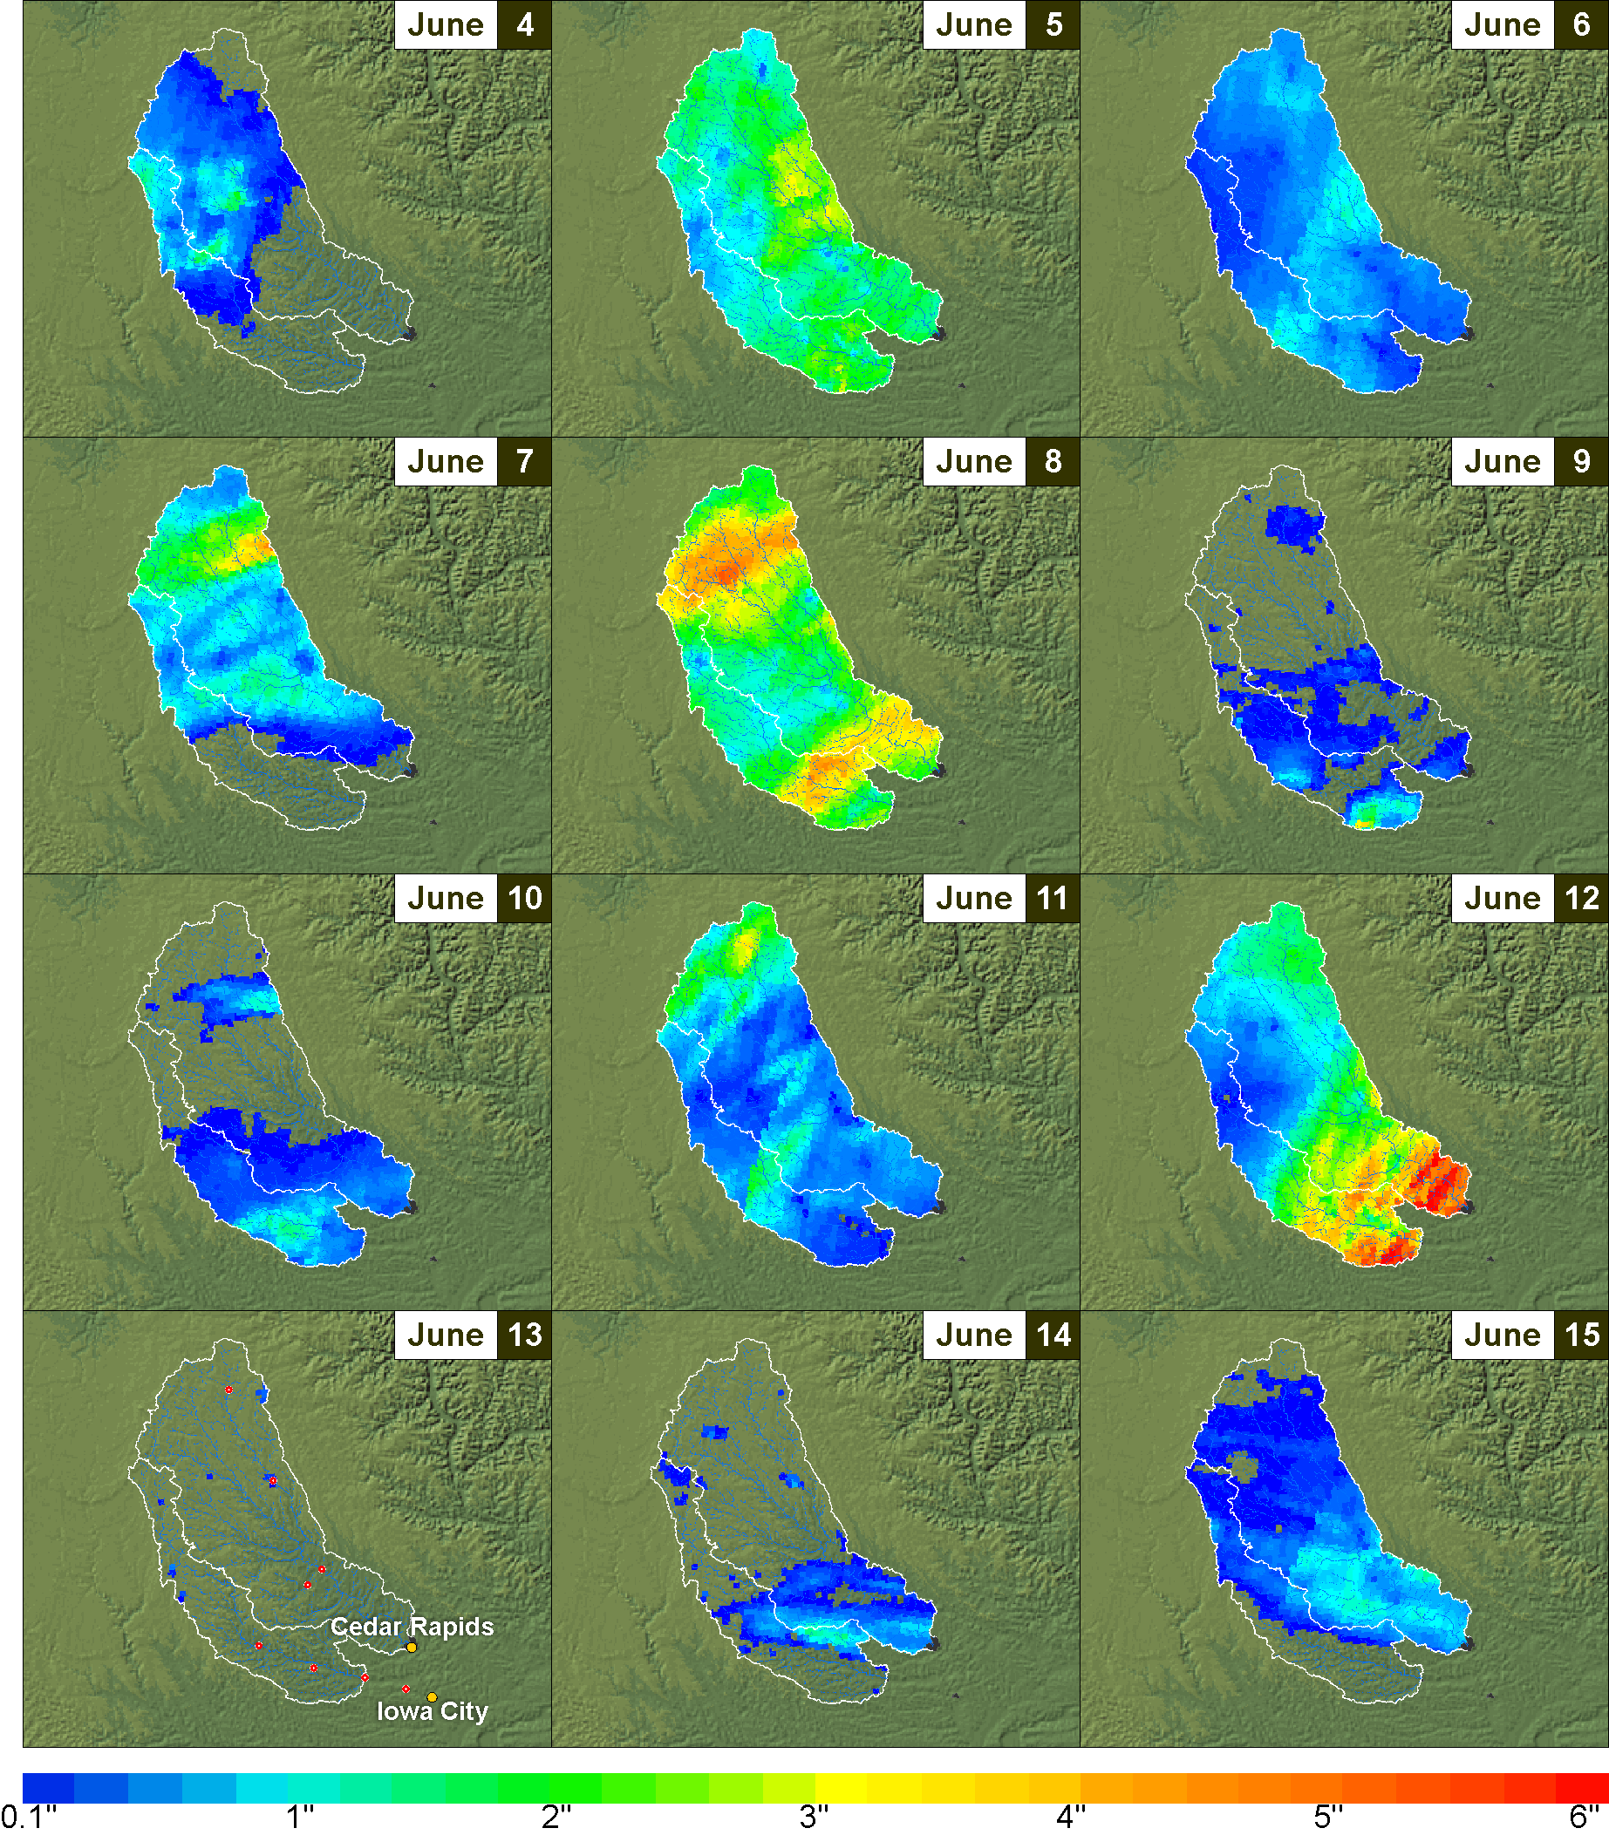
Radar Derived Rainfall Products from Hydro-NEXRAD (Krajewski 2008)
Use Google Earth to Explore the Flood Data: http://cires.colorado.edu/~ricardo/cuencas/GoogleEarthLayers/Iowa.kmz
Notes:
Point to make here is the need for physically based models given the dynamic and complex nature of rainfall.

Slide 4
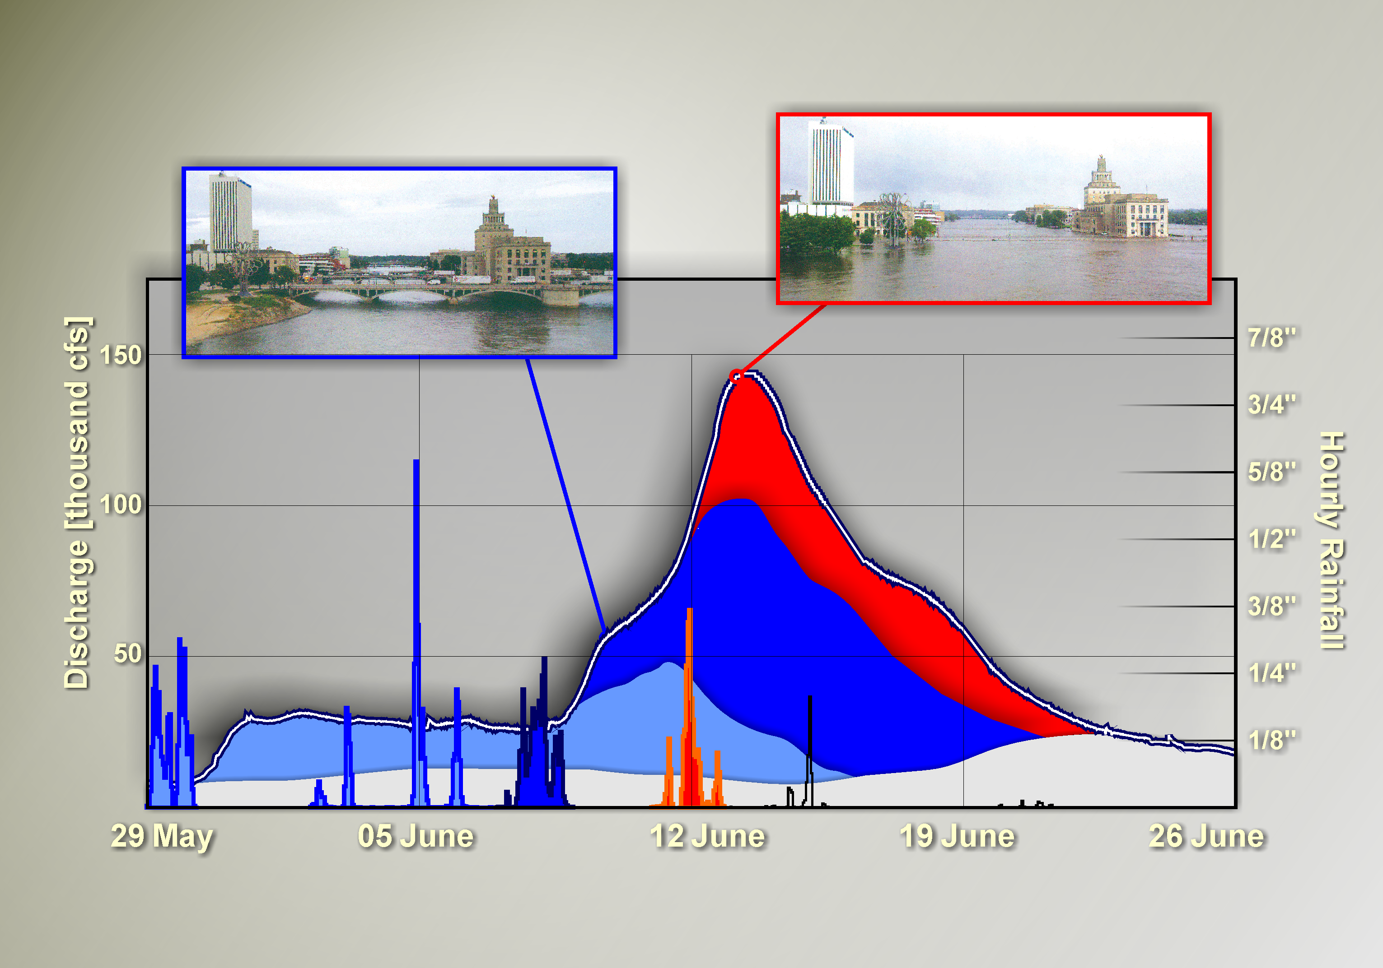
Theory Guiding Model Construction
A better understanding of primary factors involved in flood formation allow us to respond to important questions about future flooding risk

Slide 5
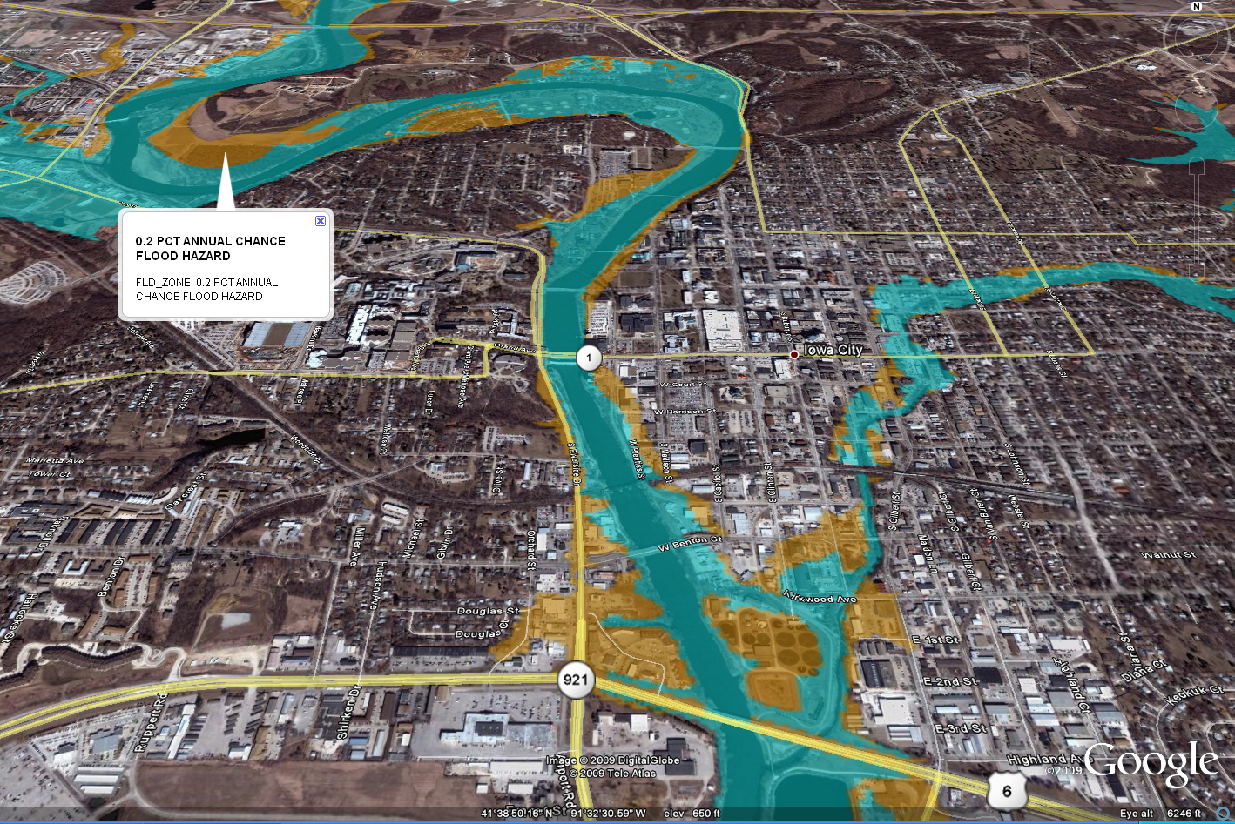
Inundation Maps

Slide 6
A Resource for Critical
Flood Research and Applications

Slide 7
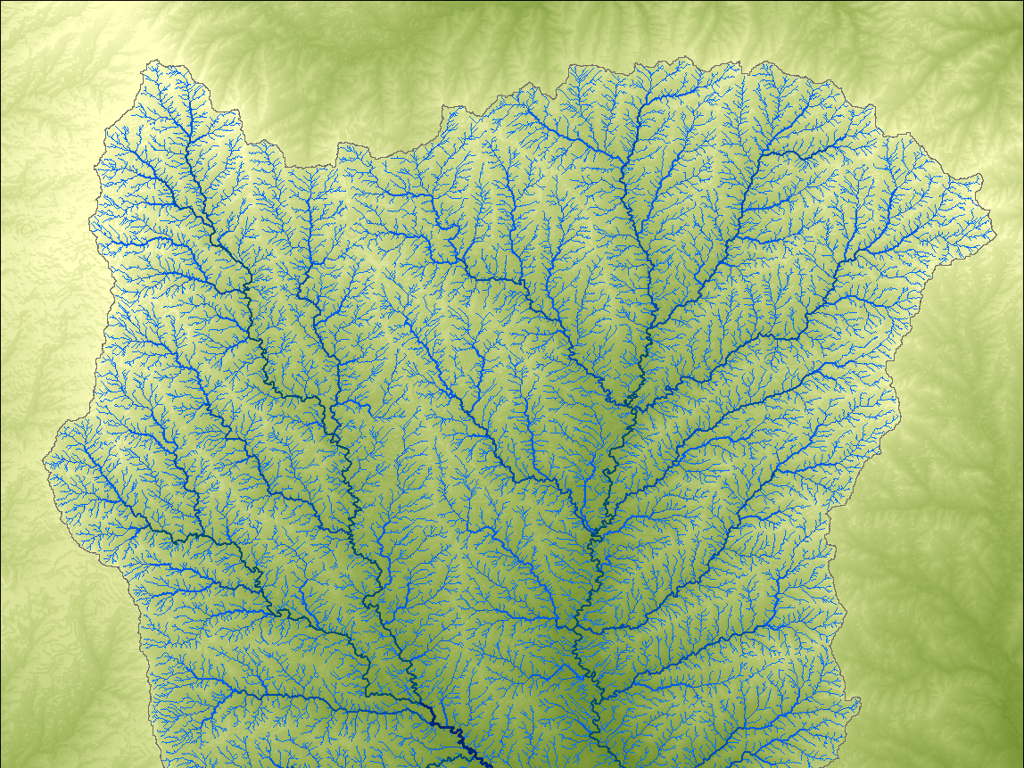

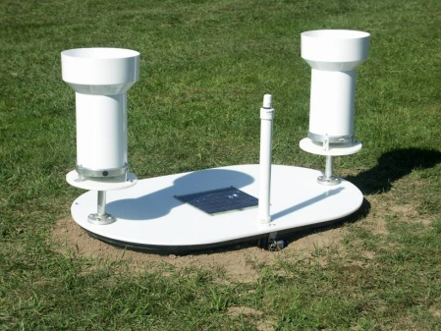
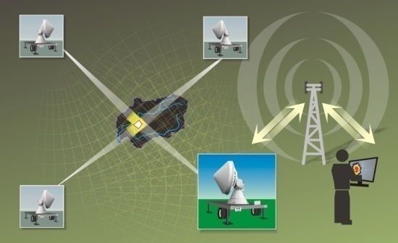
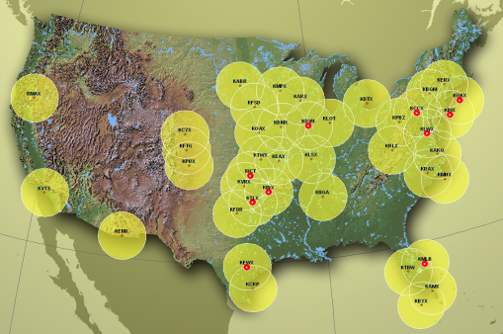
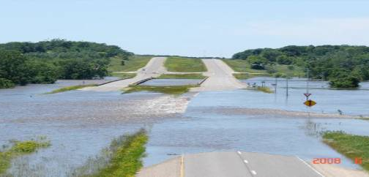
Major Activities
    Creating inundation maps
    Developing flood monitoring instrumentation
    Developing flood forecasting systems
    Updating flood frequency estimates
    Engaging with communities and training new cadres of experts
Notes:
Check to make sure these are tied back to House File 822

Slide 8
http://www.iowafloodcenter.org/
Flood Inundation Mapping
Collaboration with Iowa DNR

Slide 9


Slide 10
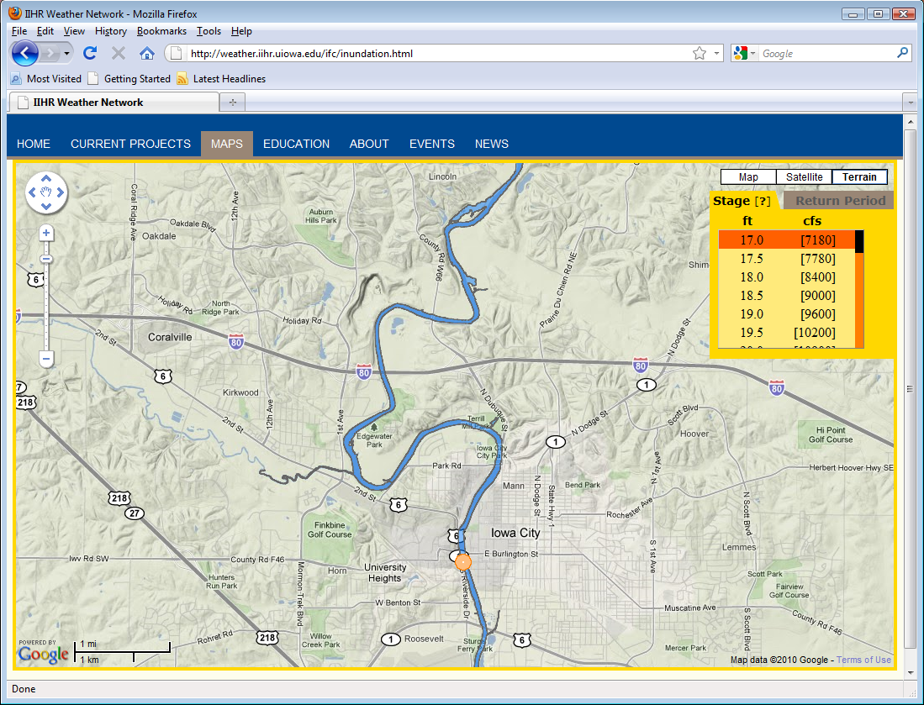

Slide 11
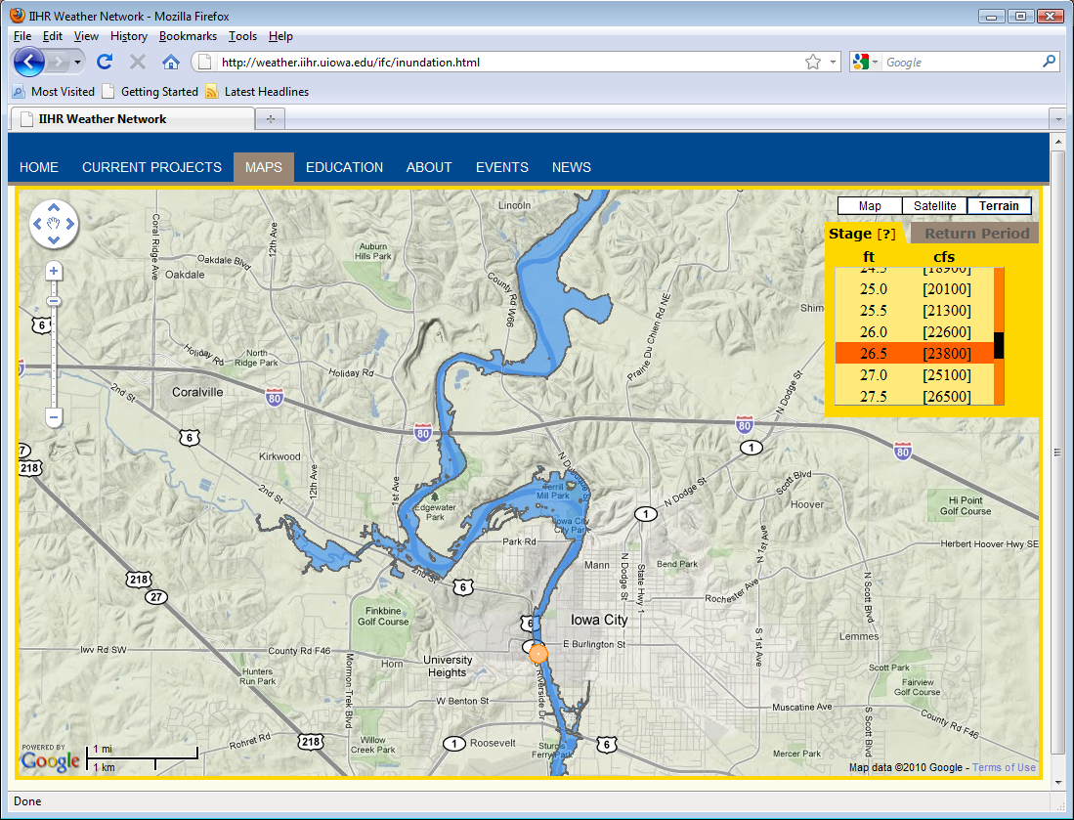

Slide 12
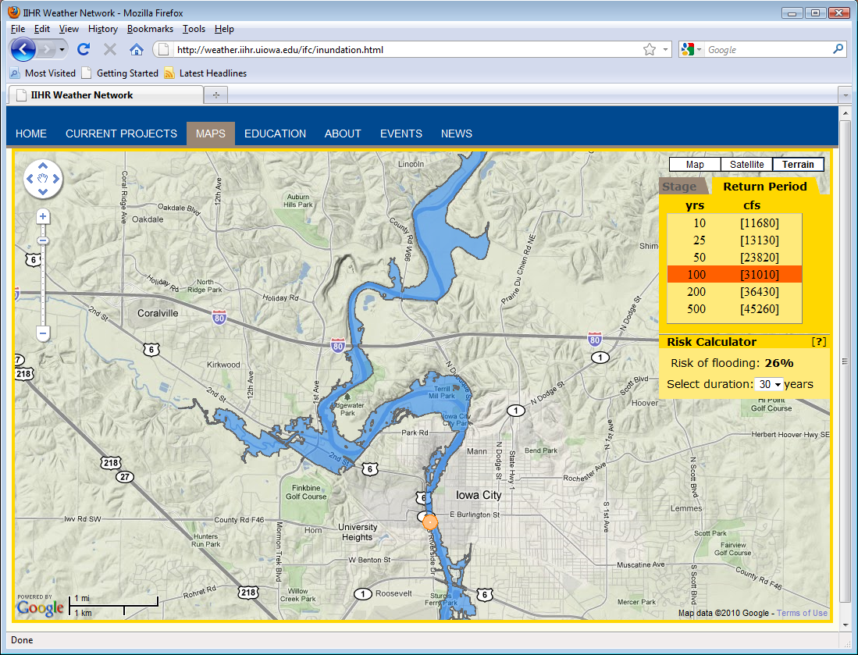

Slide 13
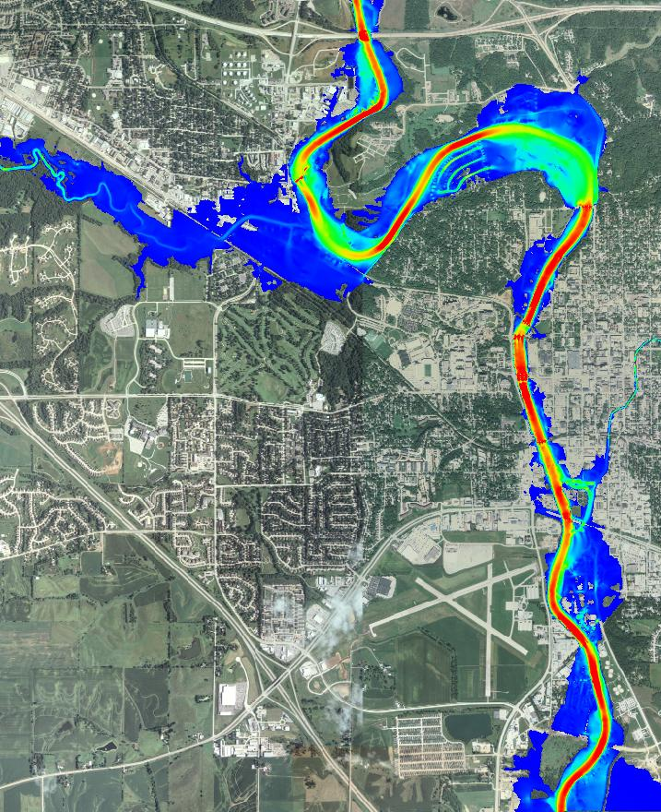
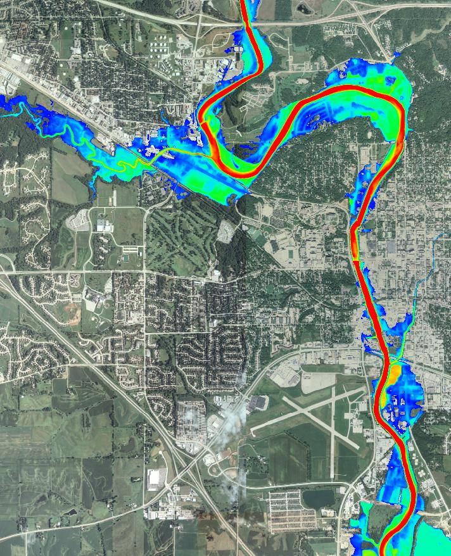
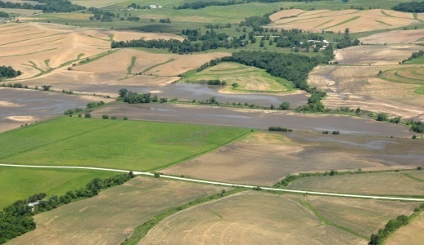
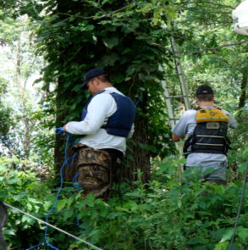
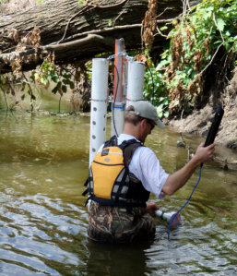
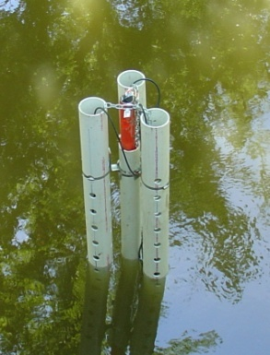
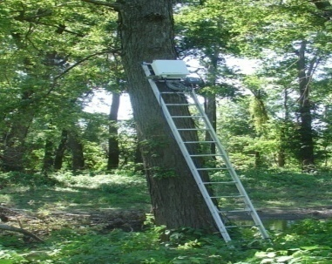
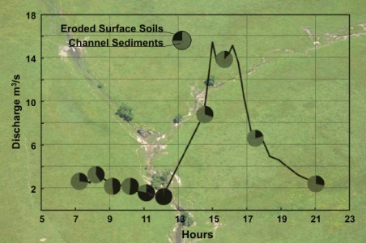
2008 Flood Peak
0
6
0
20
Water velocity (fps)
Water depth (ft)

Slide 14
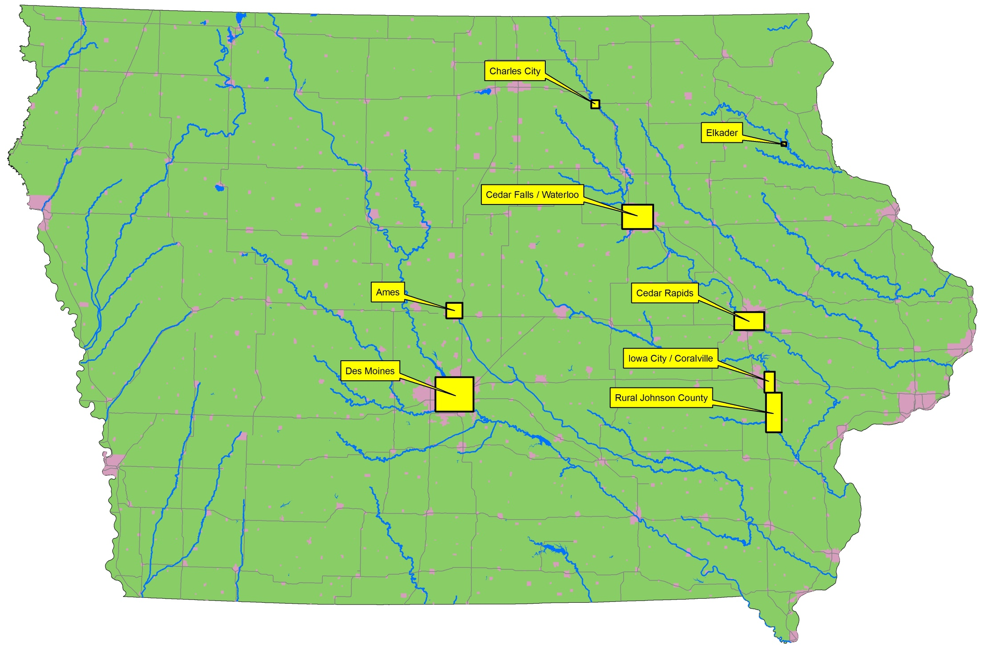

Slide 15
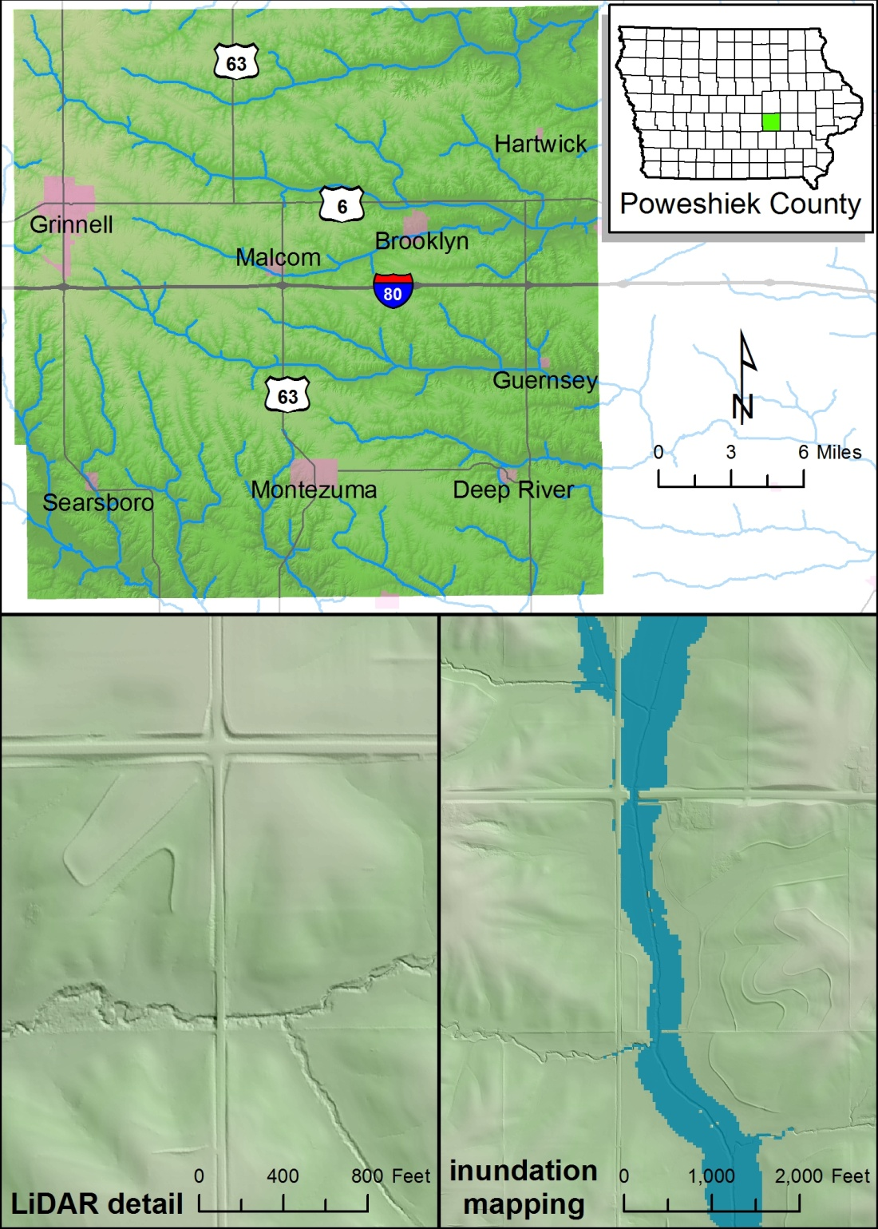

Iowa Department of Natural Resources
Statewide Floodplain Mapping Program
Pilot project goals
  Refine methodologies to take advantage of the LiDAR dataset
  Quantify the time and experience required to perform individual project tasks
  Identify distribution of internal IDNR and external effort to maximize the impact of FEMA funding provided to the State
  Produce Poweshiek County work map products for FEMA review and adoption
Pilot project completion in March 2010

Slide 16
http://www.iowafloodcenter.org/
Flood Monitoring
Creating New Technologies

Slide 17
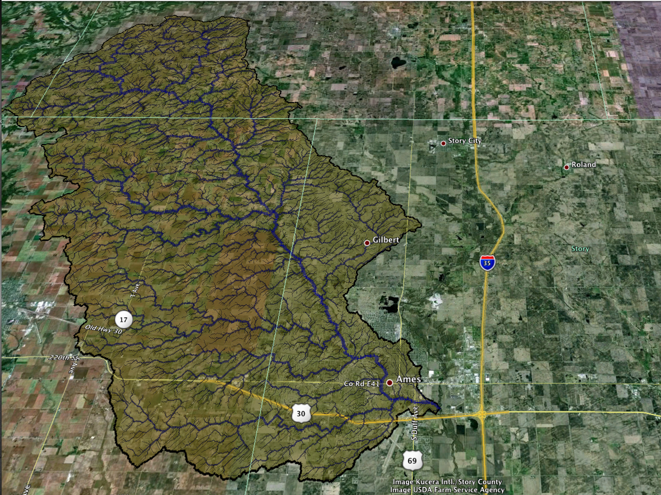
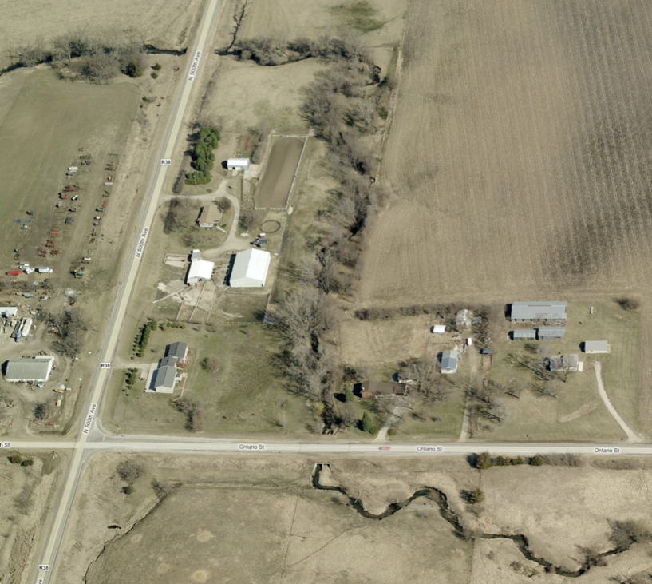

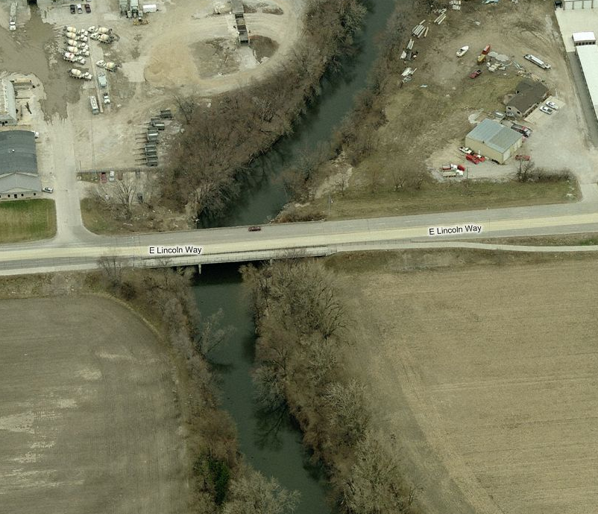

Slide 18
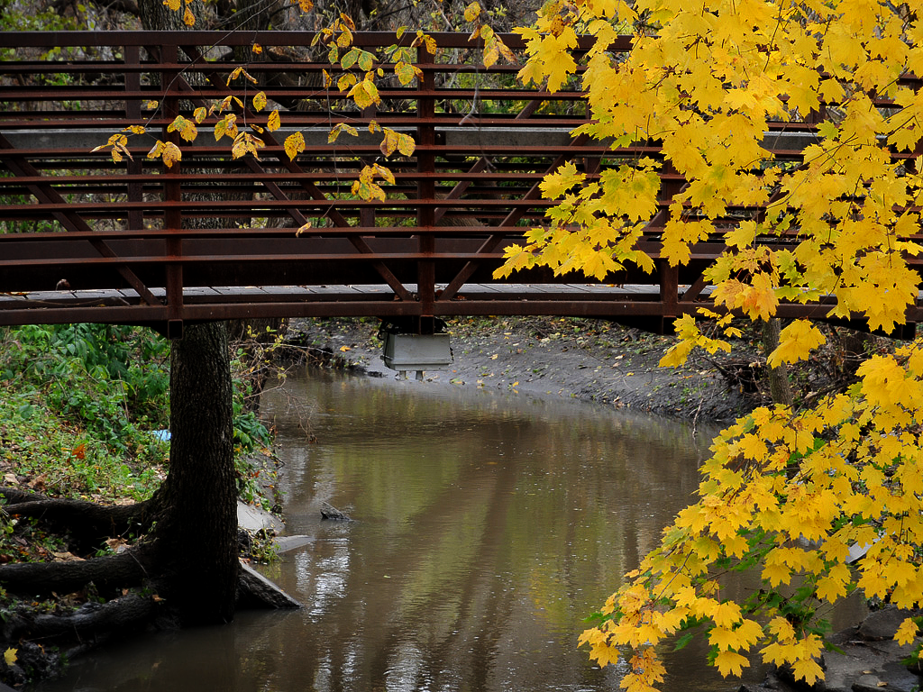
156 USGS stream gauges
25,000 bridges
Every bridge is a potential stream gauge

Slide 19
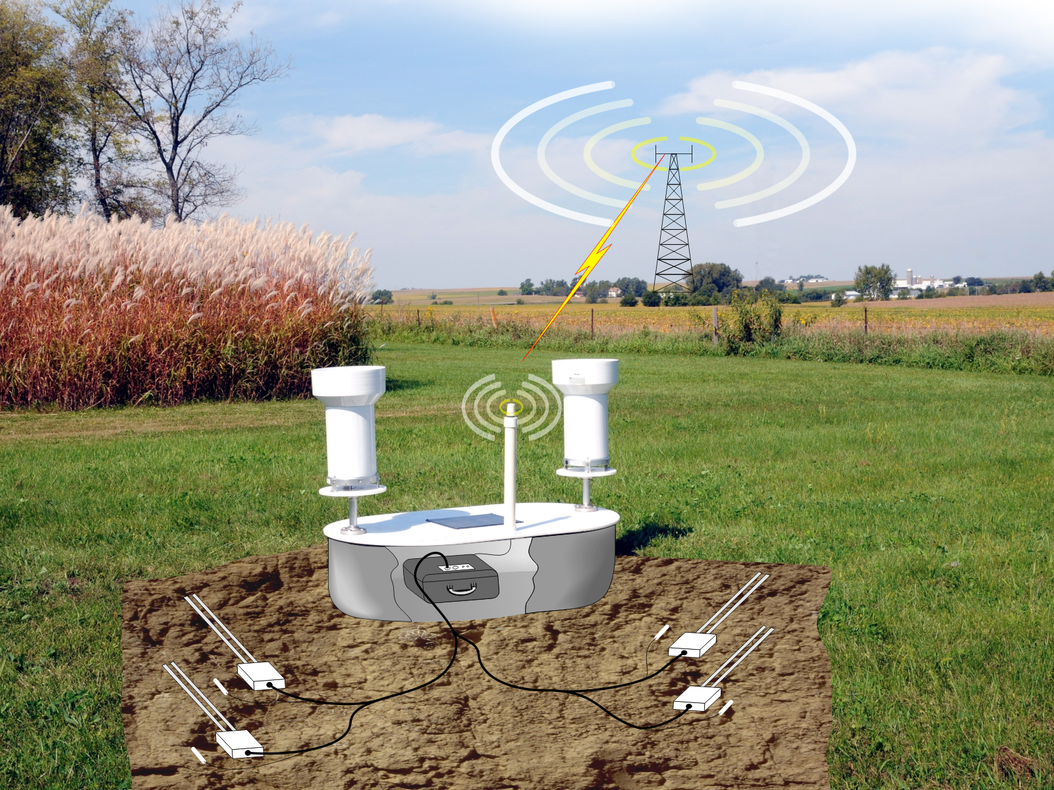

Slide 20
http://www.iowafloodcenter.org/
Real-Time Flood Forecasting
Enhancing Information from USGS and NWS

Slide 21
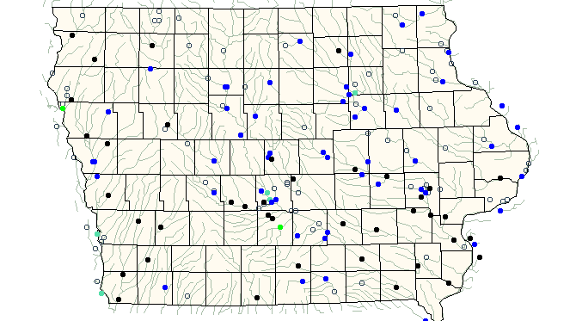
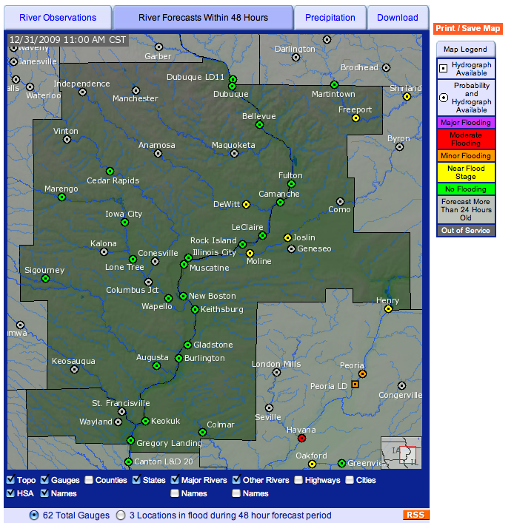
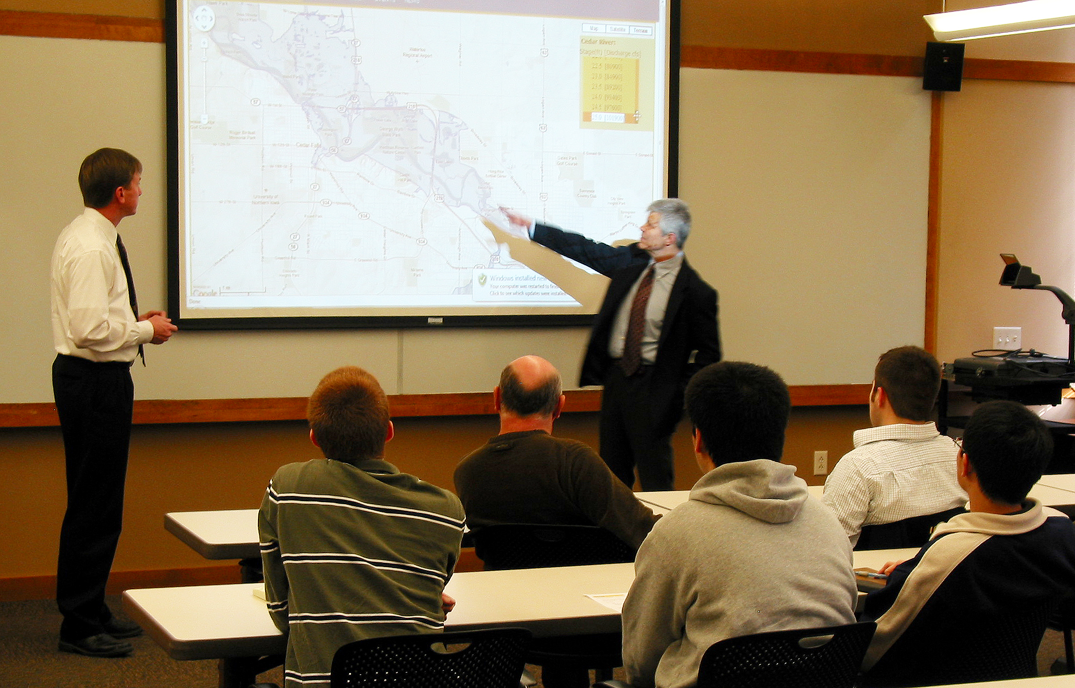

Slide 22
Development of a Real Time Flood Forecast System for Iowa

Slide 23
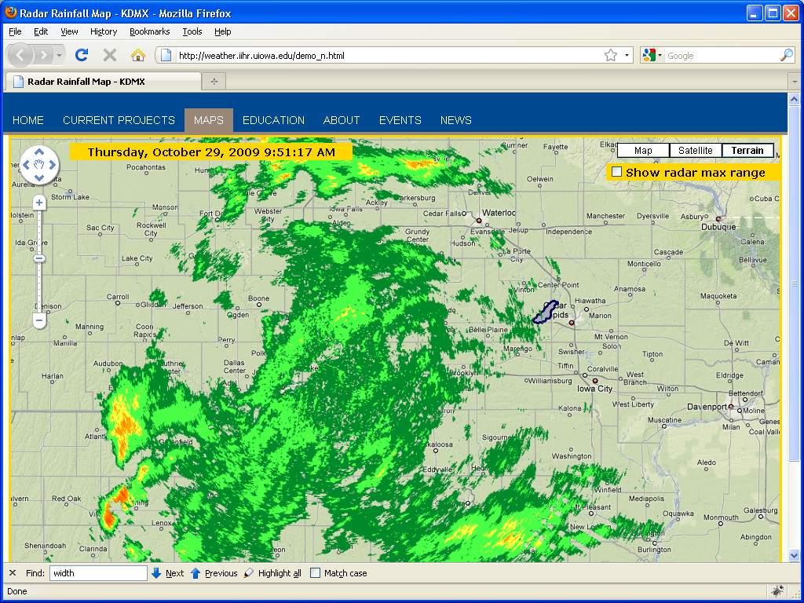

Slide 24
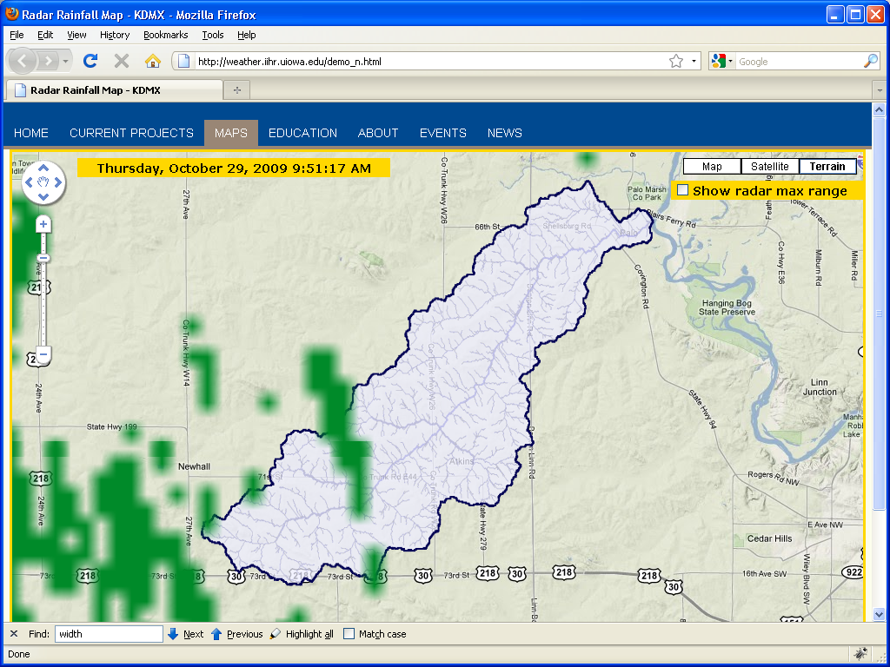

Slide 25
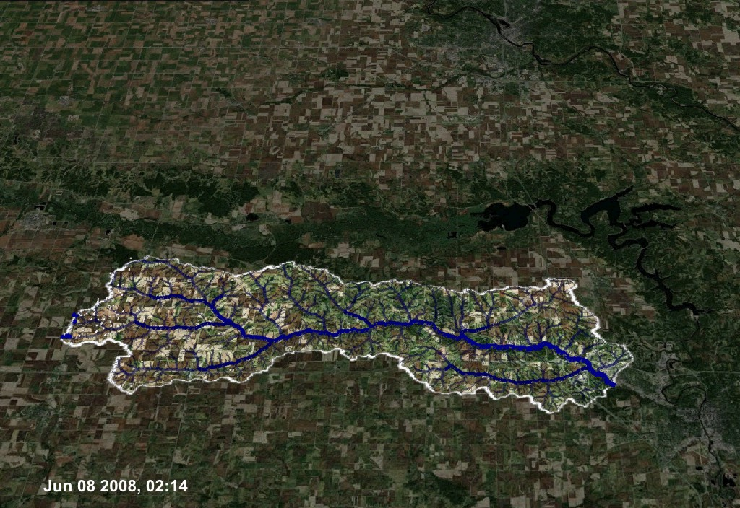

Slide 26
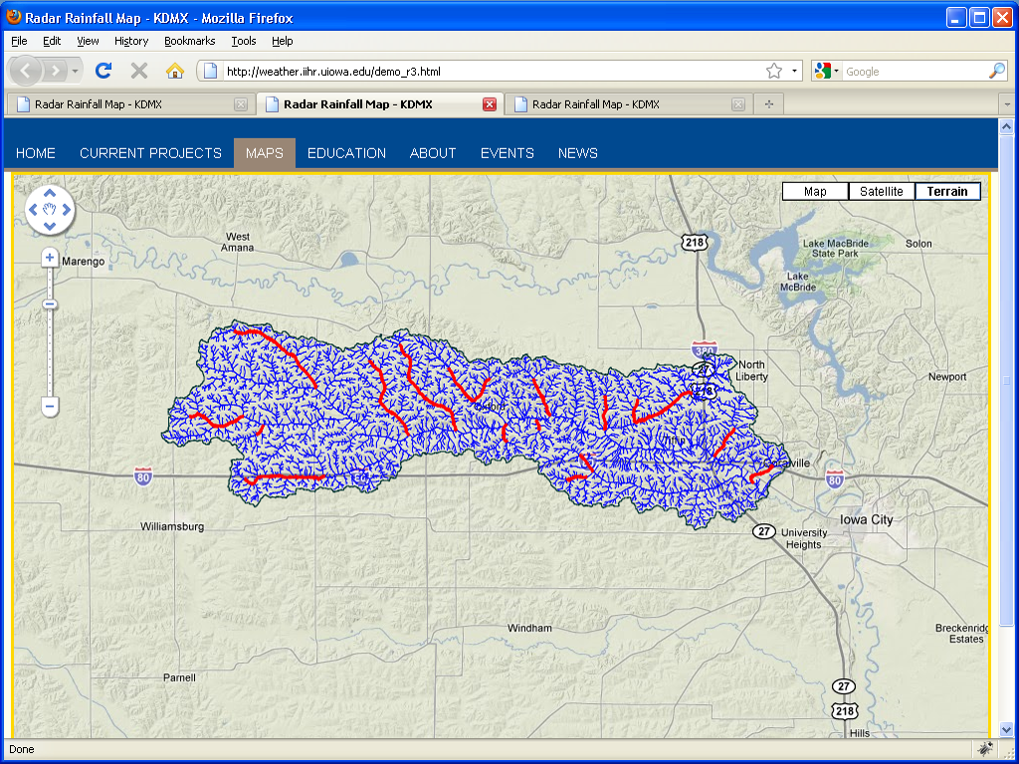
Forecast Lead Time
1h 3h 6h 12h 24h

Slide 27
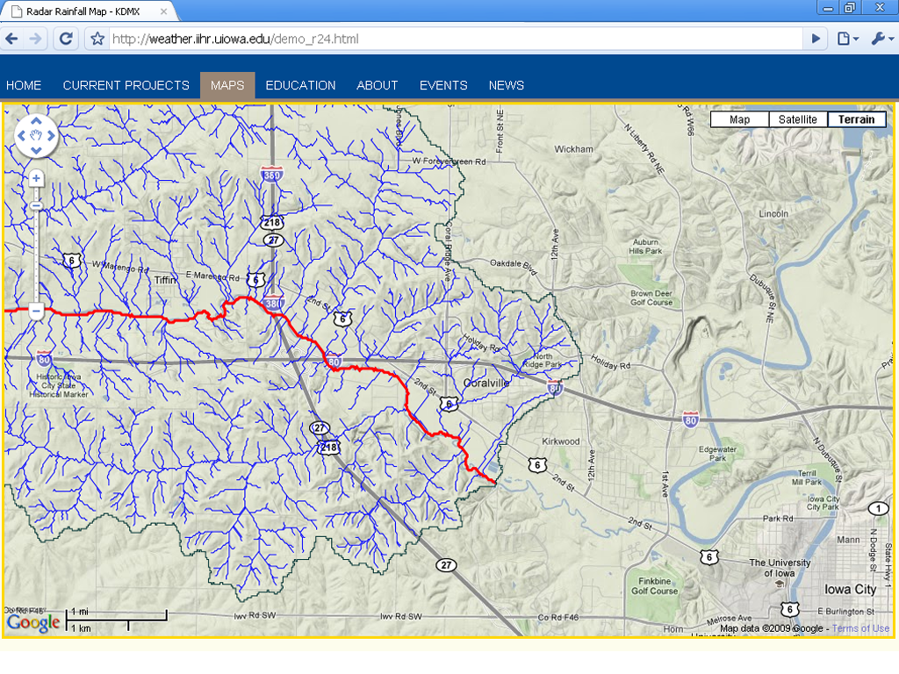
Forecast Lead Time
1h 3h 6h 12h 24h

Slide 28
Outlook
    From preparedness to mitigating risk: distributed storage pilot program (IDALS, DNR)
    Engaging ISU atmospheric science and ag economics: climate issues
    Engaging social and environmental sciences (UI and UNI)
    Seeking and attracting out-of-state funding
    Outreach

Slide 29
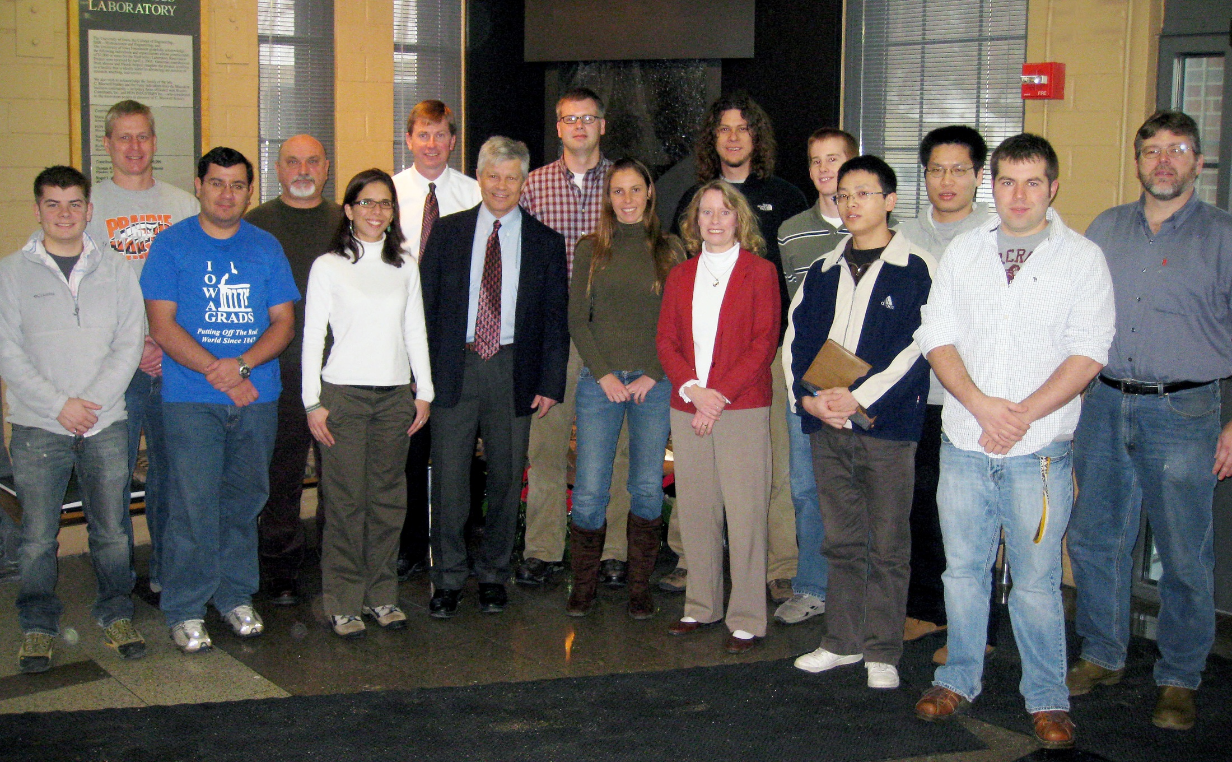
Thank You!

